Slide 1
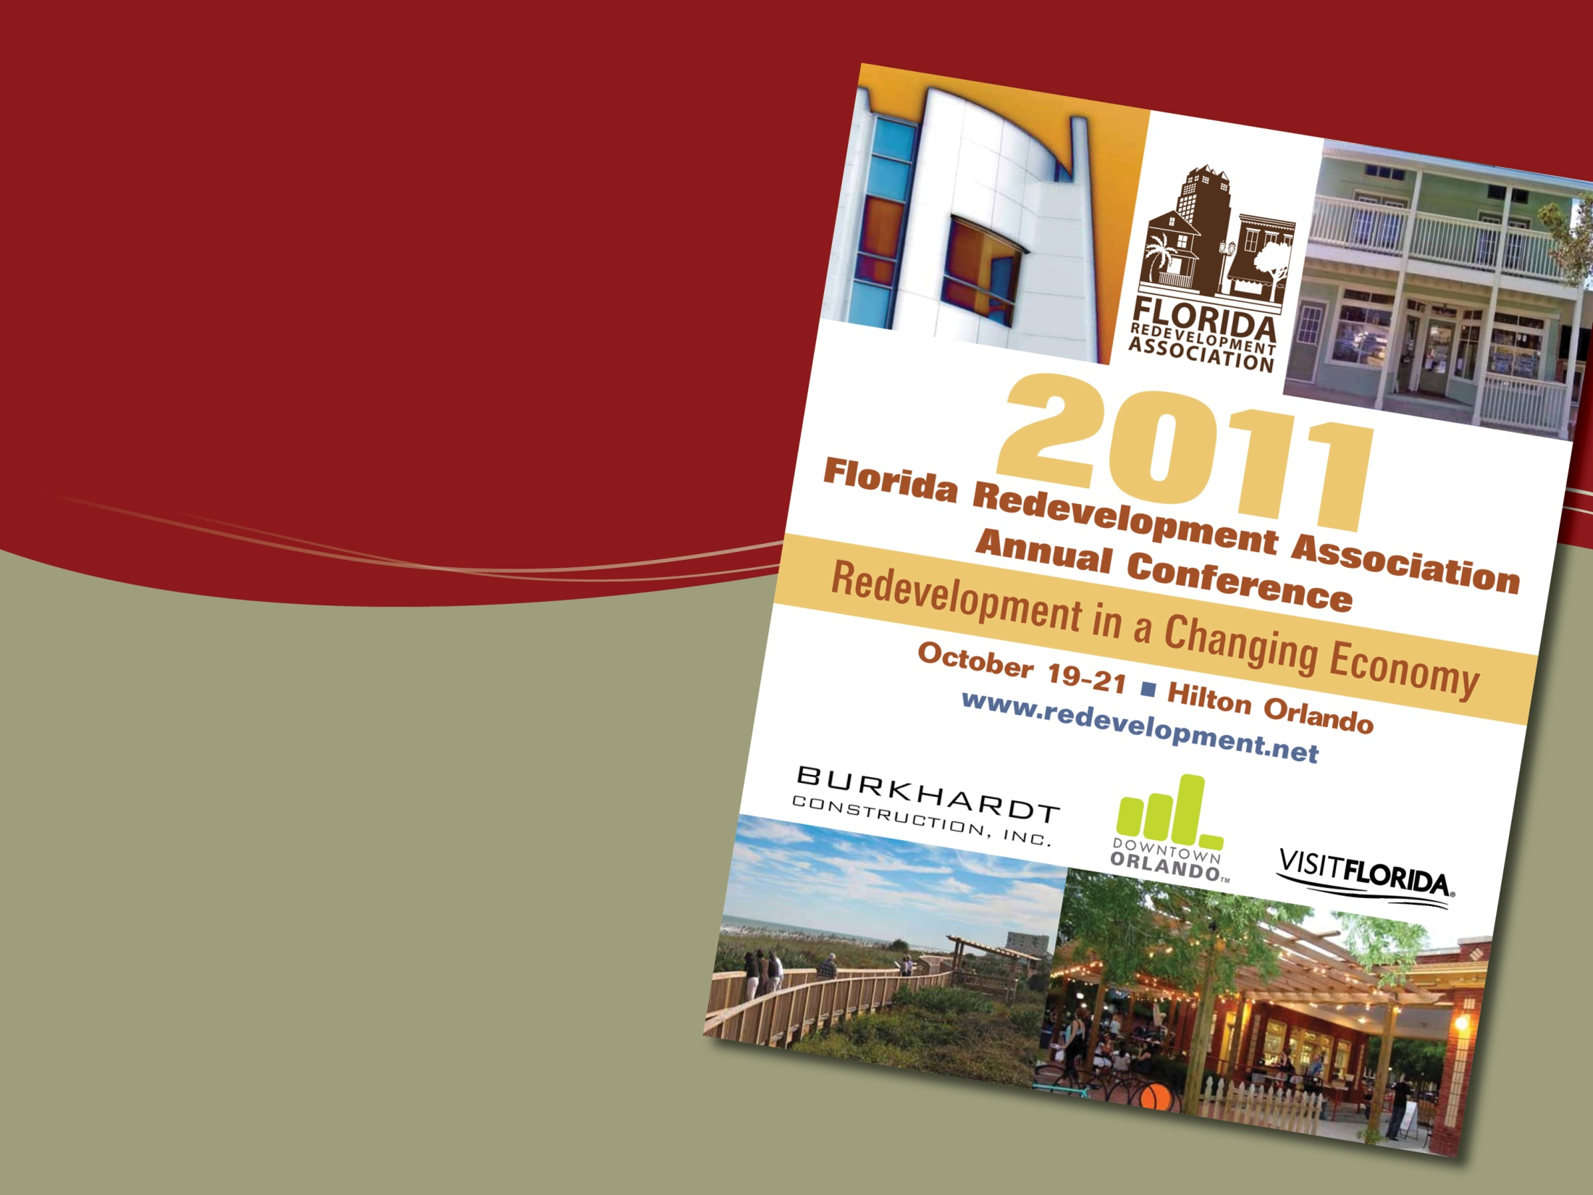



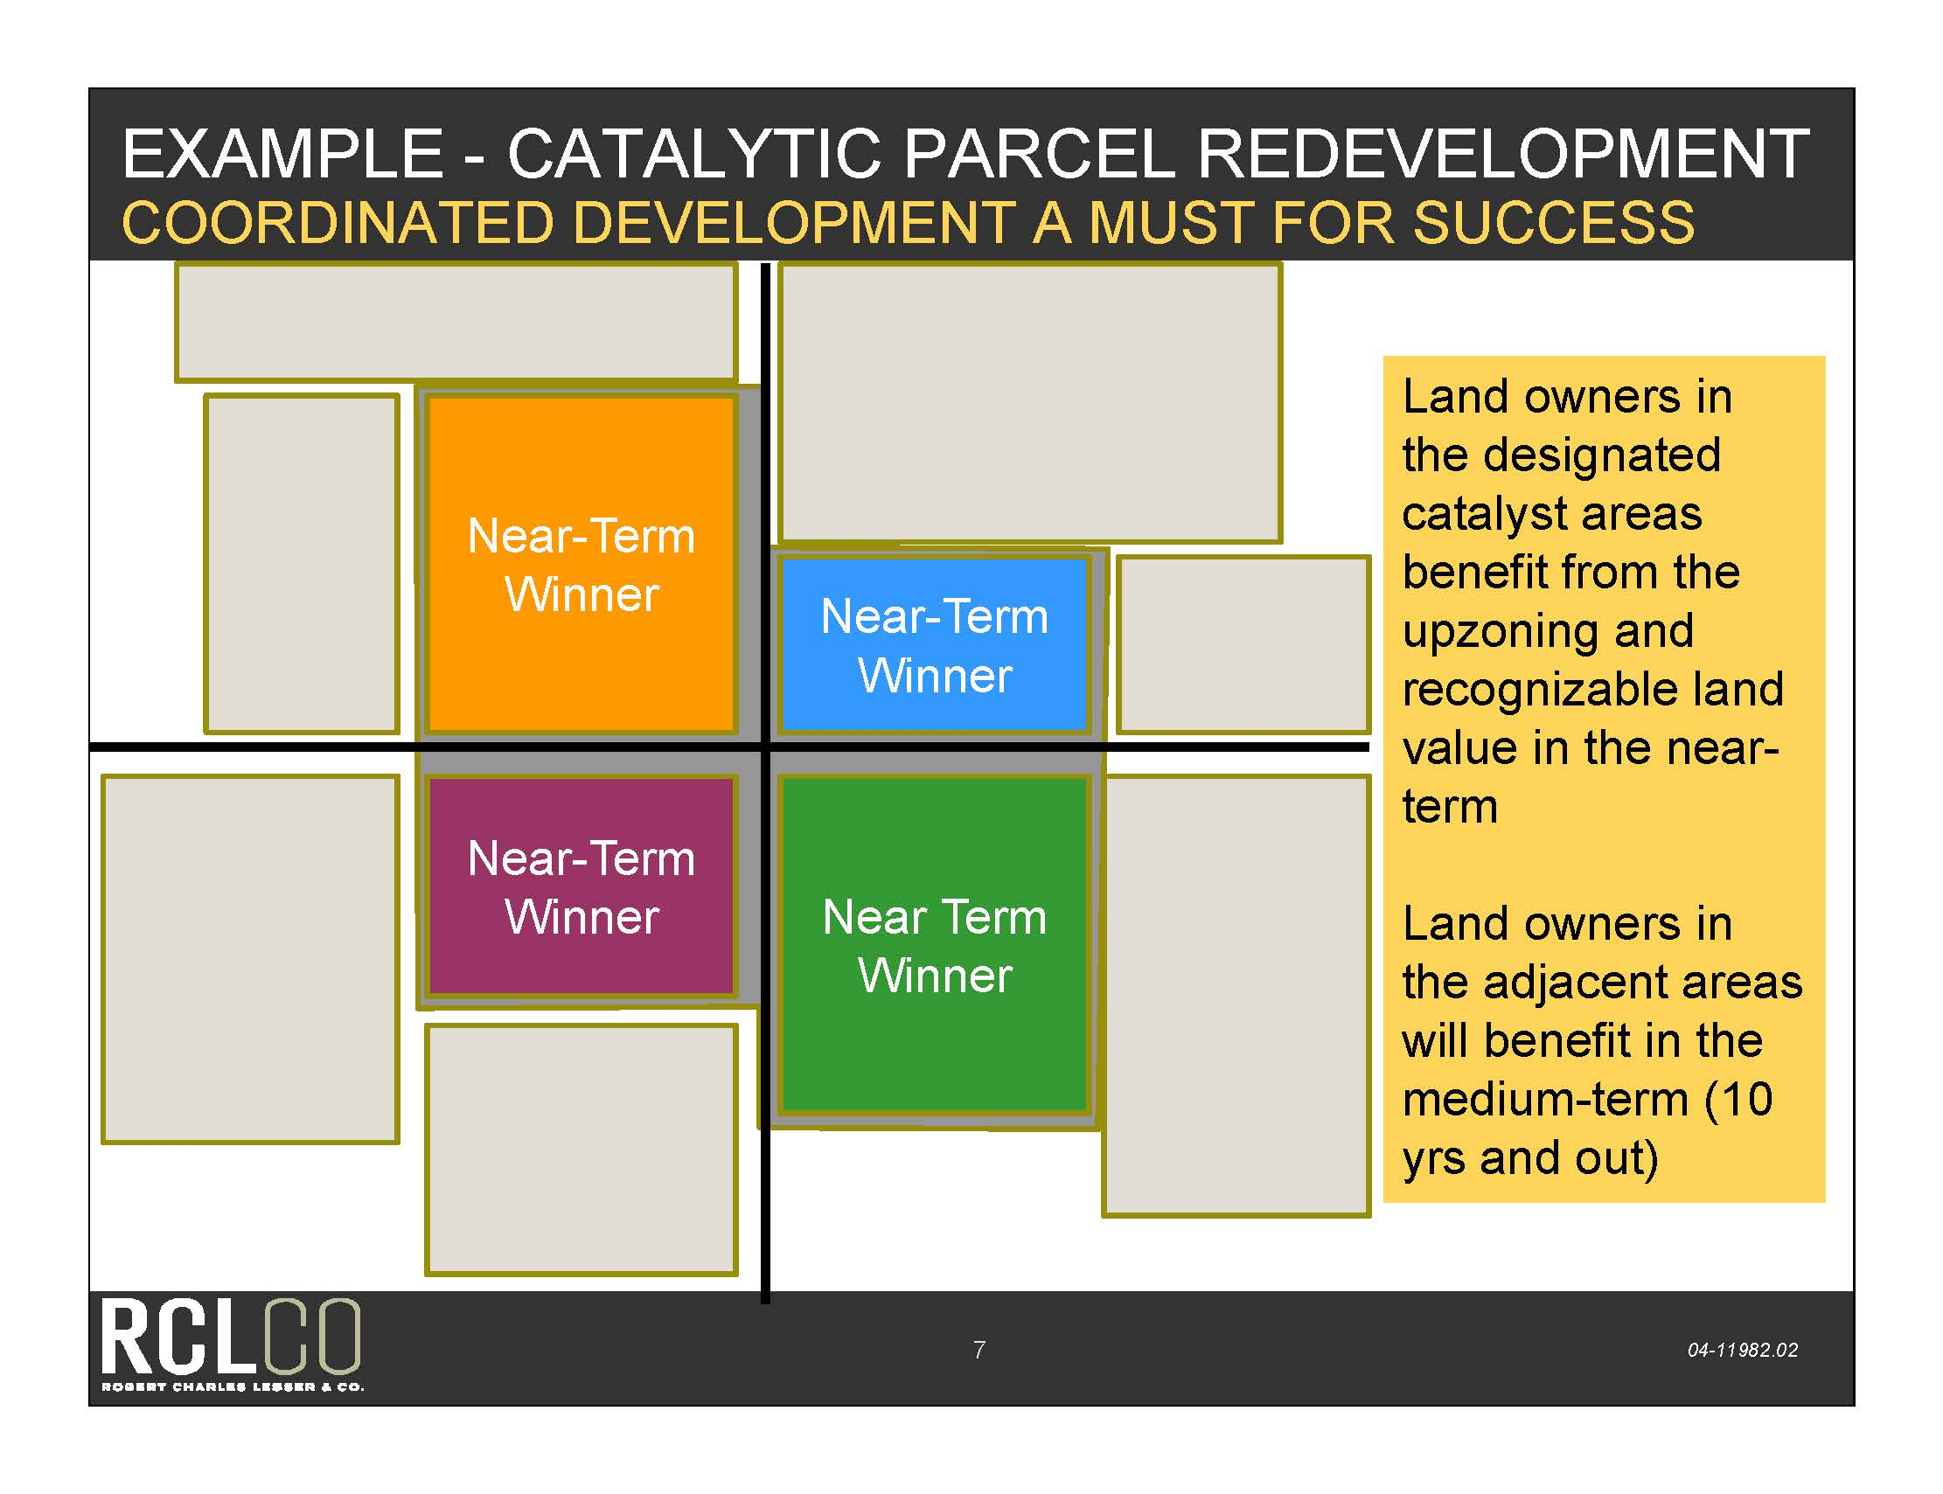

Corridor
Redevelopment

Slide 2
Speakers & Panelists
Moderator: James A. Sellen, Principal, VHB MillerSellen
Speakers & Panelists:
  Melina Duggal, Senior Principal, RCLCO
  Tom Harmer,ICMA-CM, Senior Vice President
  The Pizzuti Companies
  Bill Kercher, AICP, LEED AP, President, WCK Planning, Inc.
  Geoffrey McNeill, RLA, Planning Design Manager, VHB MillerSellen

Slide 3
American Generations
Generation | Born | 2020 Population | 2020 Share
Eisenhowers | Pre 1946 | 15M | 4%
Baby Boom | 1946-1964 | 80M | 21%
Gen-X | 1965-1980 | 90M | 24%
Gen-Y | 1981-1999 | 95M | 25%
New Millennials | Post 1999 | 95M | 25%
Source: Metropolitan Research Center, University of Utah. Data from Woods & Poole Economics

Slide 4
Households are Changing
Household Type 1970 2000 2030
HH with Children 45% 33% 27%
HH without Children 55% 67% 73%
Single/Other HH 14% 31% 34%
Source: Arthur C. Nelson, Presidential Professor & Director of Metropolitan Research, University of Utah.

Slide 5
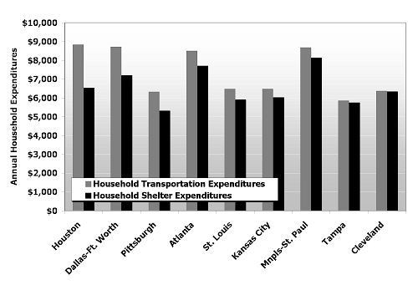
More Spent on Transportation Than Housing

Slide 6
Changing Dreams
That was Then This is Now
40-year career Free agent/independent contractor
Big house, big lot Small house, small lot/attached
Uniform housing Life-cycle housing
Far away from job Short commute, walk/bike/transit
Splendid isolation Privacy with accessibility
Cheap gas Maximize mobility options
Transit is for “those” people Where’s my transit?
All homes gain in value Rent/buy quality locations
Love my cookie-cutter suburb Want a place with options

Slide 7

Process & Principles

Slide 8
The Overarching Principle
Redevelopment Corridors are unique complex “eco”systems that exist within a framework of “eco”nomic, transportation, planning, marketing, design, regulatory,
and political opportunities and constraints.

Slide 9
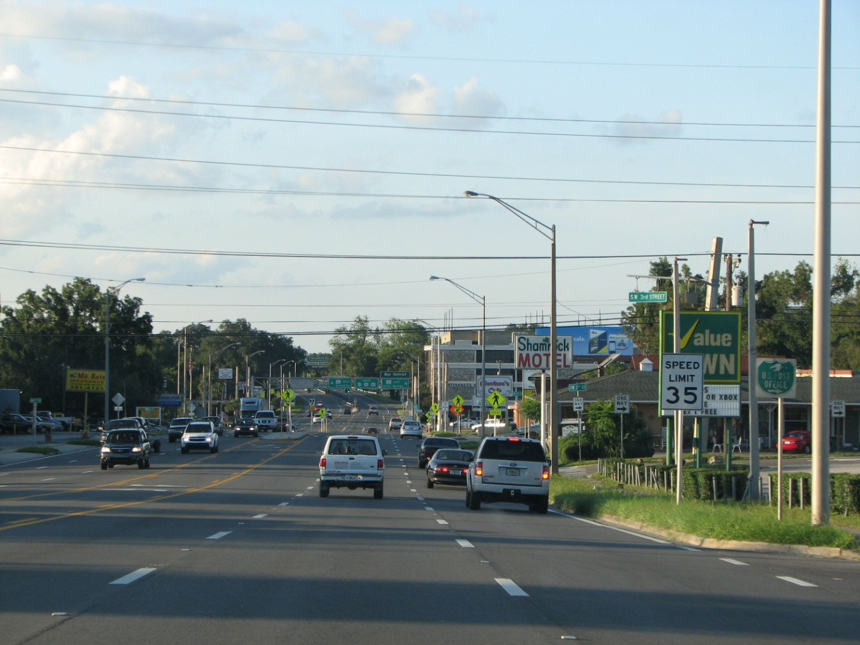
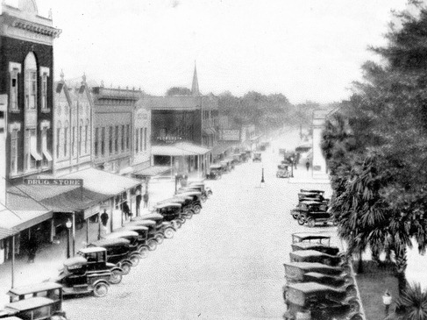
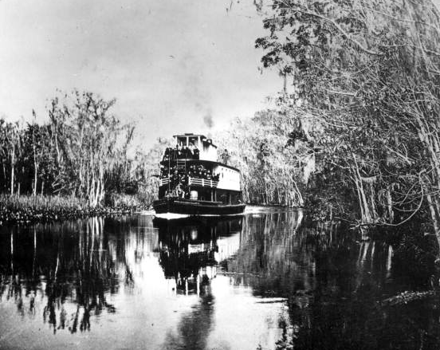
Corridor Redevelopment is a process
Redevelopment, Roads and Rivers
to Opportunity
Before there was a Main Street there was a road
Before there was a town there was
a trading post
Before there was a trading post there were settlers
Before there were settlers there were pioneers
Before there were pioneers there was an opportunity
Rivers connected opportunities.
Source of historic photography: http://www.floridamemory.com Department of State or the State Library and Archives of Florida, Florida Photographic Collection, Florida Memory Project

Slide 10

Process
4: Implementation
3: Vision Alternatives & Plan
2: Public Participation
1: Context Analysis

Slide 11
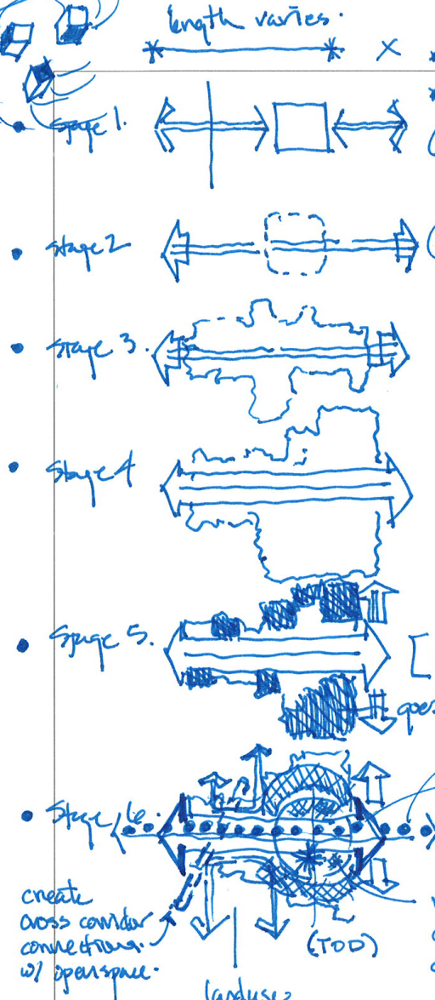
1. Context Analysis – Process
Observe the conditions
Consider the history
Look at the corridor from different perspectives
  Regional
  Community
  Local
Study the market conditions
Understand the opportunities, constraints or barriers
Define the problem(s)

Slide 12
1. Context Analysis – Guiding Principles
Approach the corridor redevelopment process with
a holistic perspective
  Economic / Transportation / Land Use / Design/ Marketing/ Regulatory/ Political
Corridors are an product of an evolution in stages and patterns and they will continue to evolve
Understand the entire contextual mosaic and the barriers to redevelopment
Understand the market forces
  Historic
  Existing
  Near term

Slide 13
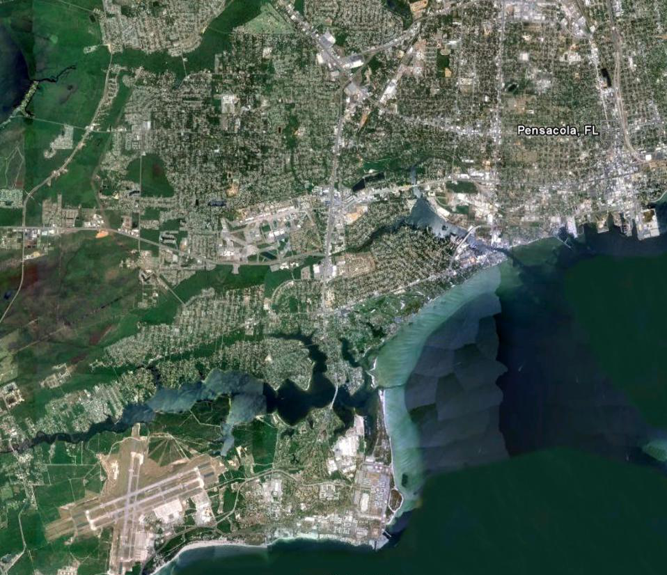
1. Context Analysis
3 Mile Radius
2 Mile Radius
1 Mile Radius

Slide 14
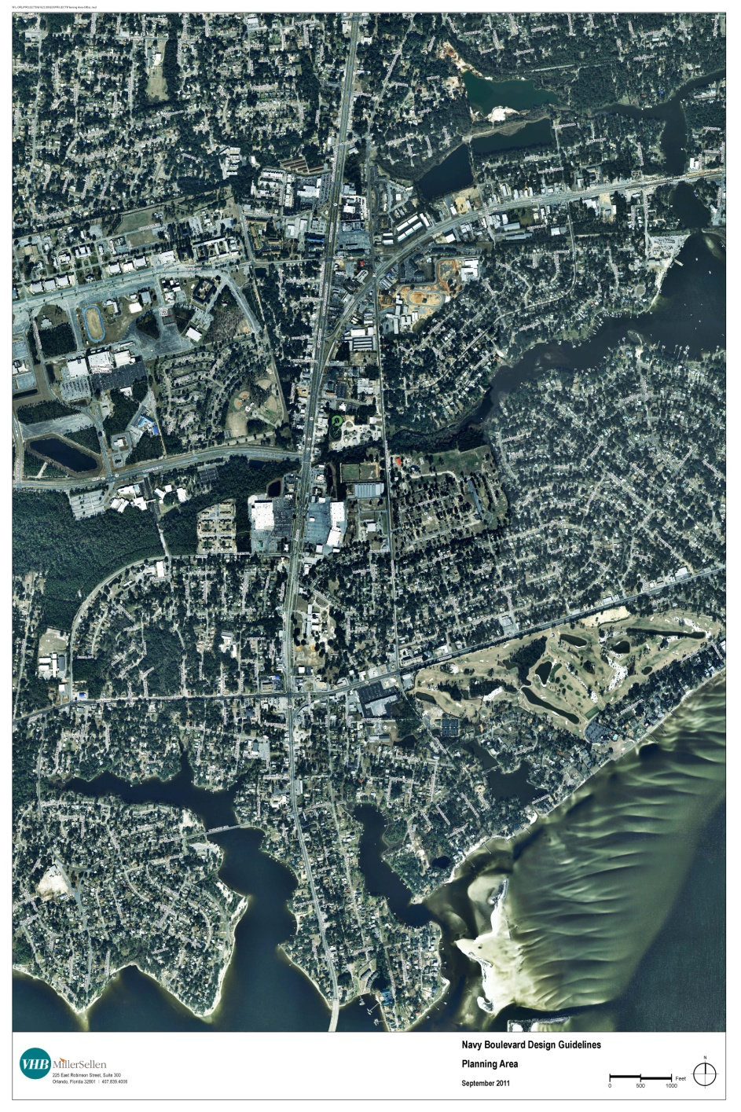
1. Context Analysis
Land Use
Zoning
Development Patterns
Transportation Systems
Utility Infrastructure
Regulatory
Environmental
Marketing
Political
Economics
1 Mile Radius

Slide 15
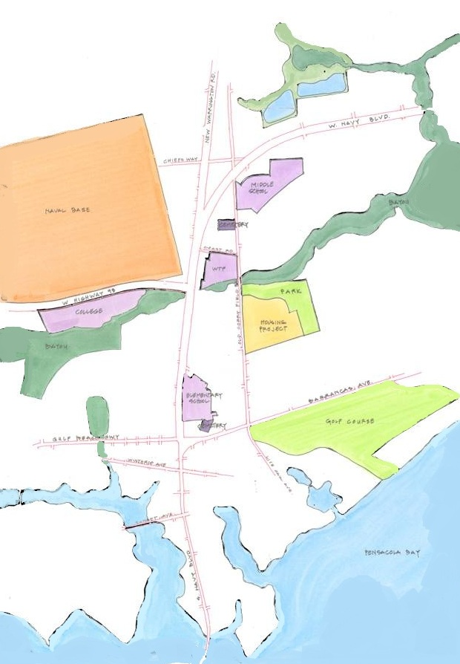
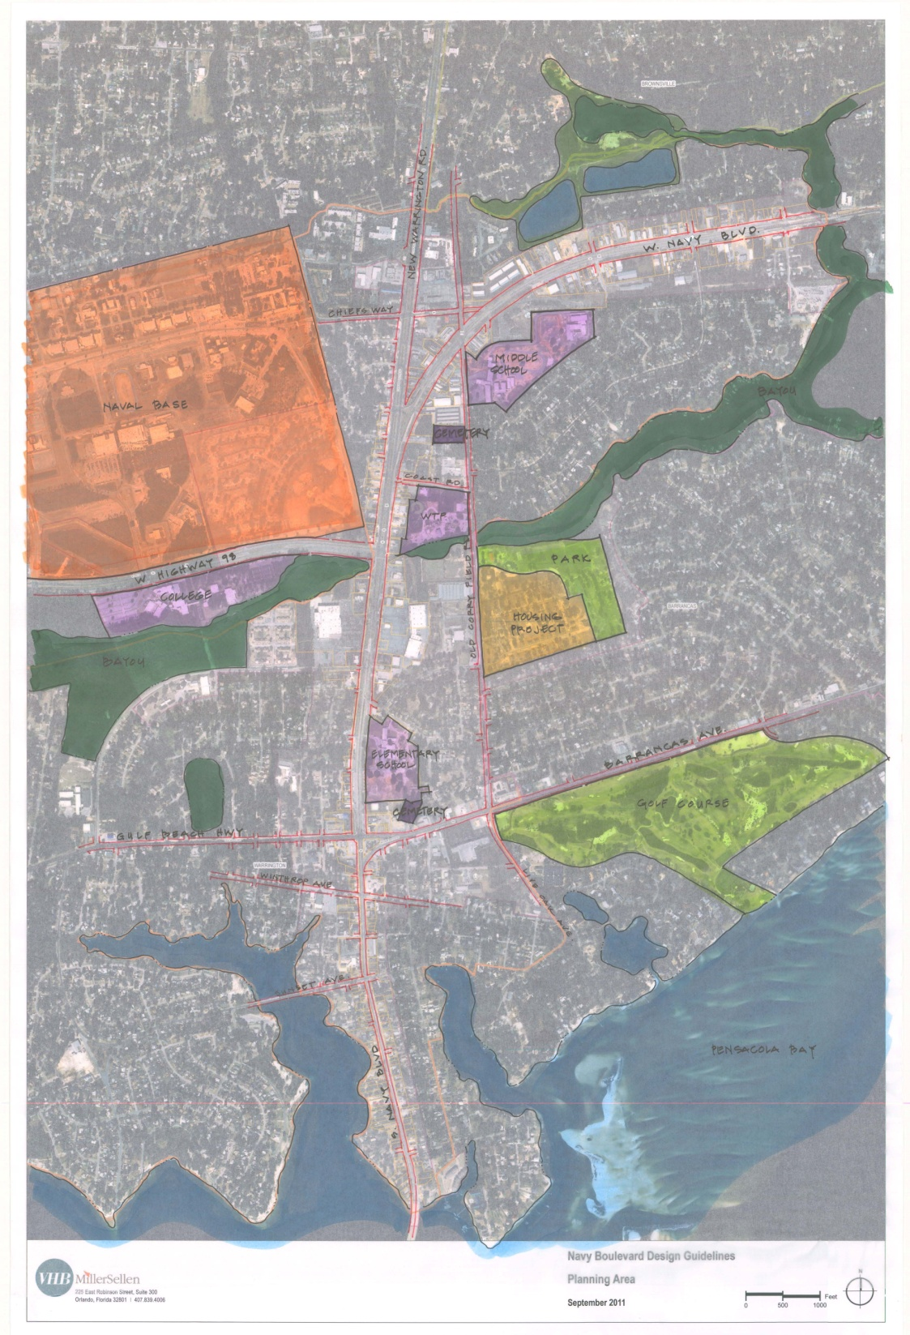
1. Context Analysis

Slide 16

1. Context Analysis

Slide 17
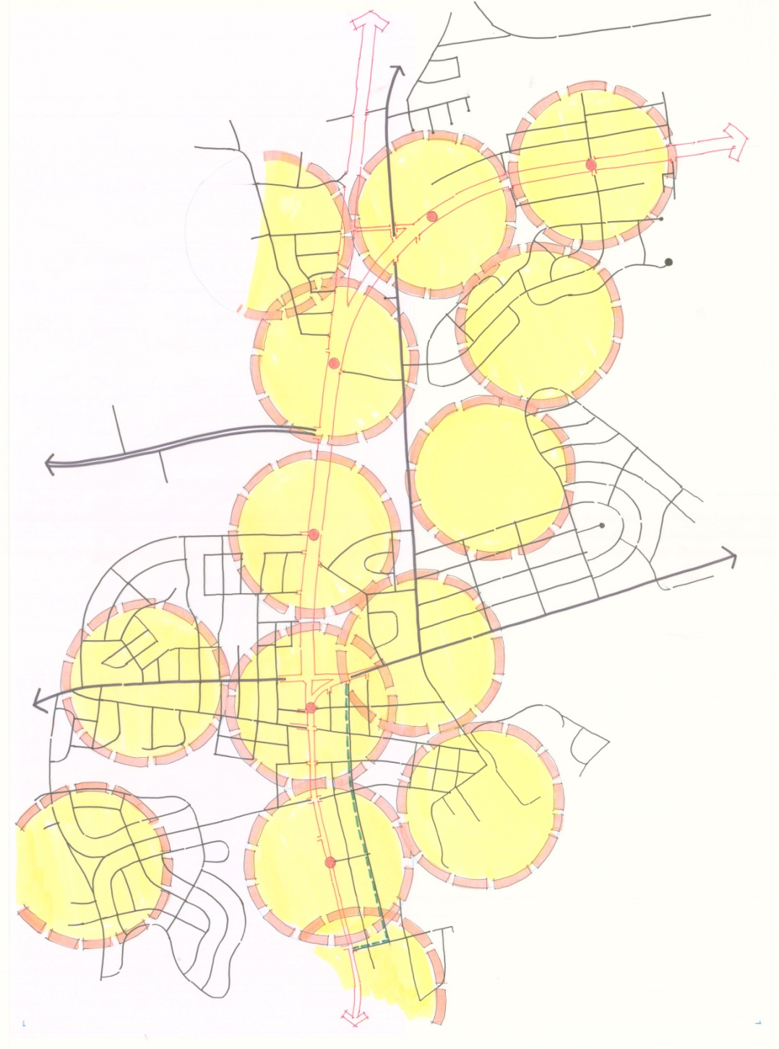
1. Context Analysis

Slide 18
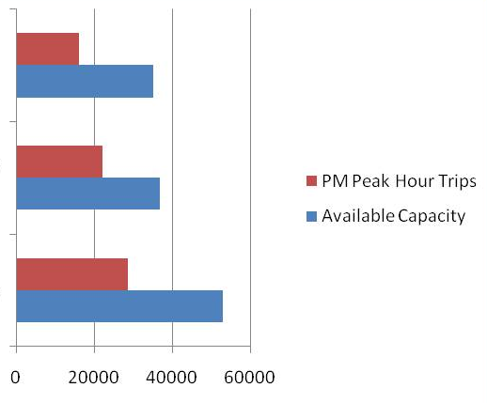
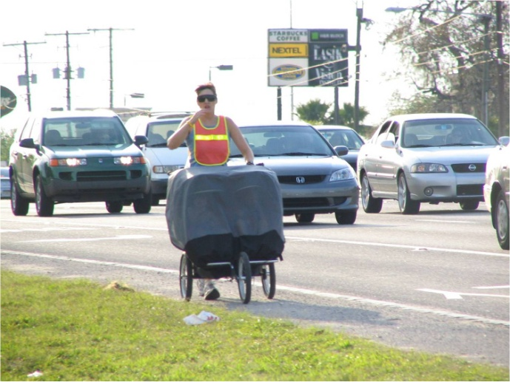
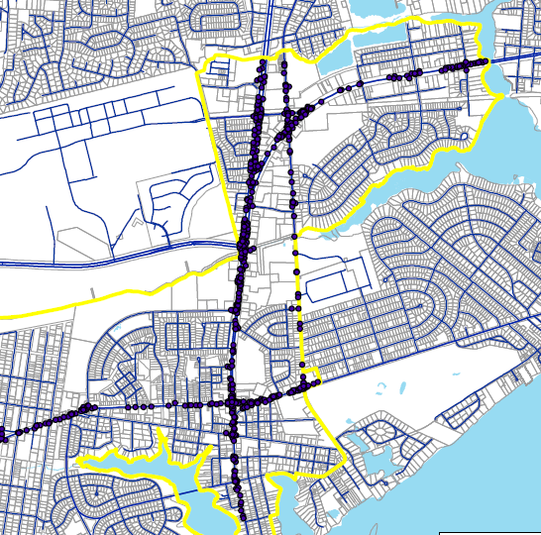
1. Context Analysis
Transportation Context
  Traffic Capacity & LOS
    Existing
    Projected
  Right of Way
    Width
    Cross section
  Speeds
    Posted
    Design
    Actuals
  Network Connections
  Pedestrian Safety & Comfort
  Modes
    Types
    Existing
    Projected

Slide 19
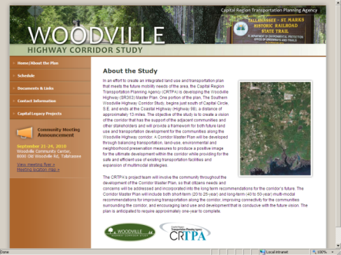
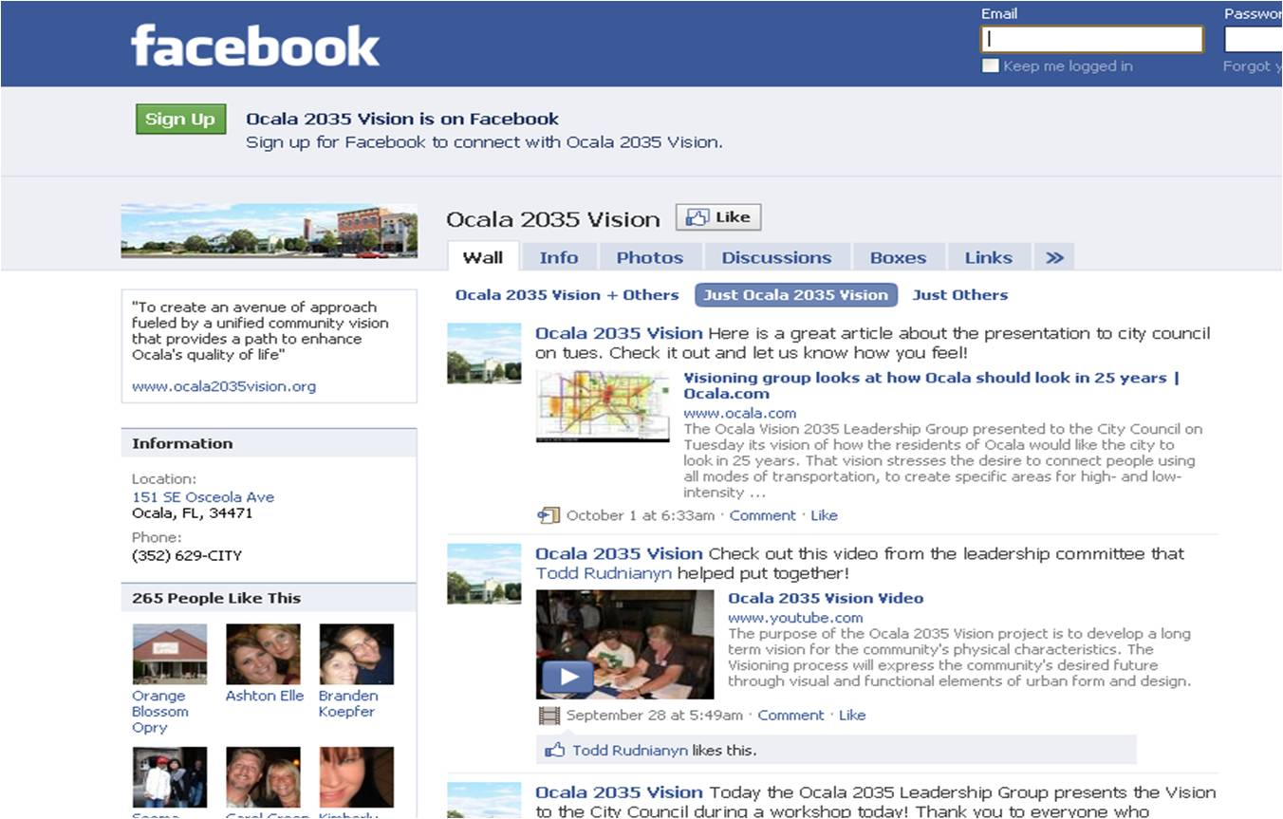
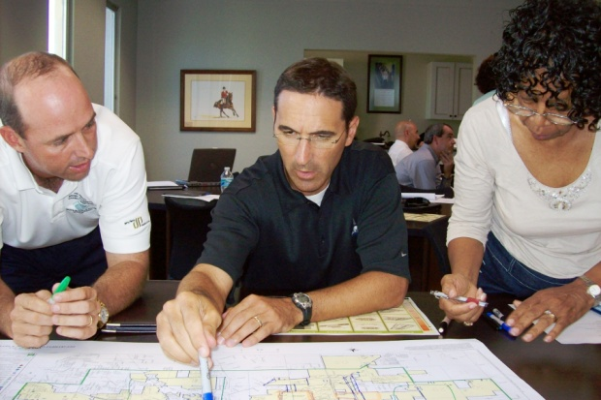
2: Public Participation - Process
Multifaceted Public Outreach
Identify Leadership “Champions”
Establish Steering Committee
Stakeholder Interviews
Public Workshops & Charrettes
Public Involvement
Web Site
Social Media

Slide 20
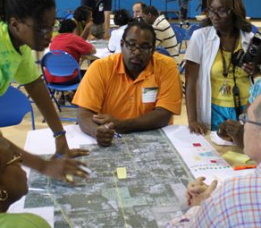
2: Public Participation - Guiding Principles
Communicate and build consensus with stakeholders on the corridor and in surrounding communities.
Communication includes listening.
Participation and outreach includes public agency and departmental stakeholders . Align projects
and priorities.
Building trust among parties with differing agendas takes time. Corridors have their own particular contexts, personalities and politics that make them unique and unsuited to a “boiler plate” approach.
Success depends on, identifying and encouraging community stakeholders who will become champions for implementing the Vision/Plan

Slide 21
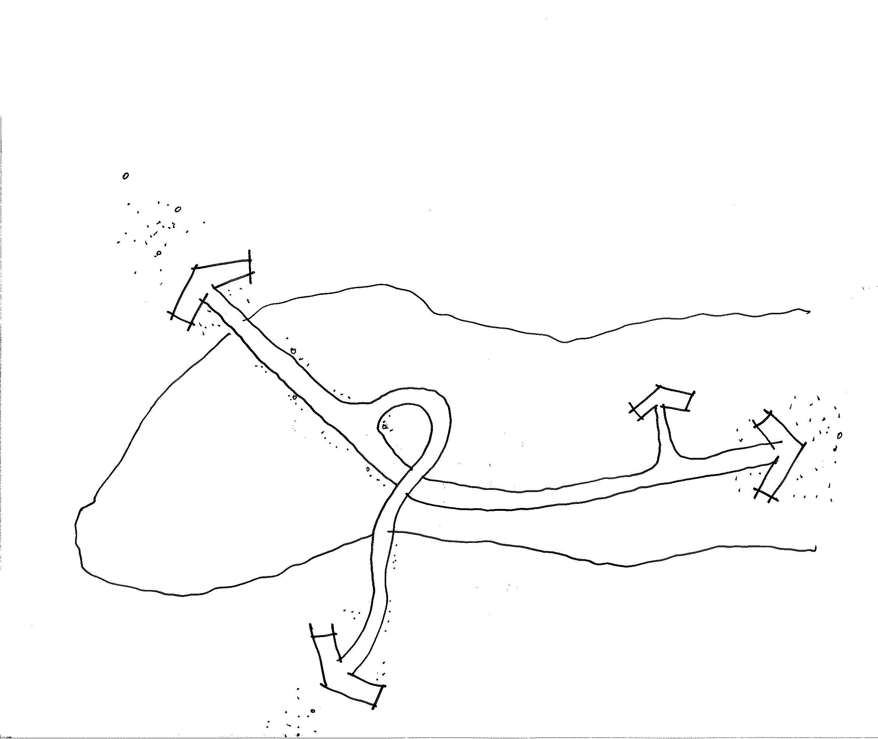
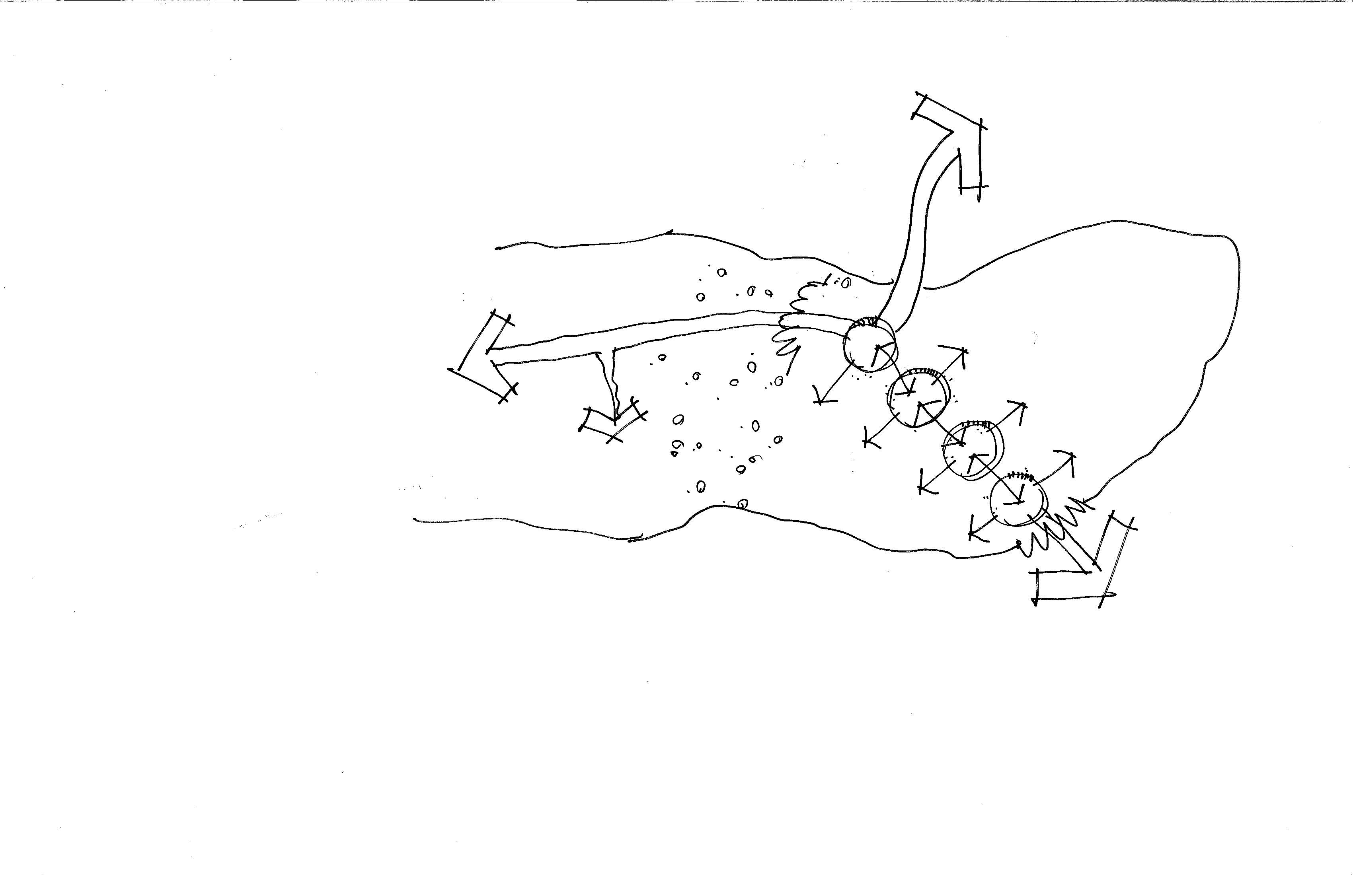
3: Visioning: Alternatives & Plan
Create Alternative Concepts
  Construct a new contextual mosaic
  Consider the history
  Consider analogues
  Understand the opportunities, constraints or barriers
Provide different perspectives
and choices
Describe & visualize desired outcomes
Solve for the market conditions
  Short term
  Long term
  Identify catalysts for change
  Illustrate the Vision
  Detail the Plan
  Short Term
  Mid term
  Long term

Slide 22
3: Visioning: Alternatives & Plan
- Guiding Principles
Break the corridor into smaller pieces;
Articulate a vision
Identify the market forces that will drive value and become catalysts for change.
Strategies for the future of the corridor should encourage multiple use not focused on retail
Pedestrian safety, comfort and status must be enhanced throughout the corridor
Strategies for the future of the corridor should create destinations/ centers promoting the broader goals for creating places that are walkable, transit supportive, carbon reducing
and energy efficient
Create centers by by solving for the places in between

Slide 23
3: Visioning: Alternatives & Plan
Section D
Section D
Section C
Section C
Section B
Section B
Section A
Section A

Slide 24
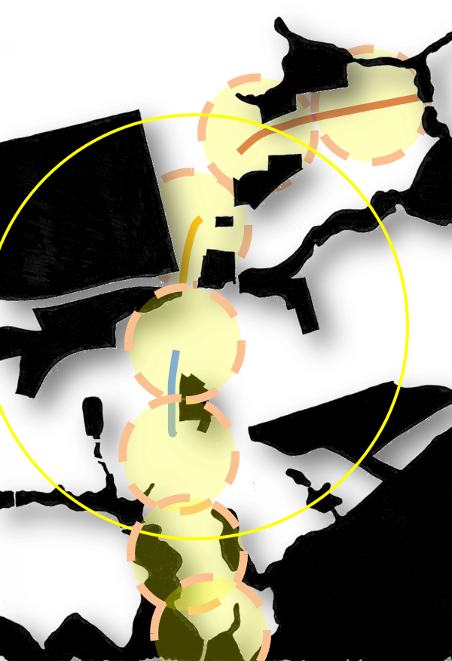
3: Visioning: Alternatives & Plan

Slide 25
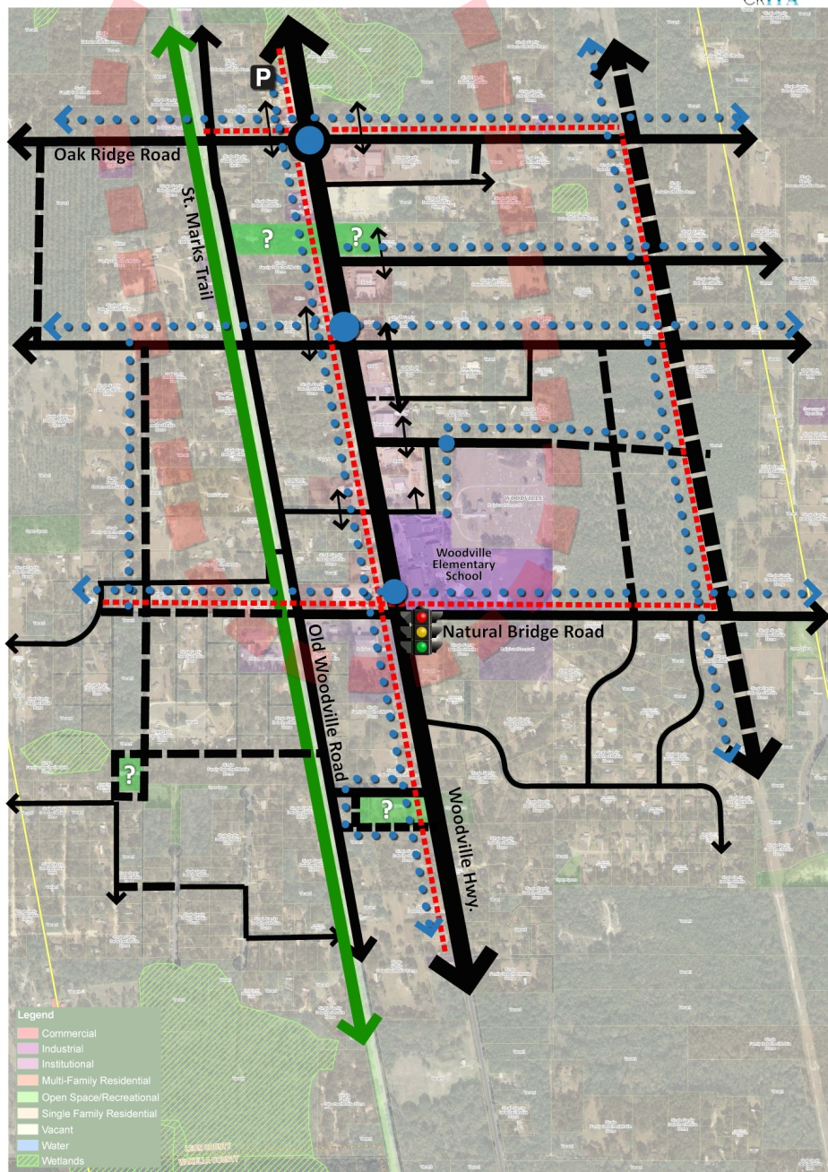
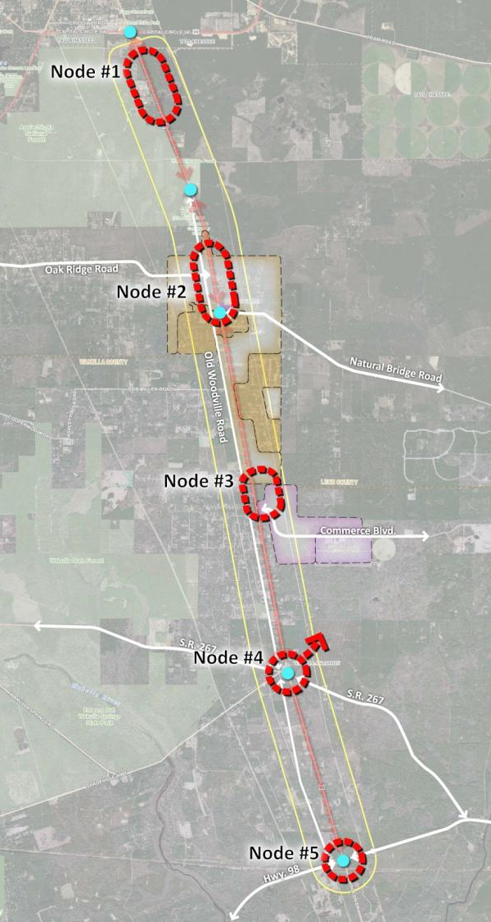
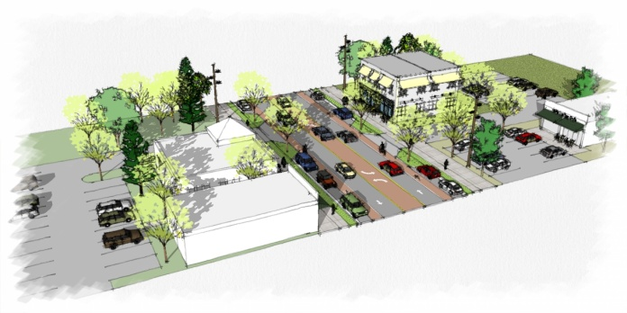
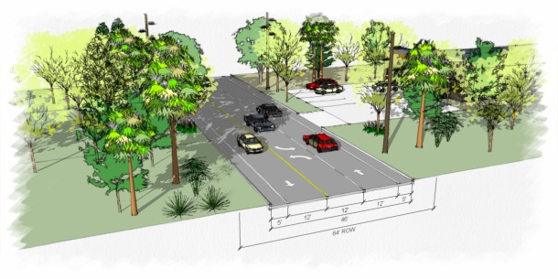
3: Visioning: Alternatives & Plan

Slide 26
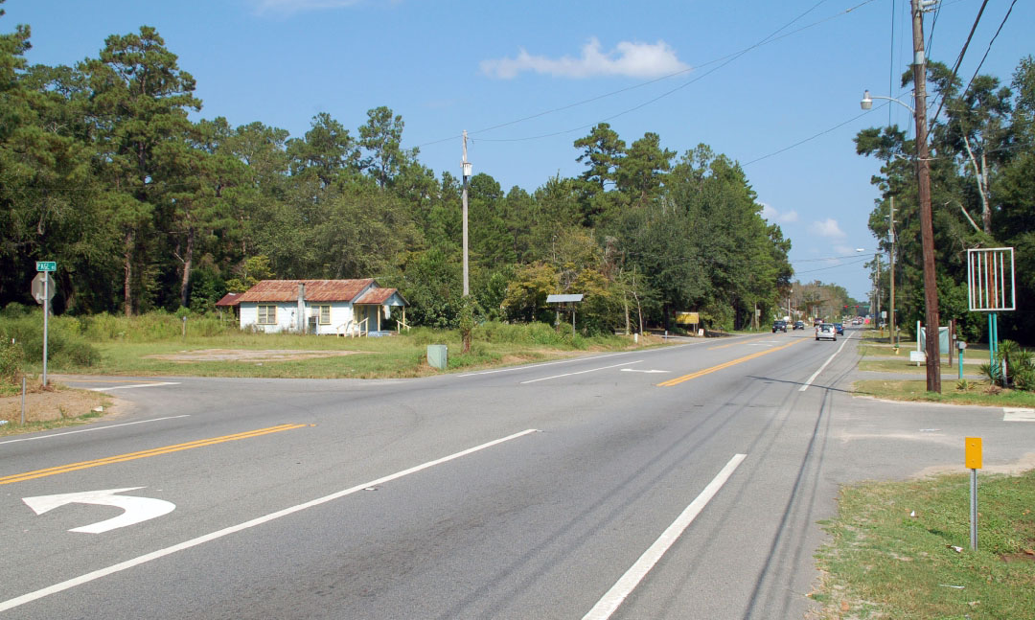
3: Visioning: Alternatives & Plan

Slide 27
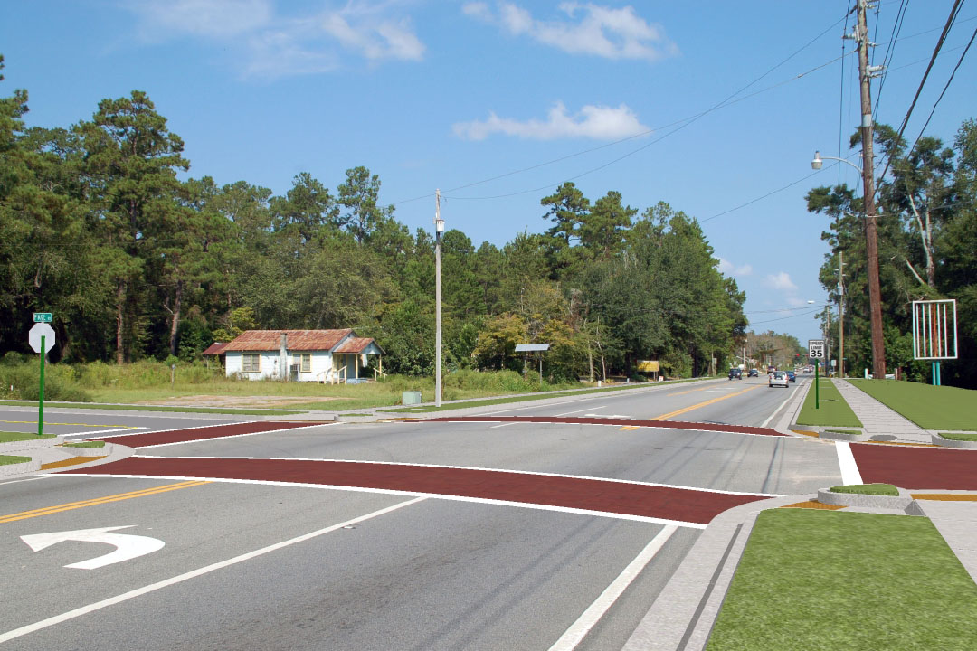
3: Visioning: Alternatives & Plan

Slide 28
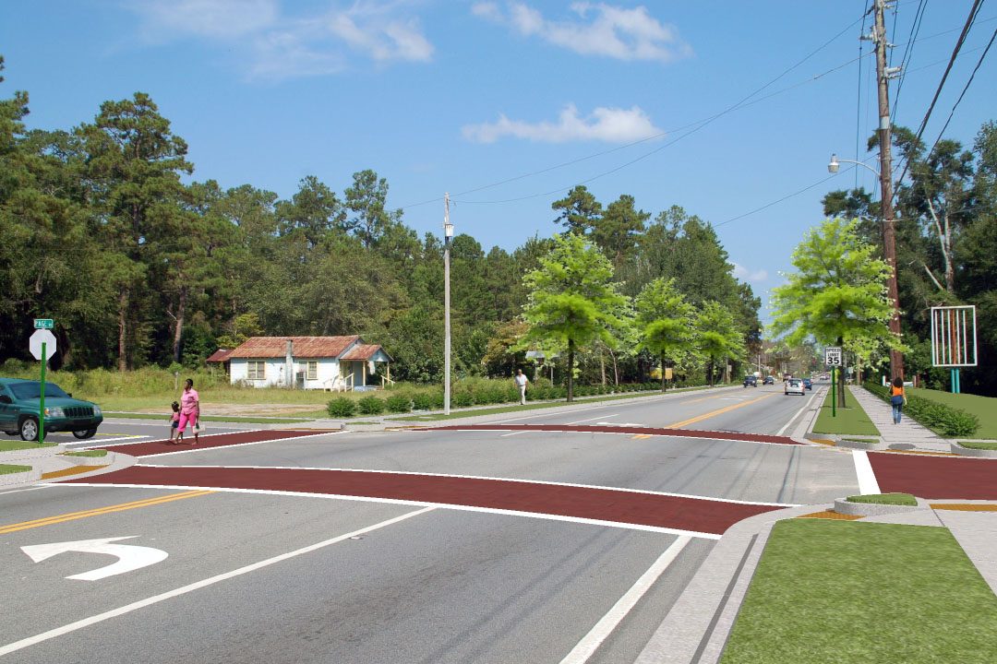
3: Visioning: Alternatives & Plan

Slide 29
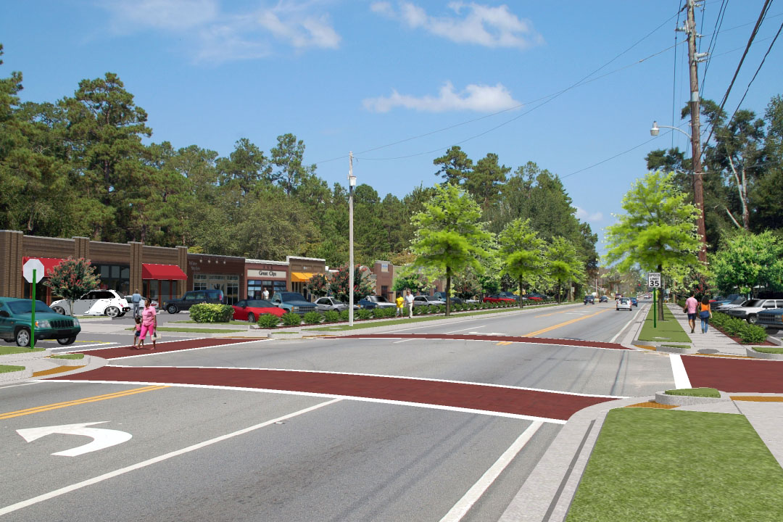
3: Visioning: Alternatives & Plan

Slide 30
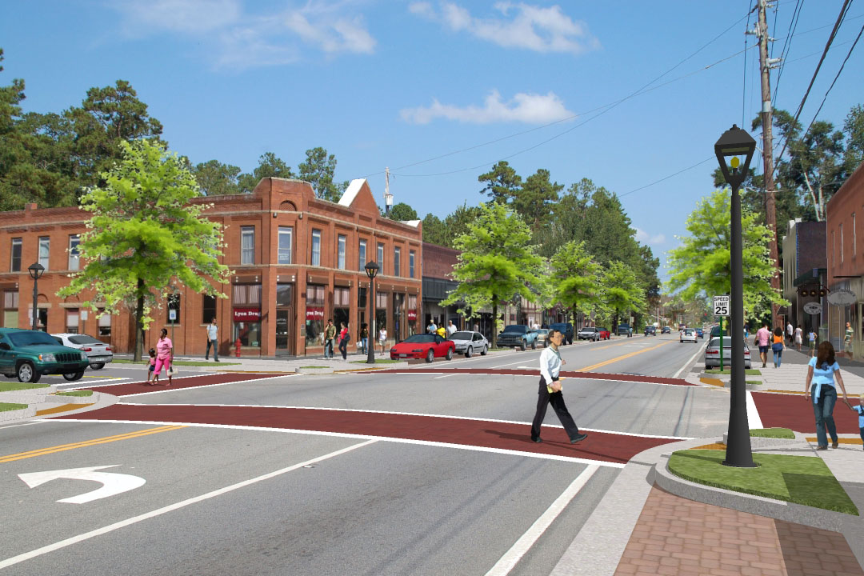
3: Visioning: Alternatives & Plan

Slide 31
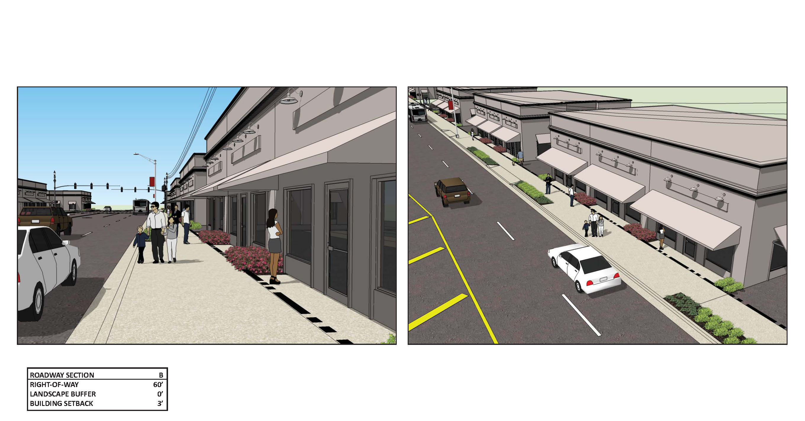
3: Visioning: Alternatives & Plan

Slide 32
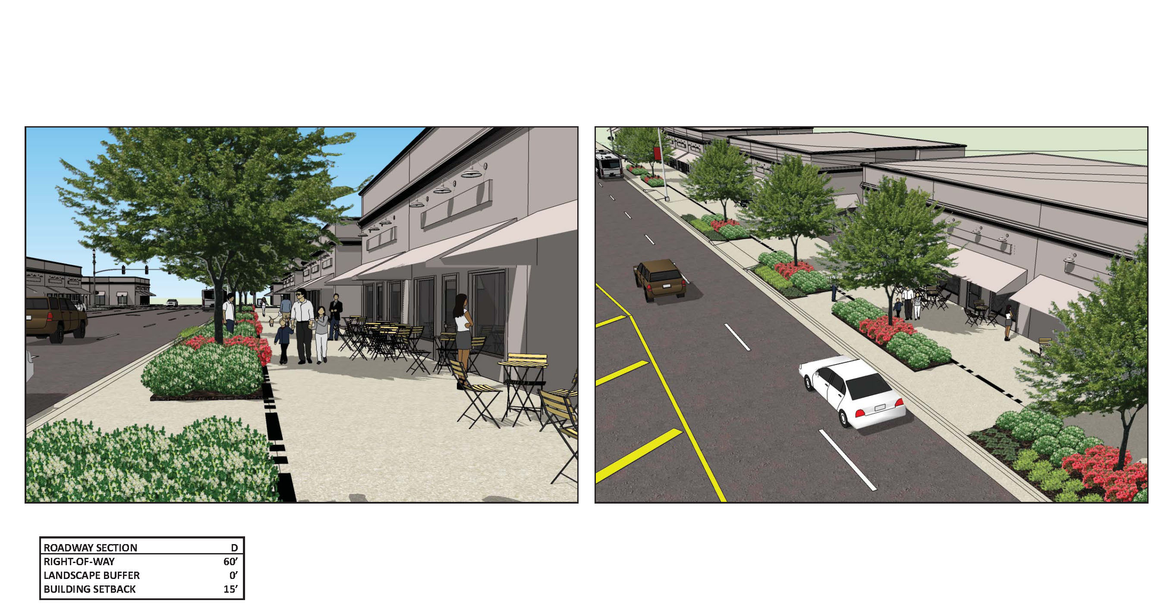
3: Visioning: Alternatives & Plan

Slide 33
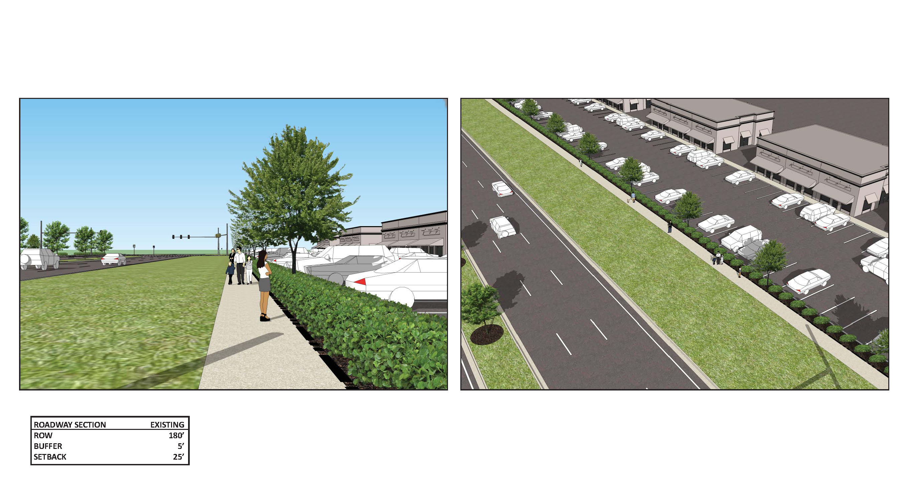
3: Visioning: Alternatives & Plan

Slide 34
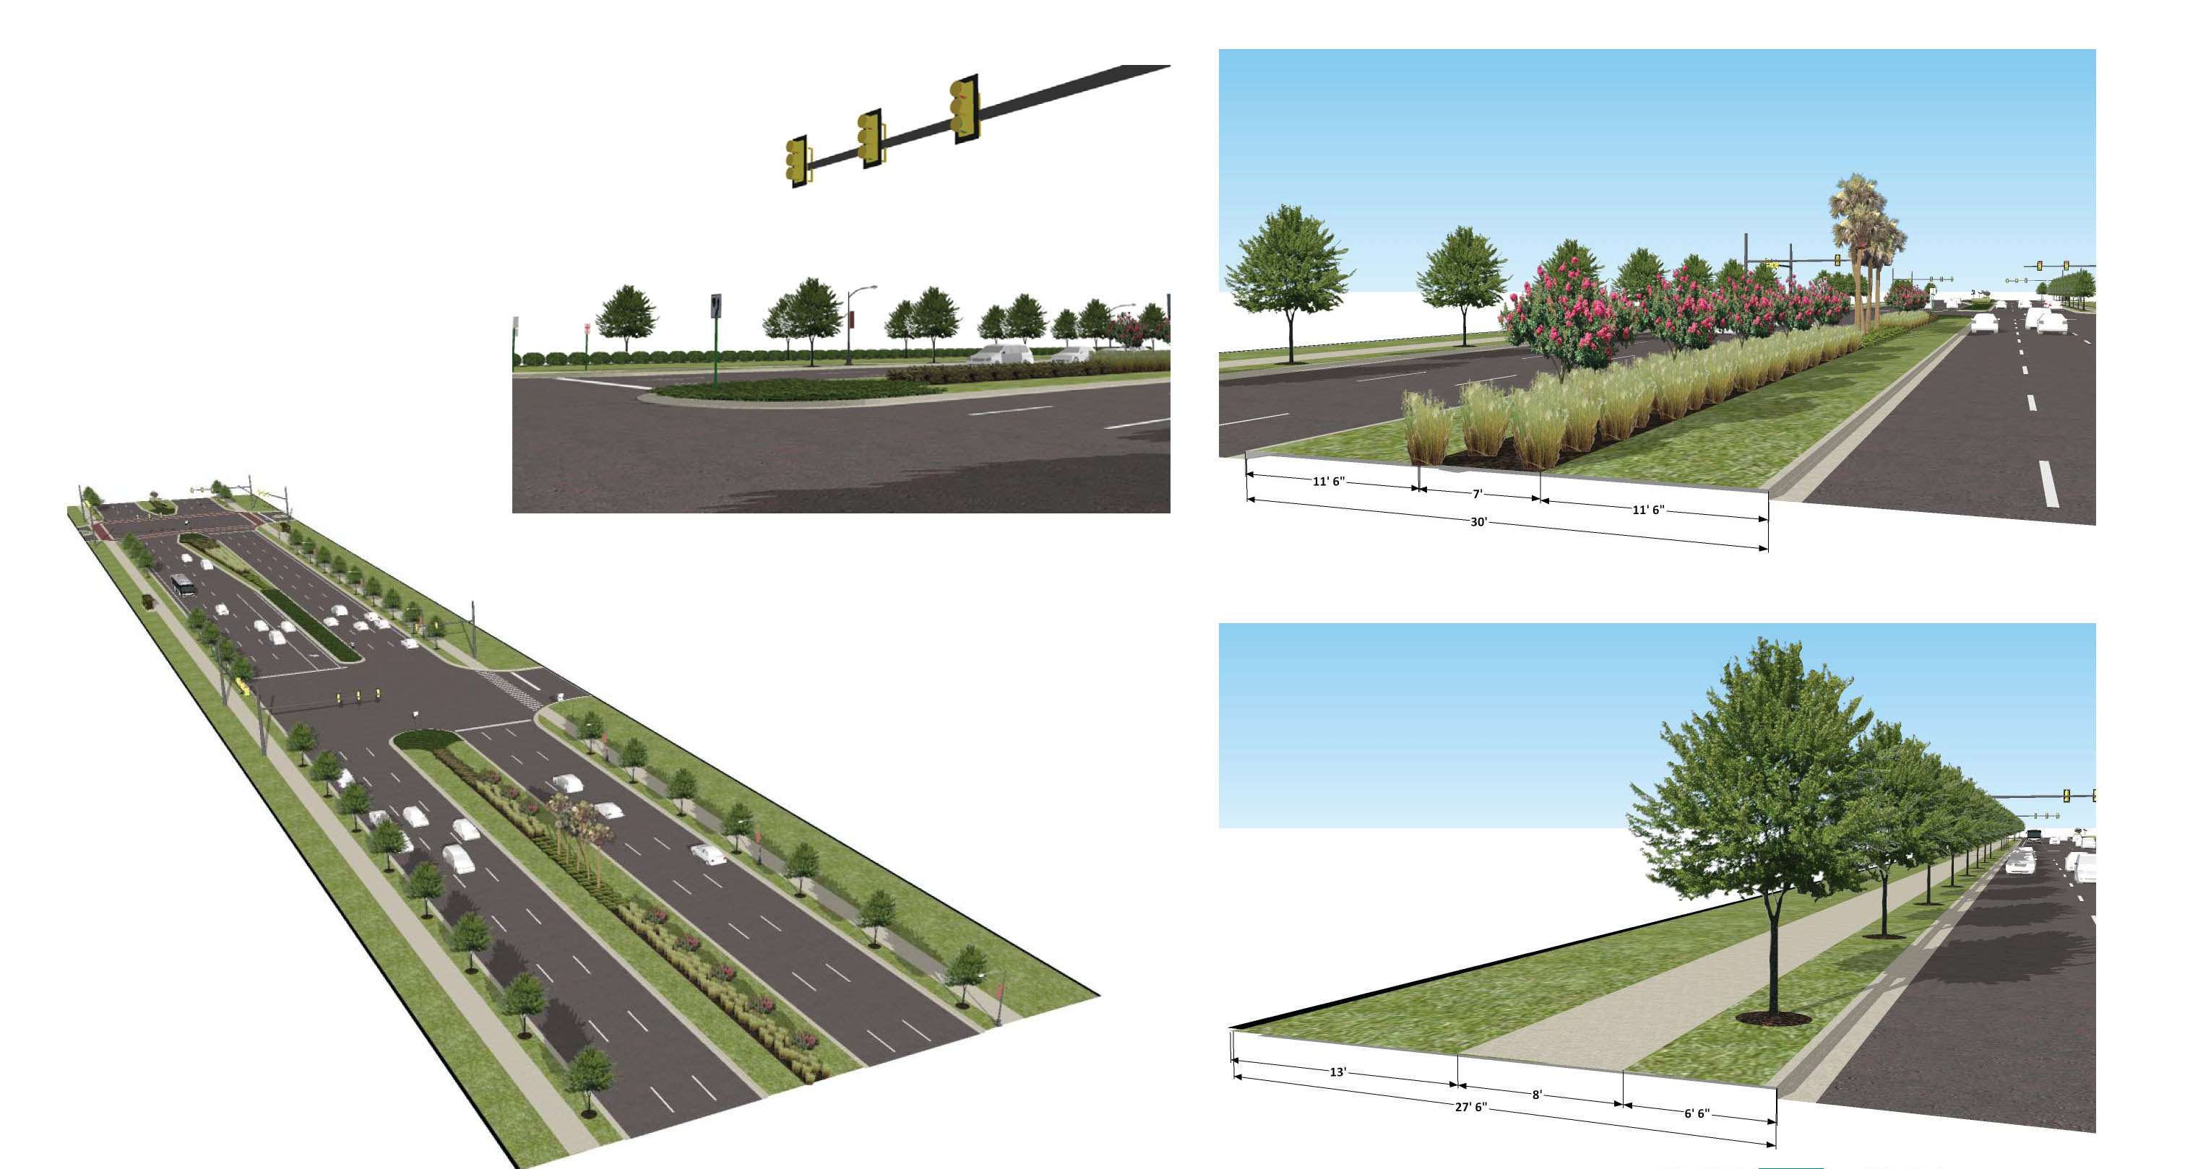
3: Visioning: Alternatives & Plan

Slide 35
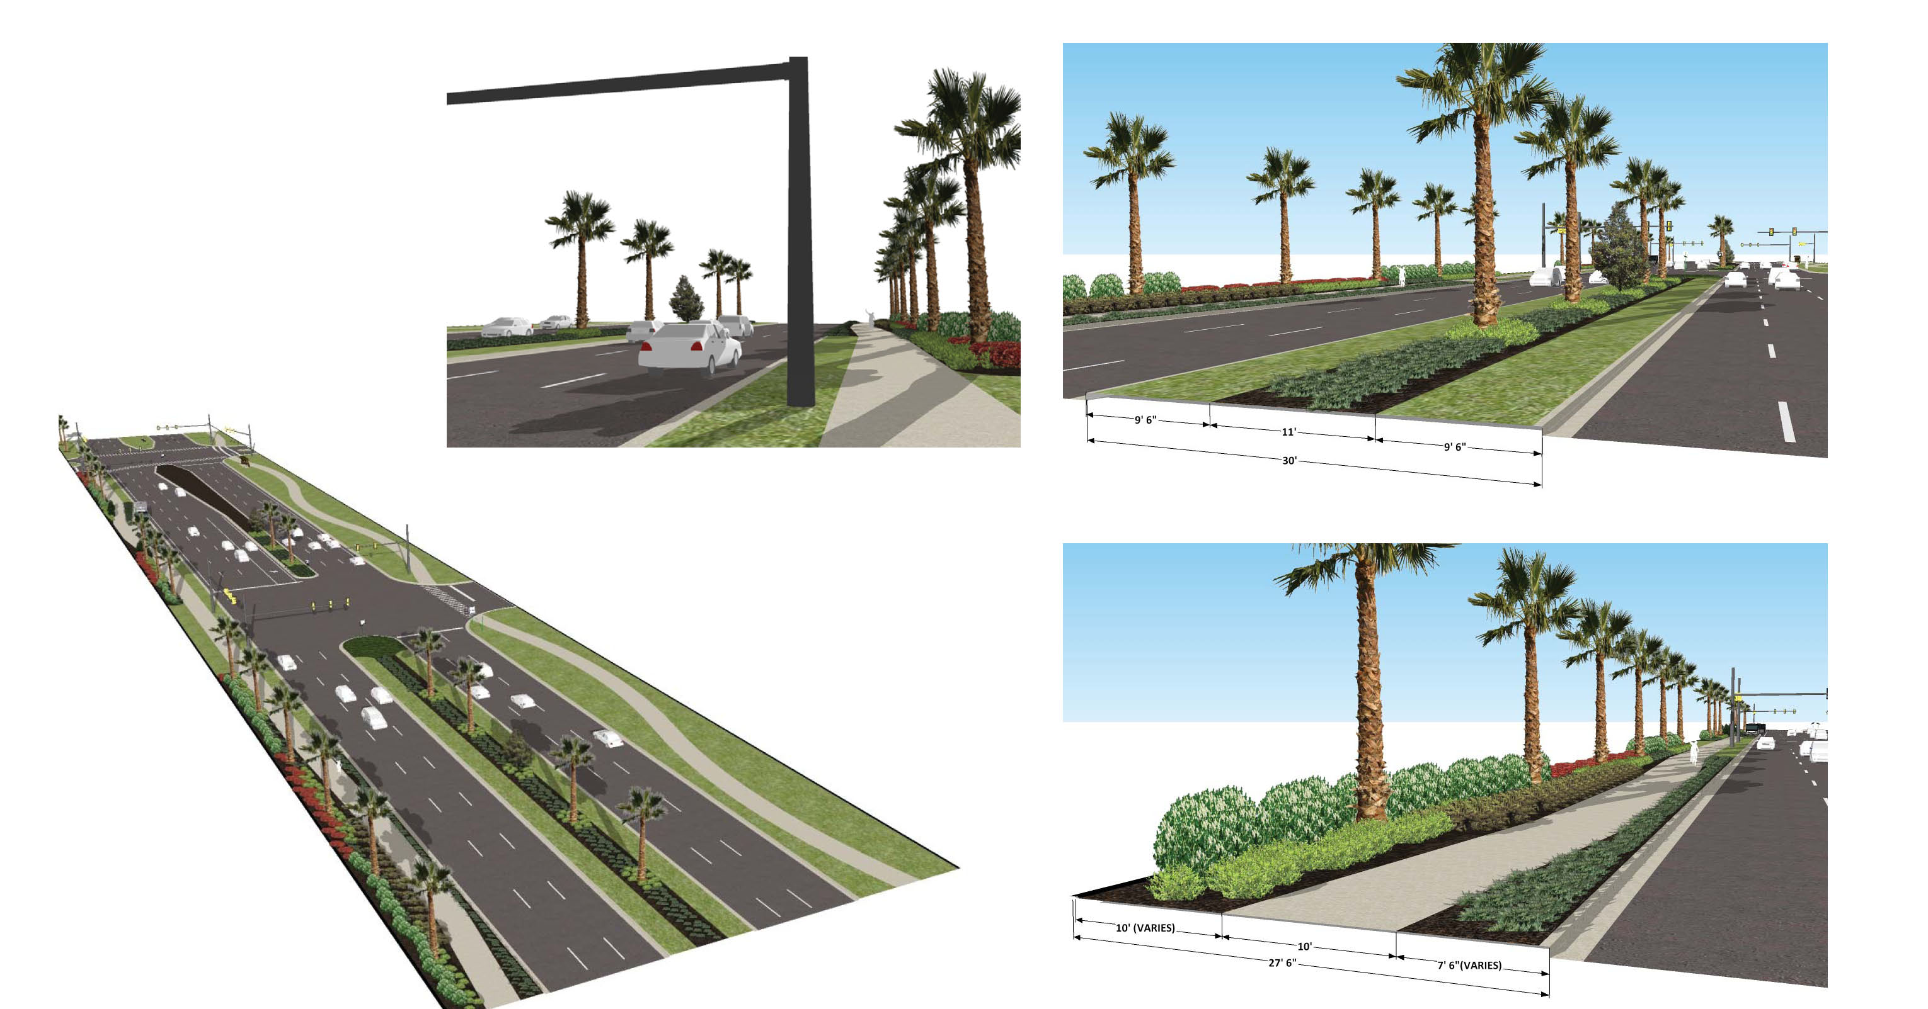
3: Visioning: Alternatives & Plan

Slide 36
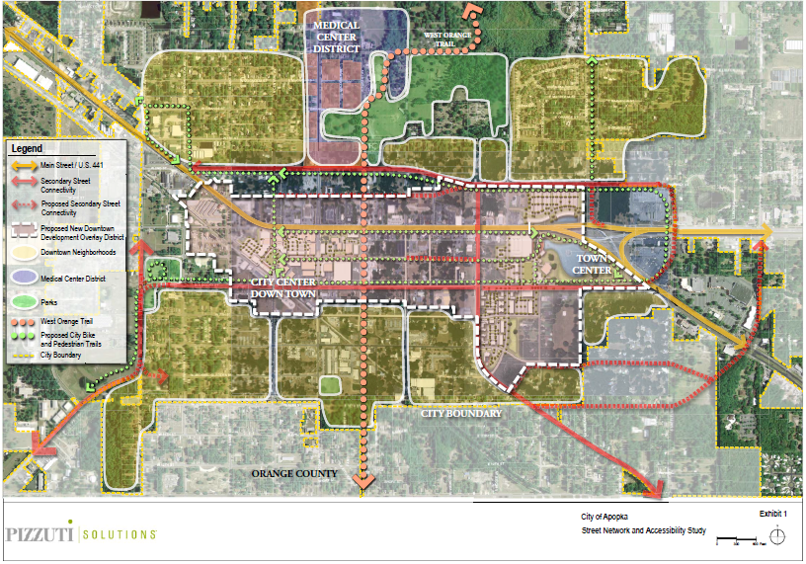
3: Visioning: Alternatives & Plan

Slide 37
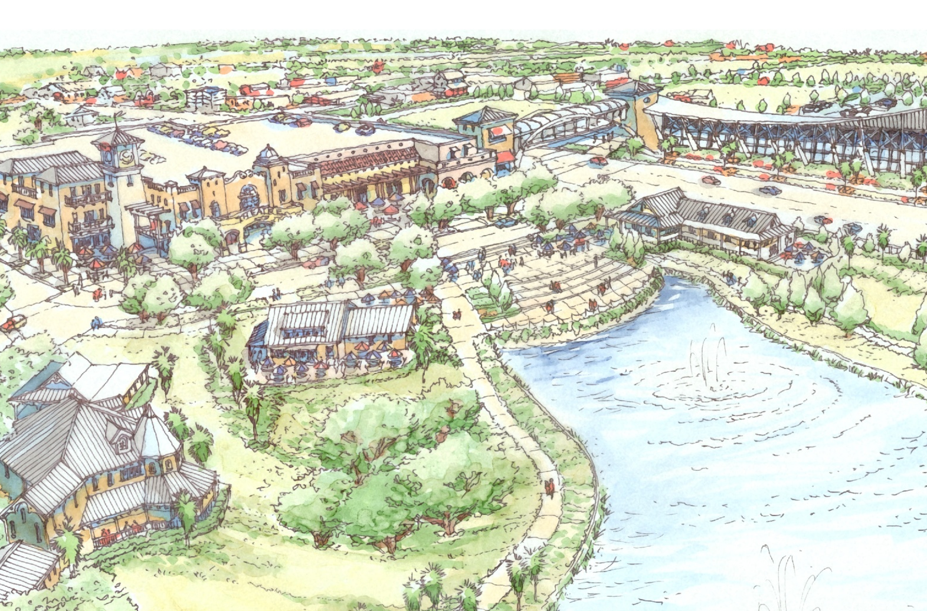
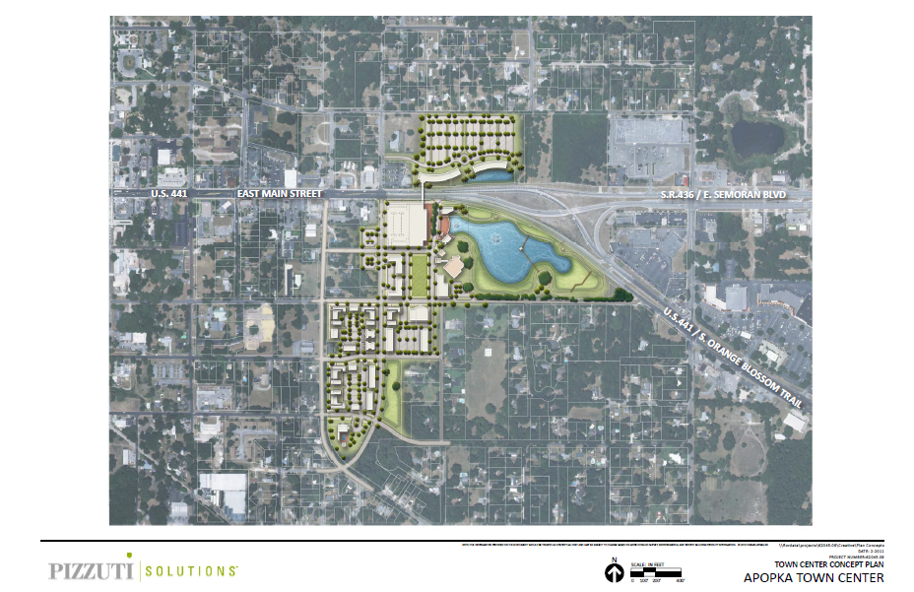
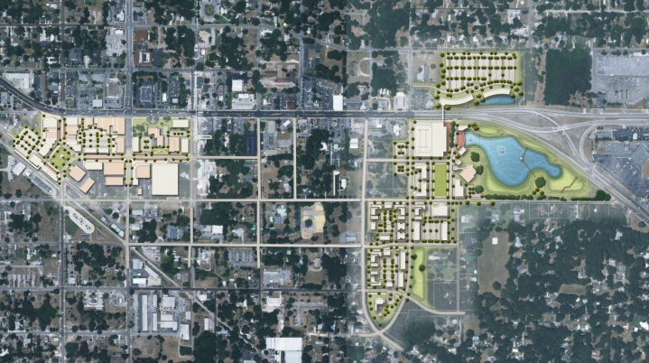
3: Visioning: Alternatives & Plan

Slide 38
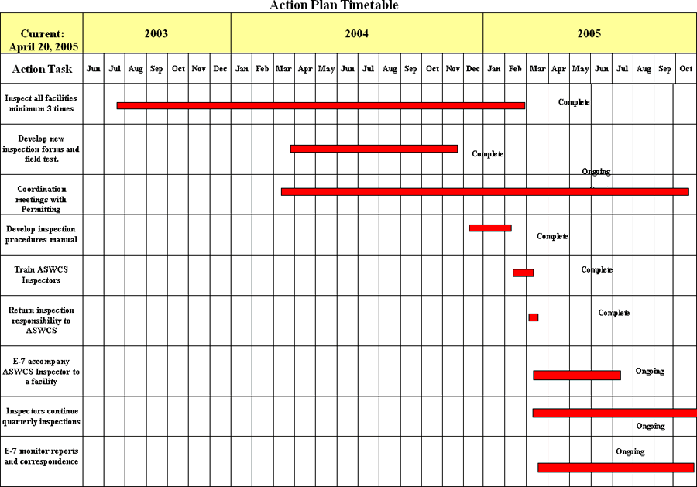
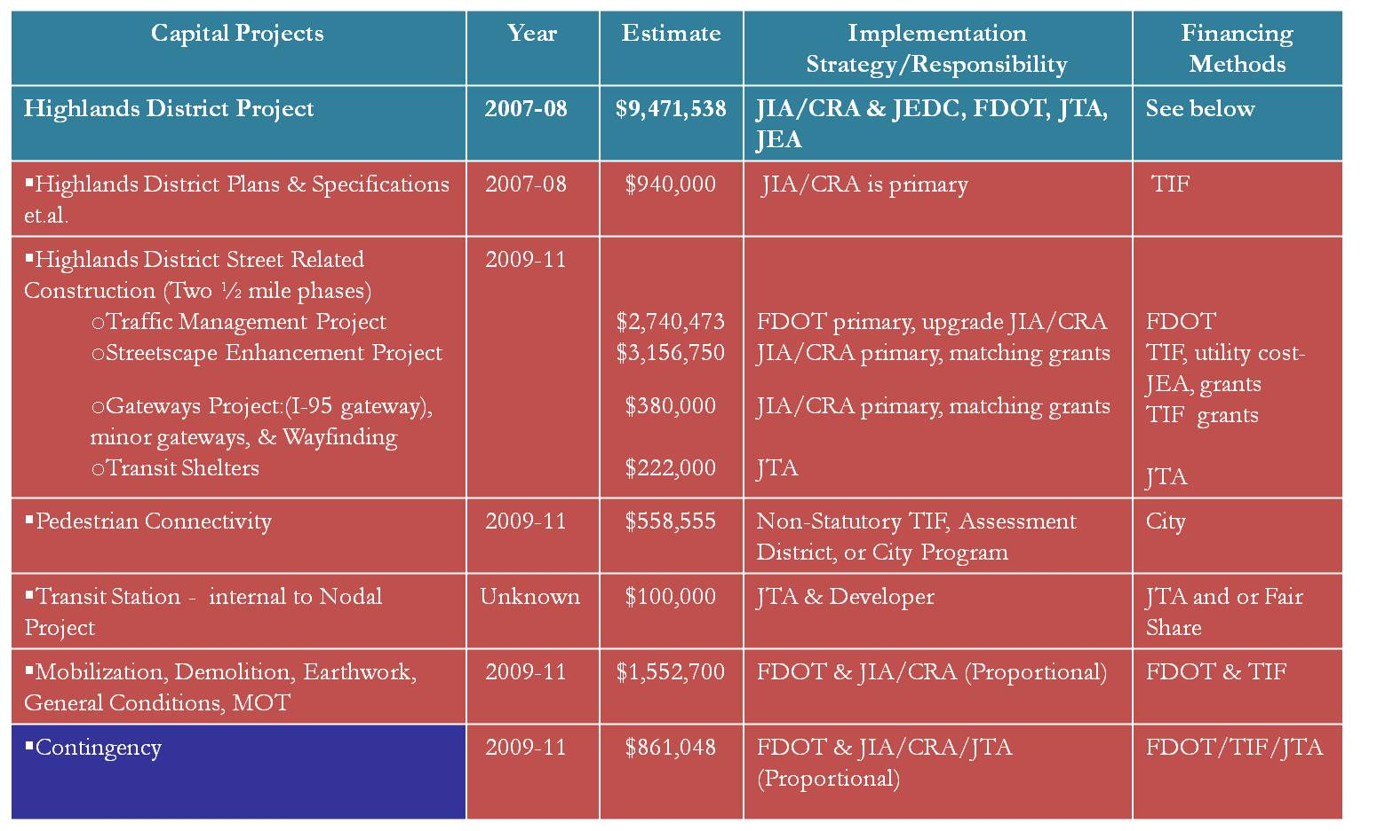
5: Implementation
Plan Policy and Land Development
Code Amendment Recommendations
Recommended Design
Guidelines Amendments
Utility Strategy
Development Strategy
Identify Incentive Strategies
Identification of Alternative
Funding Sources
Benchmarks to Measure Progress
Benchmarks to Measure Success
Implementation Action Plan

Slide 39
5: Implementation - Guiding Principles
Build a realistic implementation strategy;
Create leadership/build partnerships;
Create a proactive atmosphere for change.
Identify and incentivize the catalysts
Prioritize public and private investment
Funding is fundamental, but the public sector must be
a catalyst and demonstrate long term commitment.

Slide 40
Panel Discussion

Slide 41
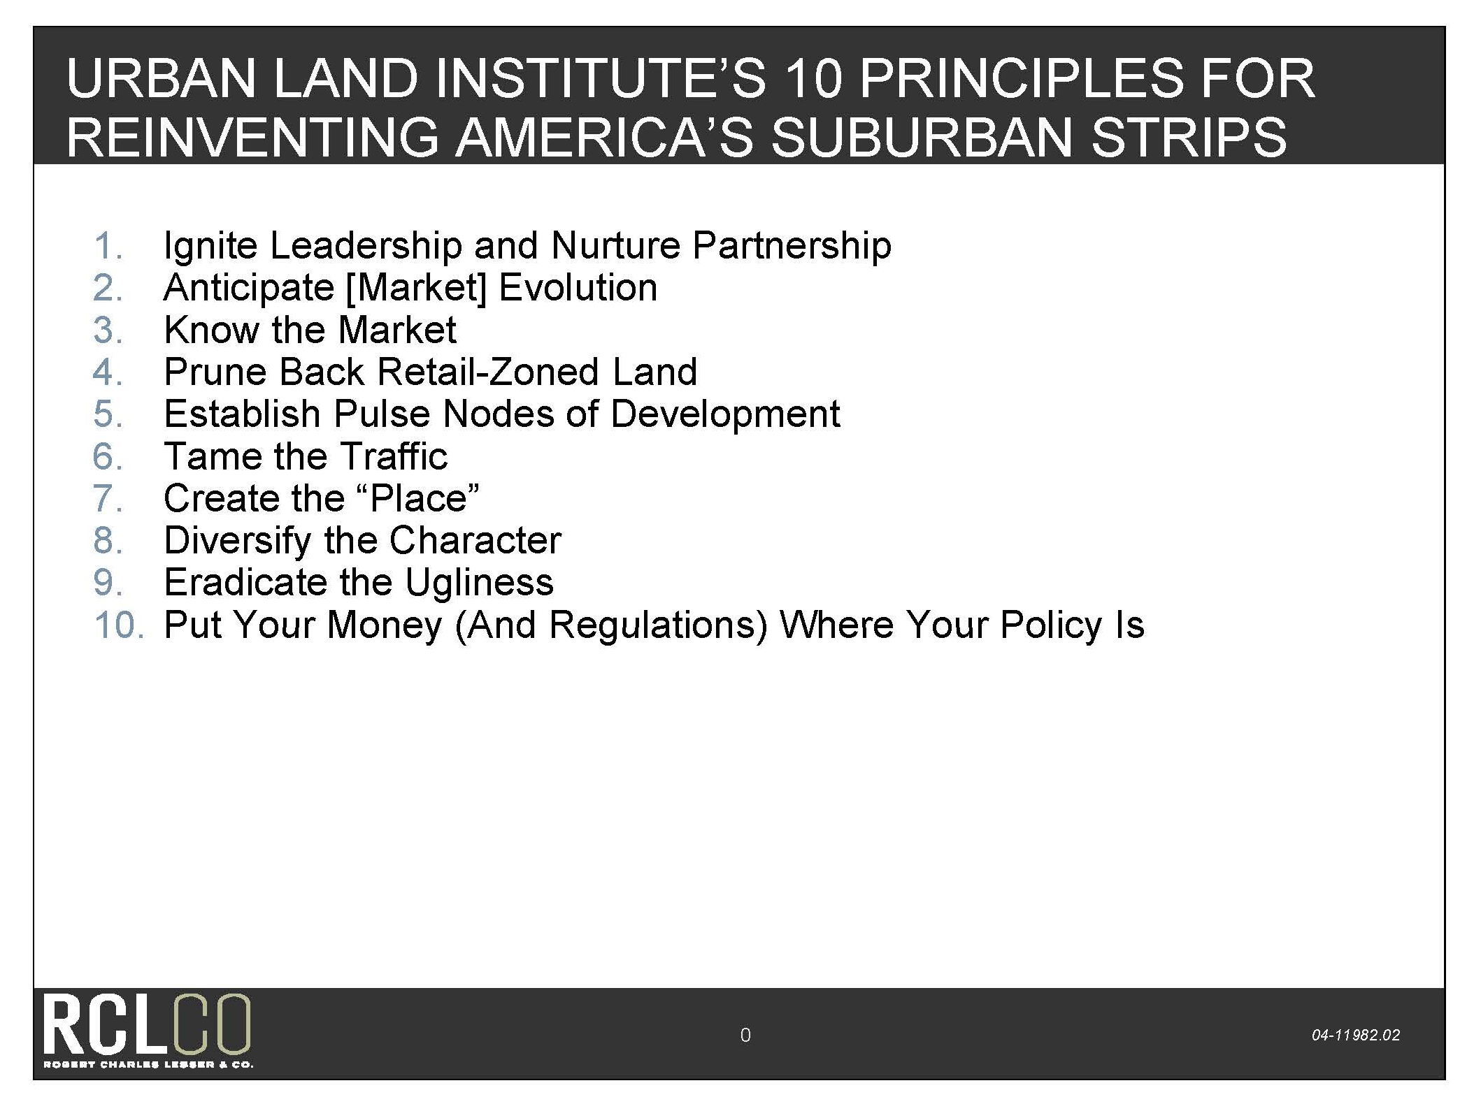

Slide 42
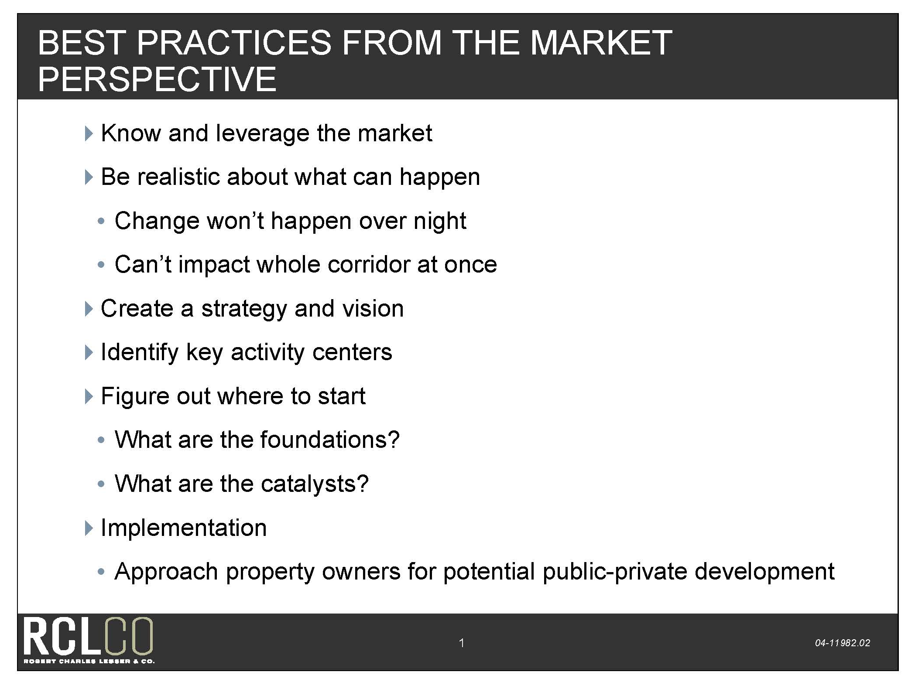

Slide 43
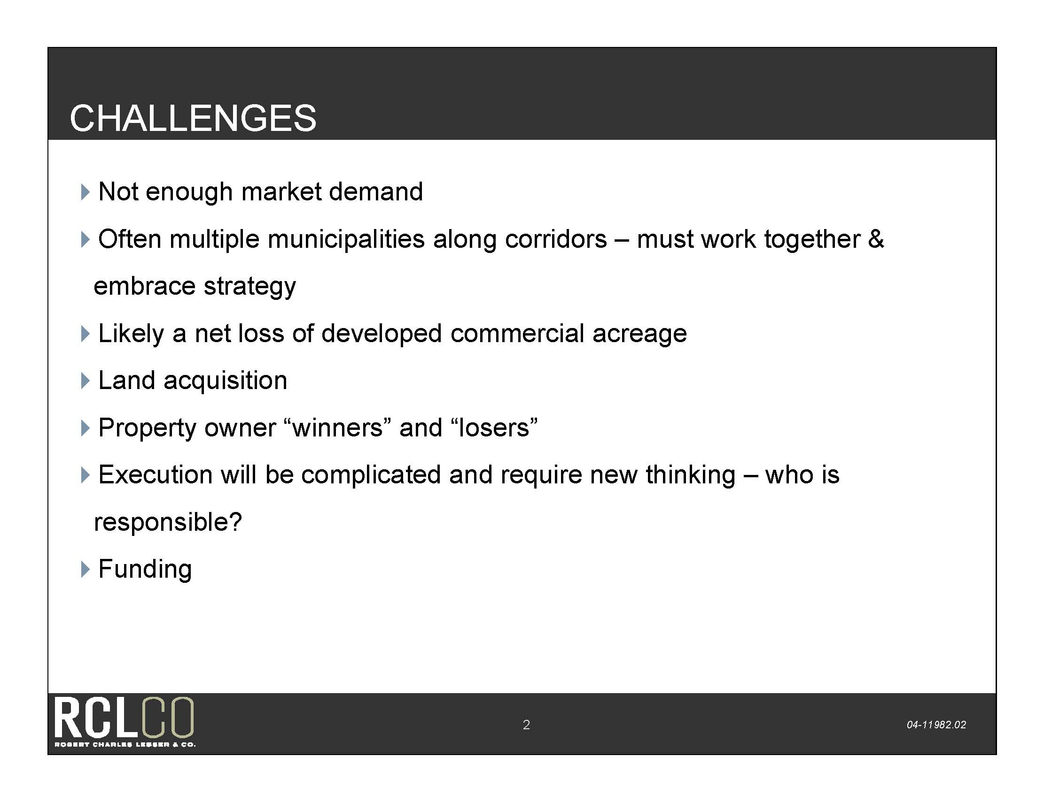

Slide 44
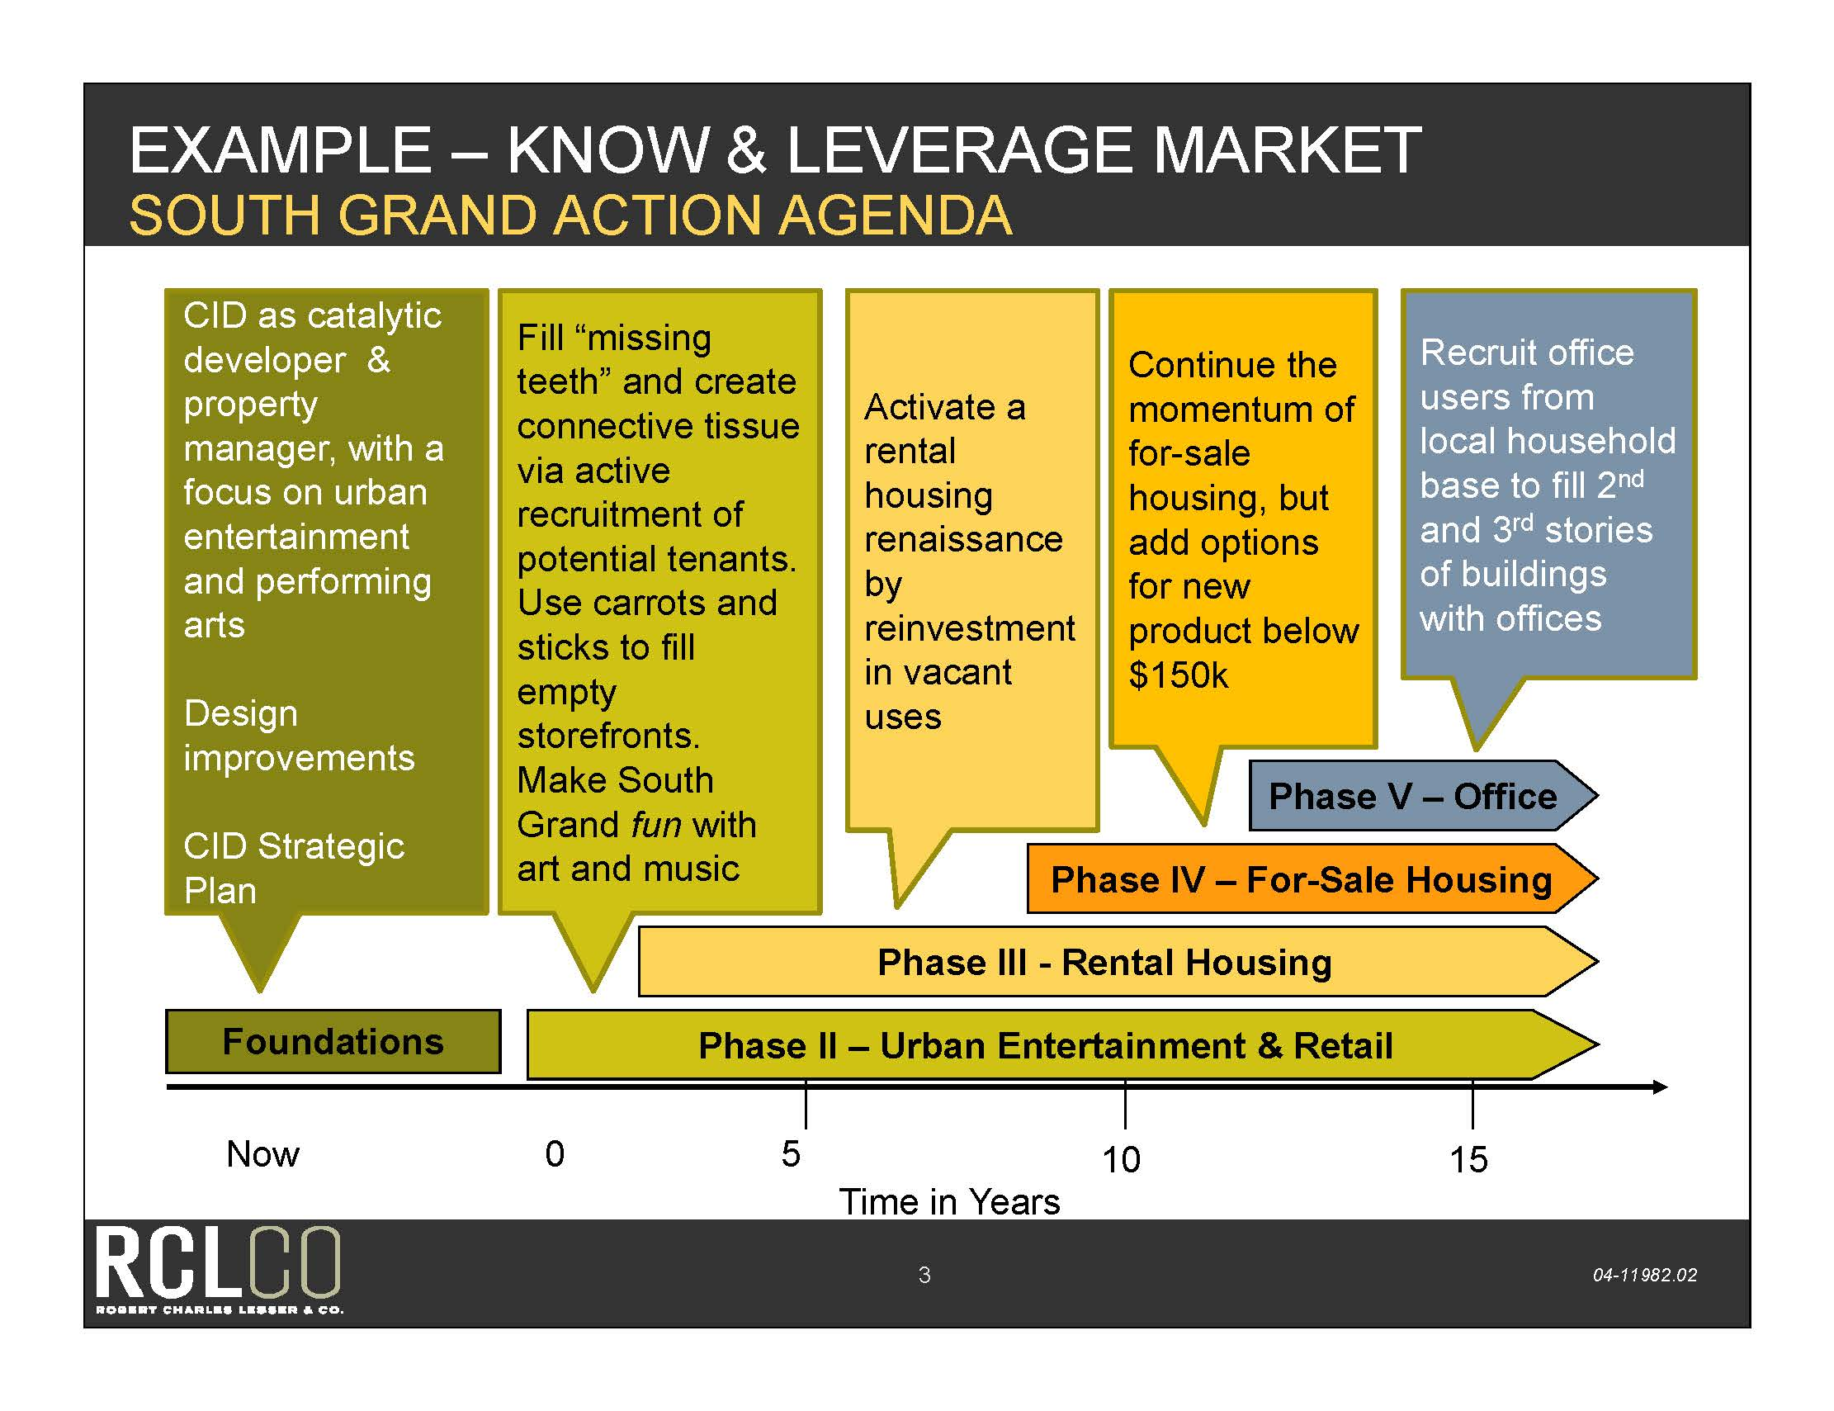

Slide 45
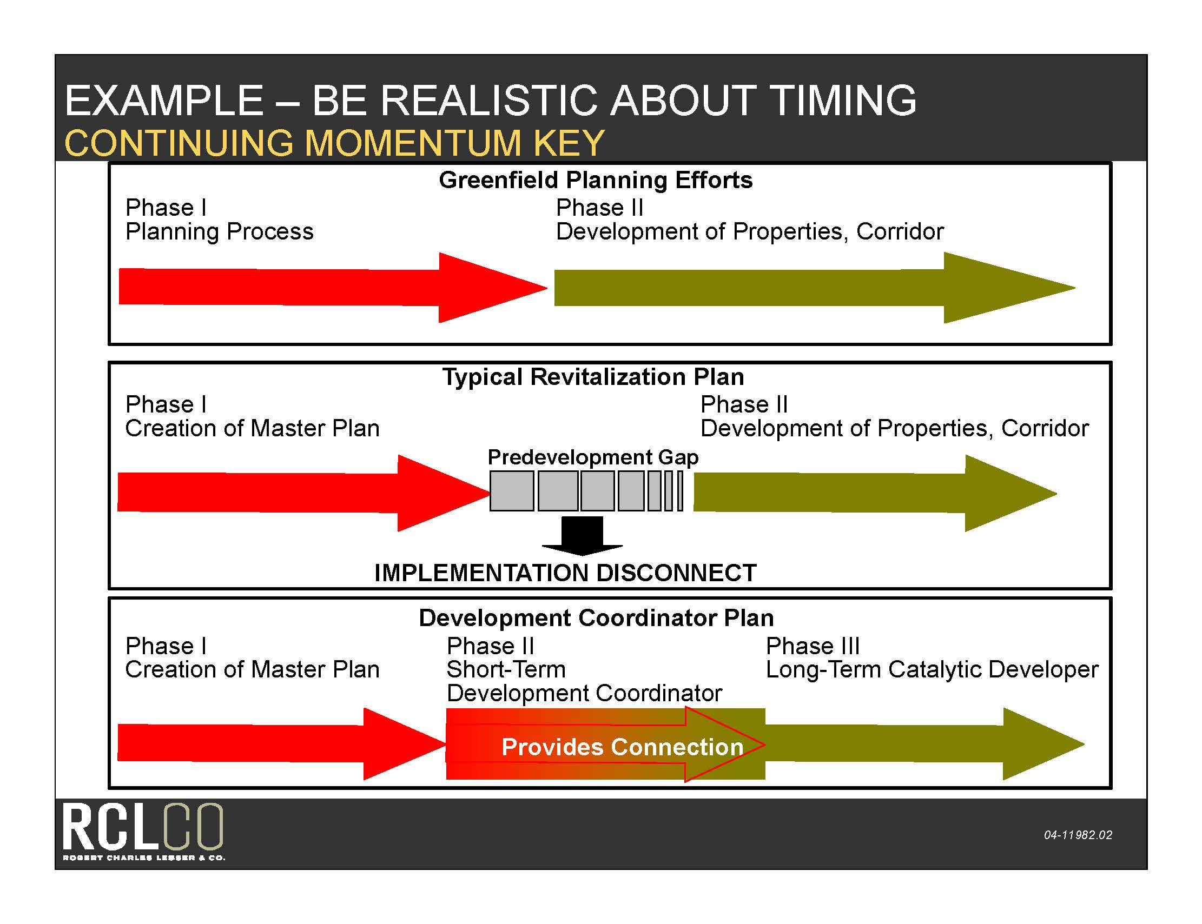

Slide 46
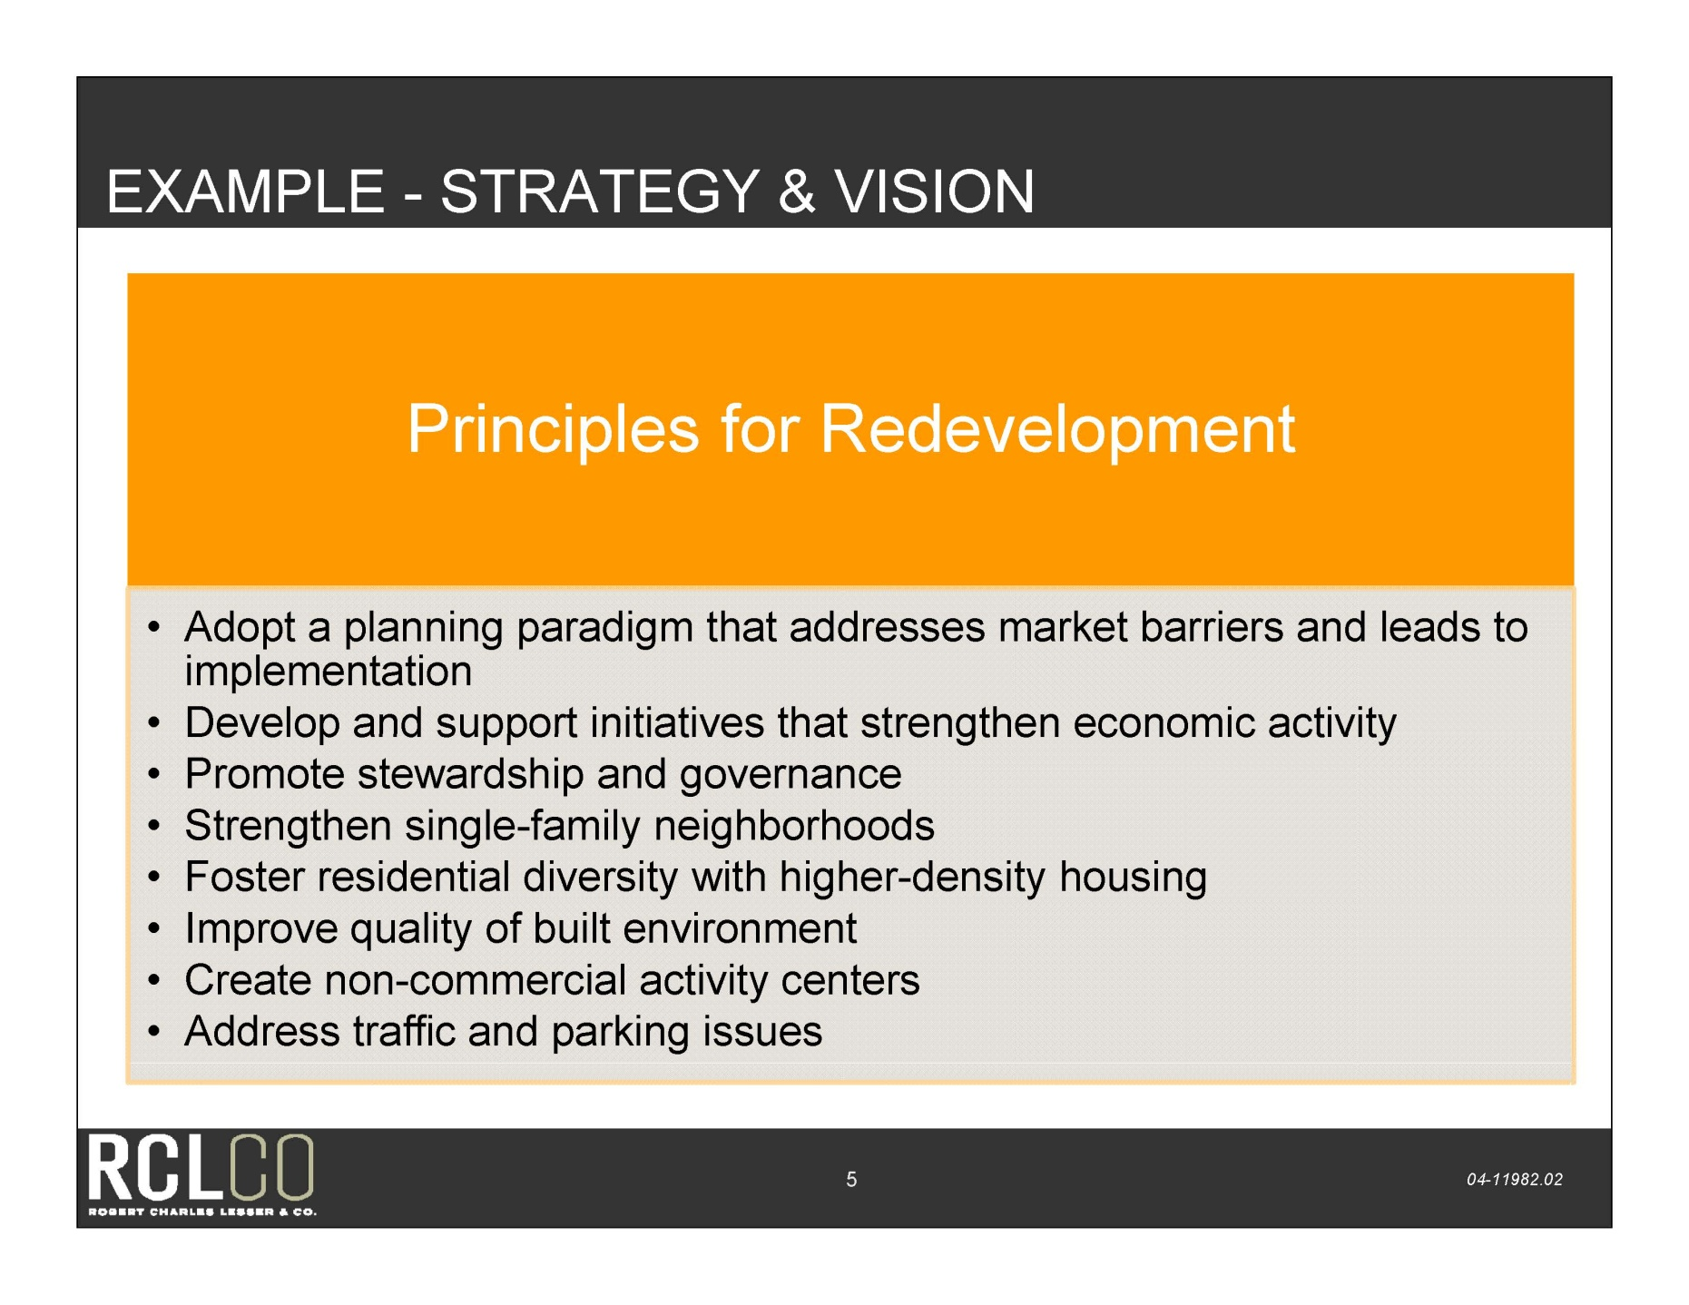

Slide 47
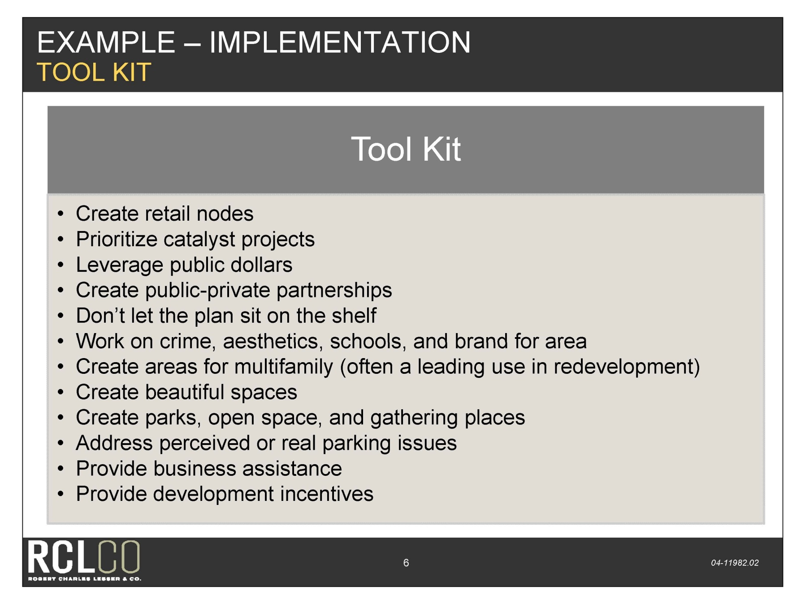

Slide 49
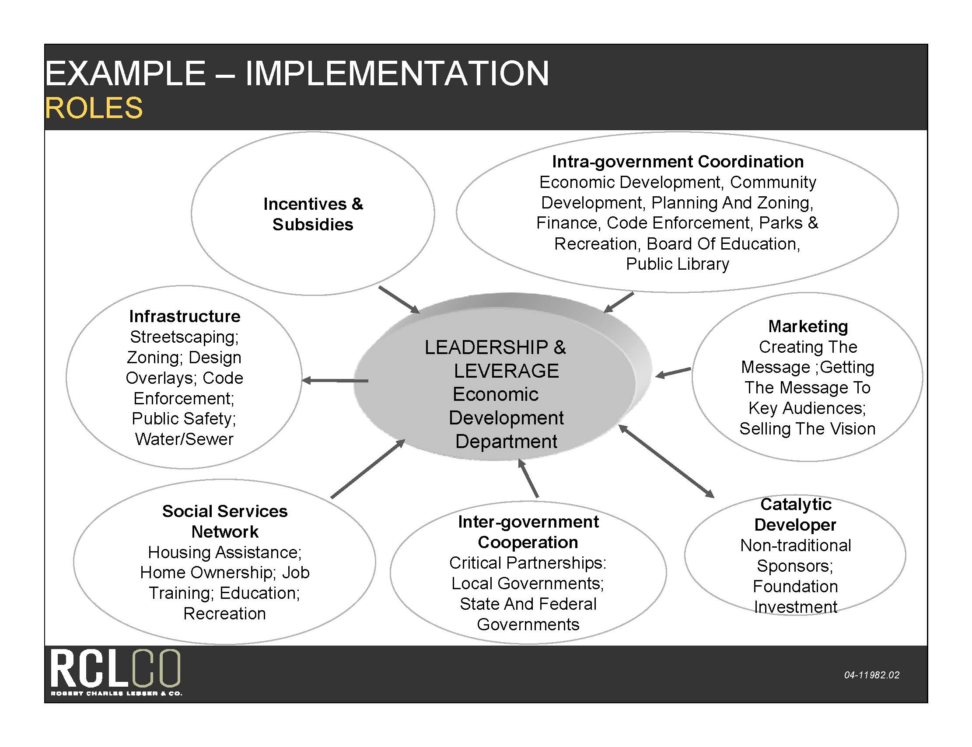

Slide 50


Slide 51


Slide 52


Slide 53


Slide 54

Corridor Redevelopment from a Developer’s Perspective…….
Tom Harmer, ICMA-CM
Senior Vice President
The Pizzuti Companies
Orlando, Florida
407-841-0000

Slide 55


M
M
A
Market, Math, and Attitude

Slide 56

Market Demand

Slide 57

Math: The Financial Deal

Slide 58

Attitude

Slide 59
Corridor
Redevelopment

