Slide 1
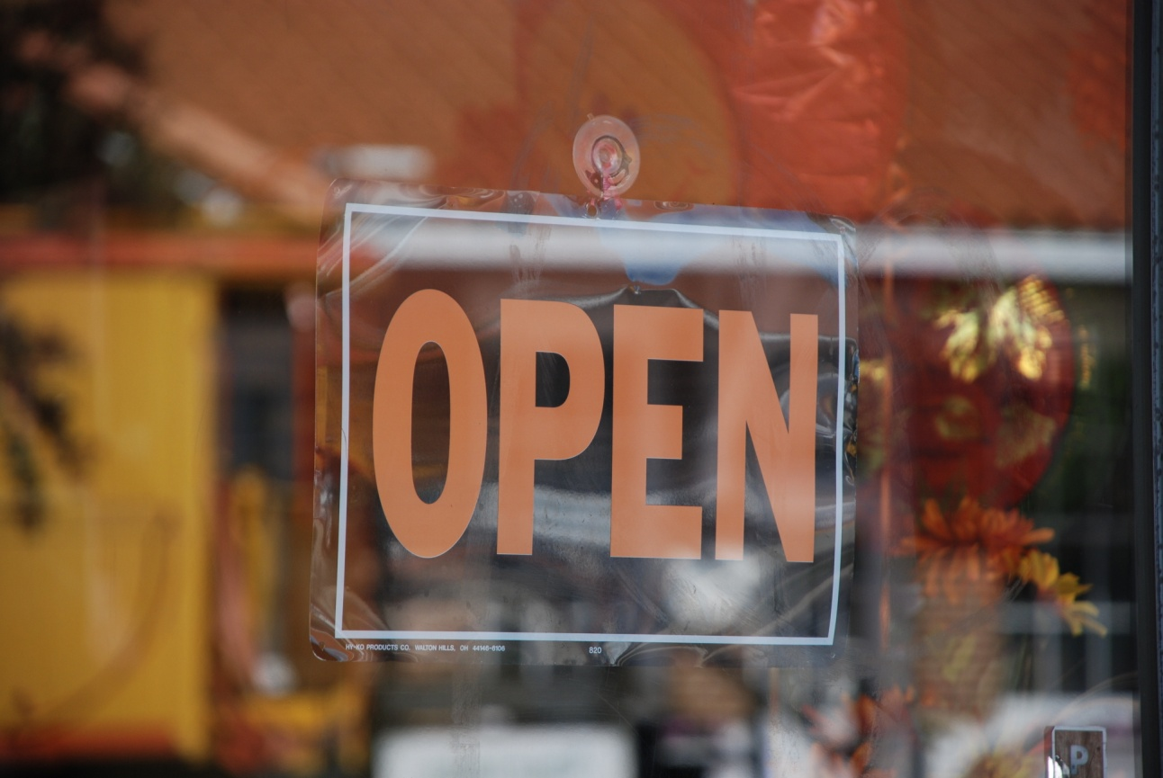

BUY LOCAL PROGRAM
City of Winter Garden

Slide 2
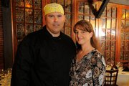
Community conditions
Downtown Winter Garden is 100% Local - Over 200 Businesses
Downtown serves West Orange Communities – 110,000 People

Slide 3
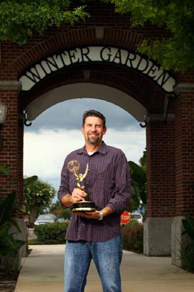
Economic facts
2,300 Businesses in Winter Garden
20,000 Employees
36,000 Residents
Business to Business
Business Spotlight

Slide 4
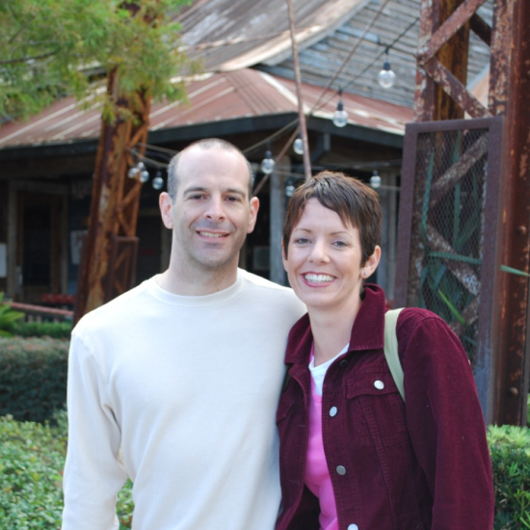
WHY BUY LOCAL?
Research demonstrates that local, independently owned businesses generate more than three times the return to our local economy than do national chain stores.

Slide 5
Buy local campaign
Builds Awareness
Support Local Businesses
Builds Community
Provides a Connection
$100 spent with locally owned businesses = $45 to local economy
$100 spent outside the local community = $13 to local economy

Slide 6
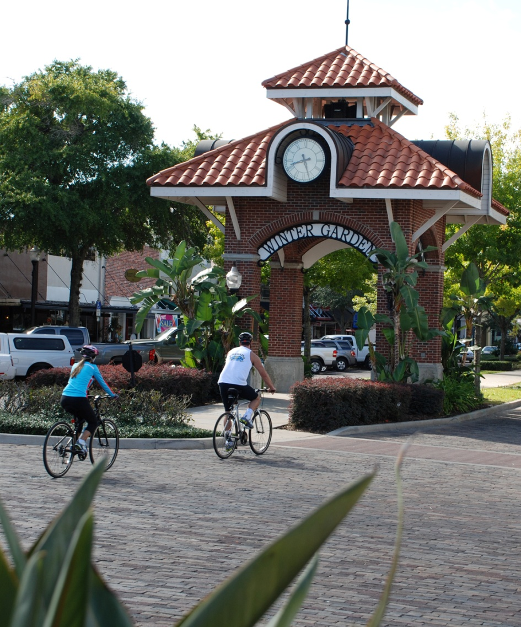
Why do it?
Did you know that by shifting just 10% of your purchases to locally owned businesses, you create more local jobs, lighten the impact on the environment, expand shopping and entertainment options, and build a stronger community?

Slide 7
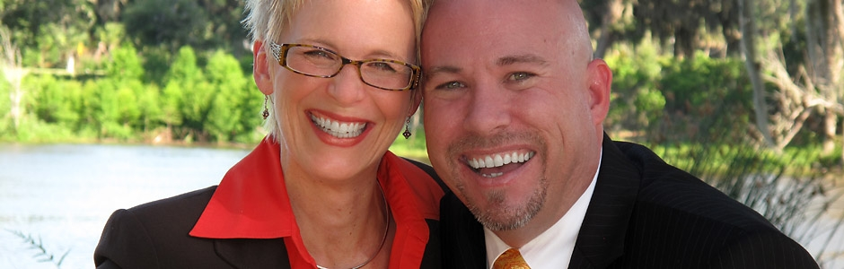
connections
Put a Face to a Business
Newsletters & Newspapers
Radio & TV
Digital Media
Welcome Packet
Marketing Kits

Slide 8
www.WinterGarden-FL.gov
407-656-4111

