Slide 1
Florida Redevelopment Association
2011 Annual Conference
Business Awareness Marketing
Sharon McCormick
Communications Director
Redevelopment Management Associates (RMA)

Slide 2
Retail Promotion:
Bookmark your way through Northwood Village…
A register to win promotion designed to drive restaurant patron traffic to retail shops.
Notes:
In this register to win promotion, restaurant patrons were given an artfully designed bookmark with their check. The idea was to collect all 4 bookmarks. Each bookmark included a unique list of shops on the back and a register to win card that had to be submitted at one of the shops listed on the back of the bookmark. Retail shops collected the register to win cards for 3 months and the winner won a $500 shopping spree in participating Northwood Village shops.

Slide 3
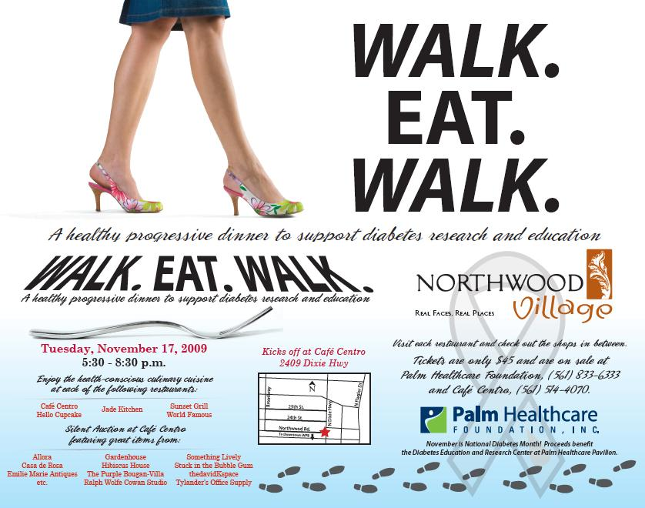
Restaurant Promotion:
Walk Eat Walk Tour…
A fundraising event for diabetes awareness through Palm Healthcare (a non-profit organization) involving all of the restaurants in the 6 block commercial redevelopment district.
Notes:
This event and promotion was developed in conjunction with a local non-profit to build awareness about diabetes and Northwood Village restaurants. A healthy progressive menu was coordinated with each of the 5 participating restaurants. Retail shops donated items for a silent auction. The event began and ended at a single location that hosted the silent auction. Attendees walked the district to enjoy culinary delights at each location.

Slide 4
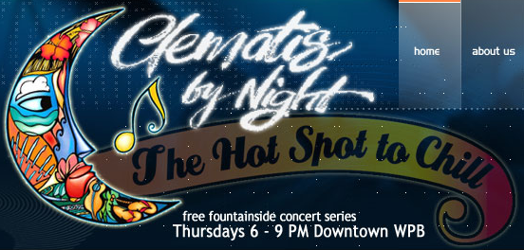
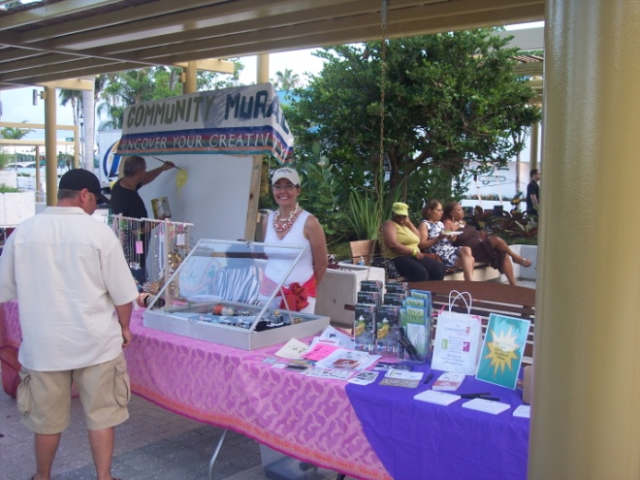
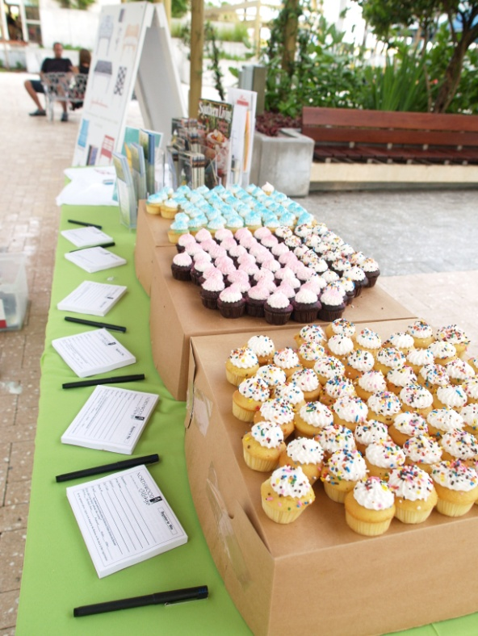
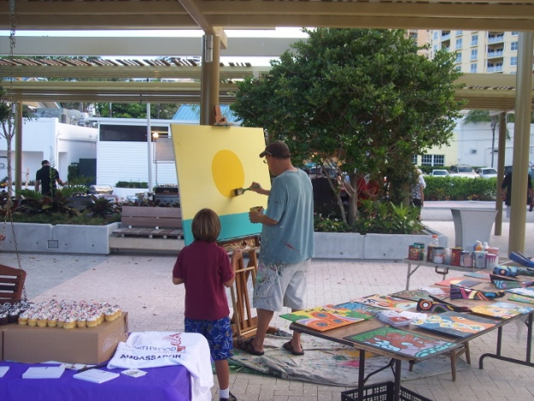
Incentives and Off-Site Promotions:
Monthly register to win promotional campaigns:
$100 Shopping Spree! -Every third Thursday, Northwood Village is a featured guest at the waterfront
Notes:
In appreciation of the visitors who take the time to learn about Northwood Village, monthly register to win promotional campaigns are held at the Art & Wine Promenade and at Clematis by Night. Every third Thursday, Northwood Village is a featured guest at the waterfront and everyone who visits the Northwood Village Showcase can register to win a
$100 Northwood Village Shopping Spree!

Slide 5
Special Events:
Spring & Holiday Bouquets
A discovery event to promote retail and restaurant businesses in a blighted commercial redevelopment area.
Notes:
These events were designed to facilitate discovery of shops and restaurants within a 6 block district. Live music, art and culinary demonstrations added value to the day while attendees strolled through the district. Each attendee received at the information booth, a few flower stems with tissue and a district map highlighting the 20+ shops and restaurants participating in the event. Attendees were given a different type of flower at each shop, so when they finished the tour, they went home with a huge, beautiful bouquet of flowers.

Slide 6
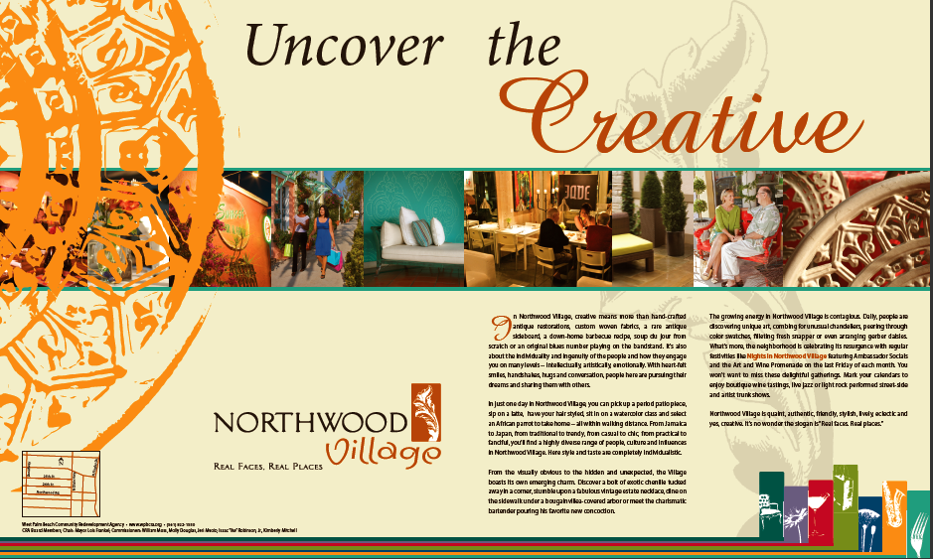
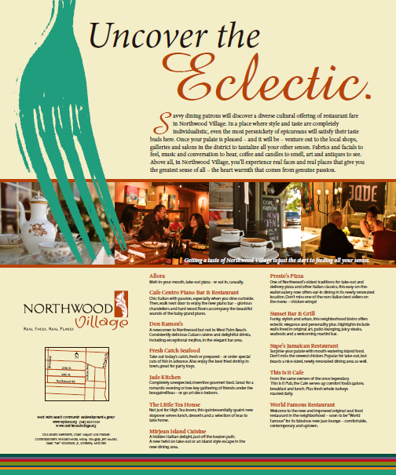

Co-op advertising retail
Events & Promotions Assistance Grant Program:
Designed to offer financial and promotional support to new and emerging events and promotions by individual business owners or a group of businesses.
American Heart Association event at Jade Kitchen
Co-op advertising restaurants
Notes:
The events and promotions assistance program was designed to increase the number of events taking place in the district. As a matching grant of up to $1000, individual business owners or a group of businesses could develop an event idea or cooperative ad campaign and apply for up to $1000 (if the event was $2000 or more – grant would be $1000…if the event was less, they could qualify for half of the total cost.

Slide 7
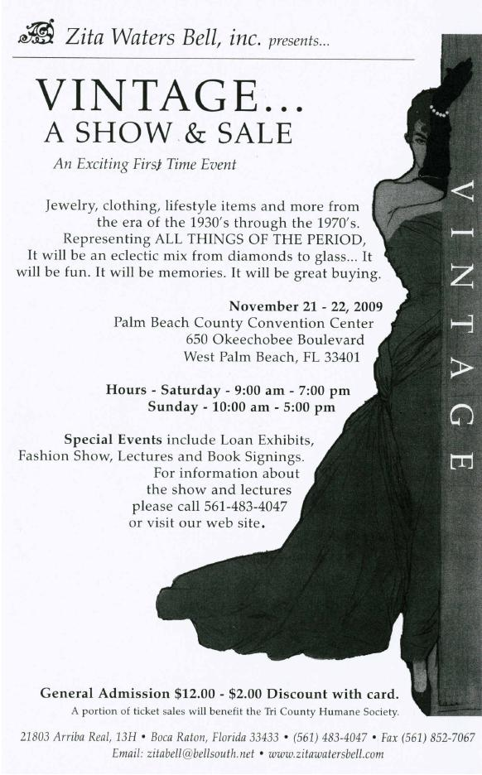
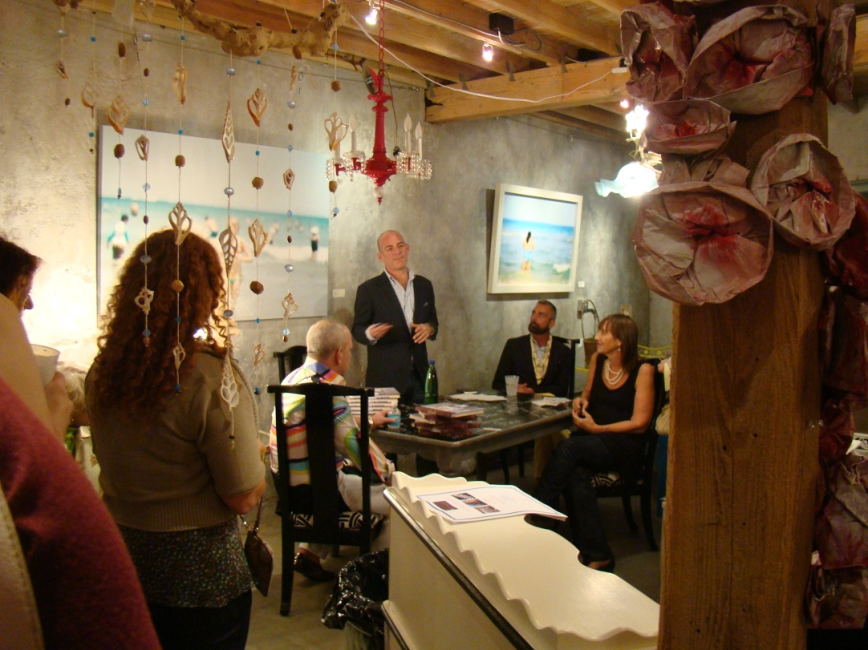
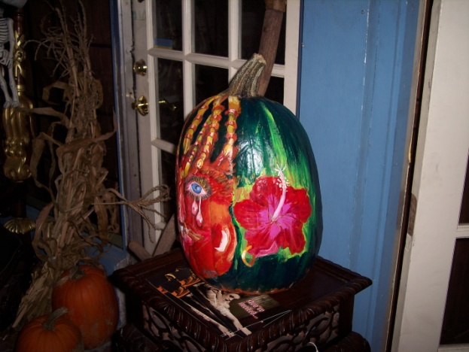
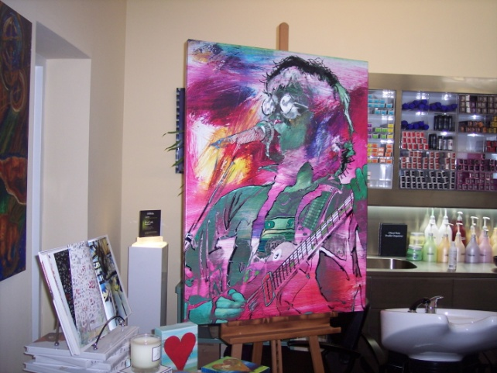

Stan Williams - Booksigning event at Gardenhouse with the Historical Society of Palm Beach County
Art & Humanities Month pumpkin painting promotion
Art for Autism event at the davidKspace

