Slide 1
Florida Redevelopment Agency Annual Conference – October 20, 2011 Orlando, Florida Marjorie Ferrer, DDA

Slide 2
2010-2011 Marketing & Promotion Program
Marketing Goal: To strengthen the brand and increase
awareness of the downtown businesses that will result in
positive economic growth
Strategies:
Consistently utilize the Night and Day brand within all advertising and promotional materials
Enhance the Monthly Merchant Advertising Promotion
Identify the core customer
Expand the Reach of the consumer audience
Print / Online / Social Media / Multi Media
Broaden the reach of customers

Slide 3
2010-2011 Recap: Monthly Brochures

Slide 4
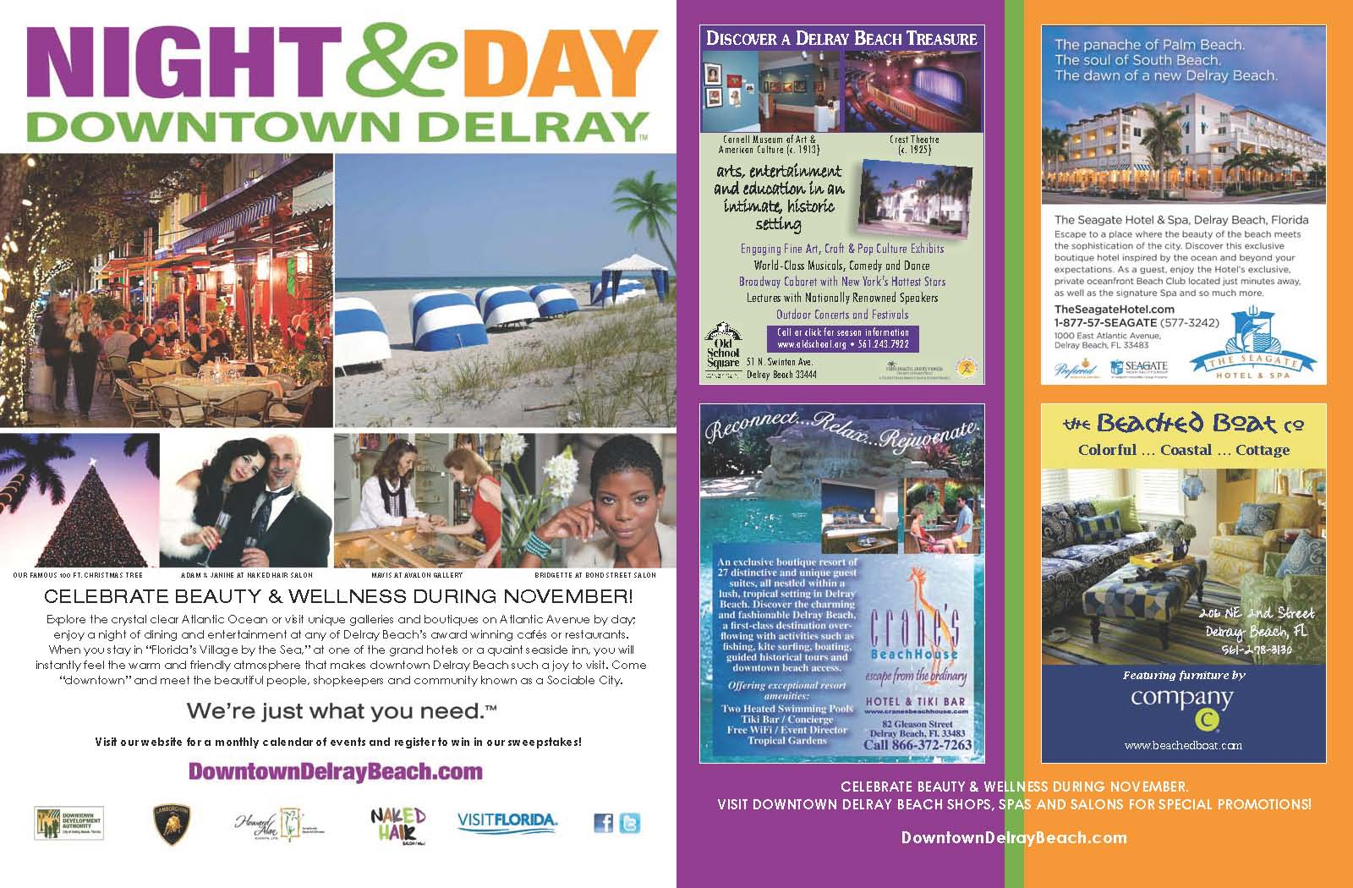
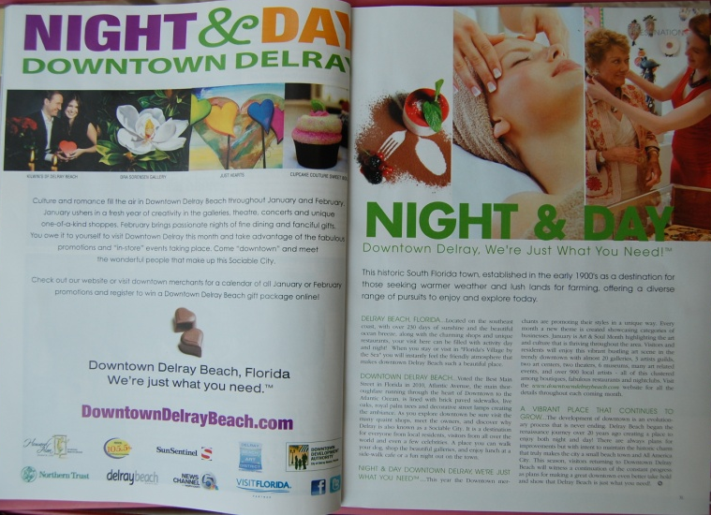
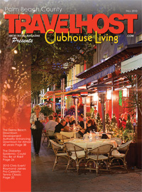
2010-2011 Advertising - samples
Monthly magazine ads
Negotiate Coop Opportunities for the Businesses to participate
Monthly magazine ads and editorial
Utilize photos of own businesses
Within the community as another
source of advertising
Monthly TV Spot

Slide 5
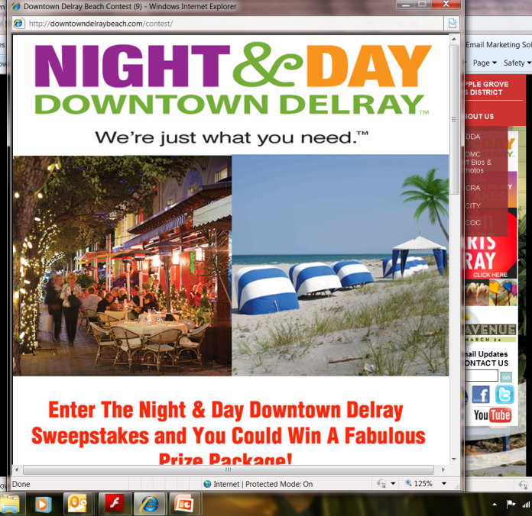
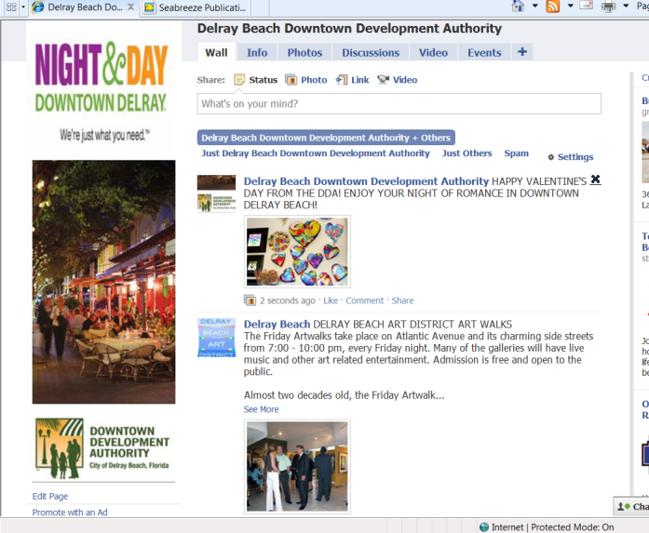
Downtowndelraybeach.com
Website:
156, 014 Total Visits
121,582 Unique
513,972 Pageviews

Slide 6
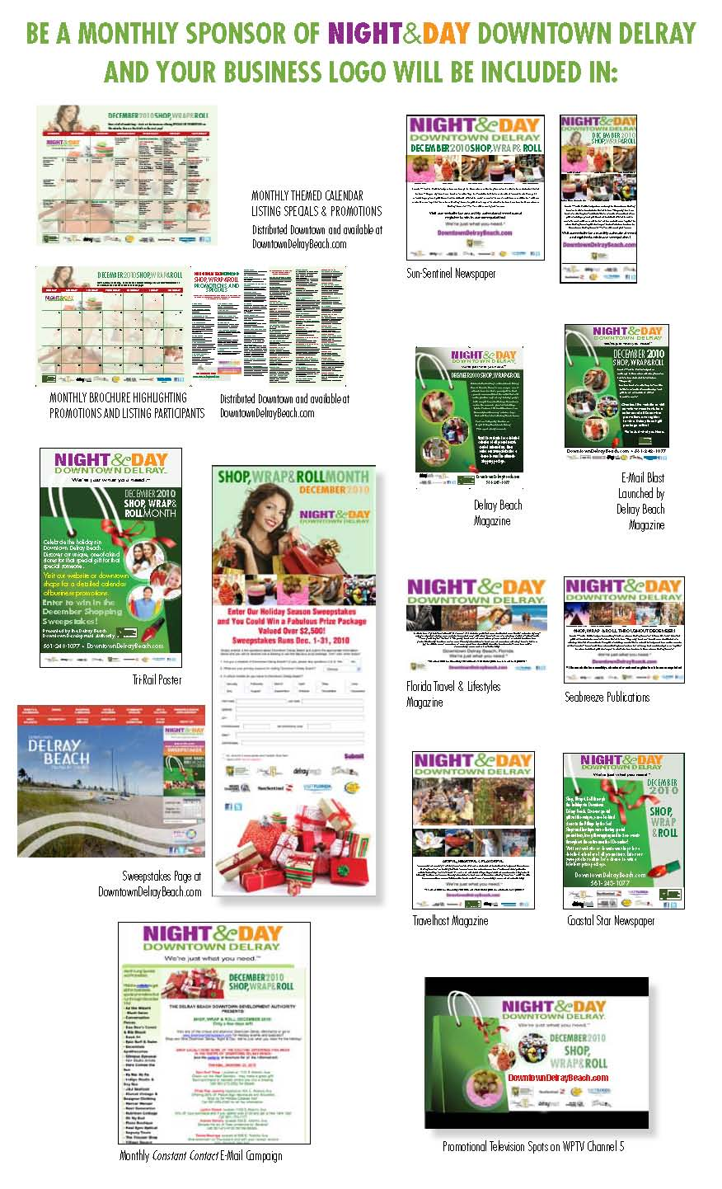
Monthly Snapshot

Slide 7
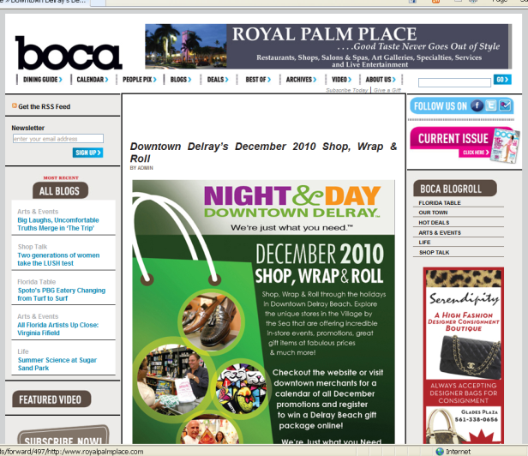
2010-2011 Marketing Summary
Efforts for the past 12 months (Oct. – September)
Target Audience: Local and Regional
Supporting the Downtown Brand & Merchant Program & Drive to the Website
Print Ads:
Over 50 Full and Half page Ads Designed & Produced
8 Editorial Pieces written
Newspaper and Magazine
Multi Media:
9 - TV Monthly Spots (WPTV Channel 5)
10 - Radio Spots (Clear Channel Radio)
Online:
Over 60 Online ads produces / e-blasts / articles
VisitFlorida, CVB, Sun-Sentinel, Clear Channel Radio,
DelrayMag.com, FL Travel Lifestyles
Notes:
Update with newer figures

Slide 8
2010-2011 Marketing Successes
Total Impressions : 49 Million Impressions
Print – 32 Million Impressions
Media – 13.5 Million
Online –3.1Million (includes Social Media outlets)
Email Blasts (constant contact): 28,260 emails opened / 785 opens per blast (29% rate) average (industry average 22%)
Total Leads and Database increases: 5,799 Customers
Sweepstakes:
Conducted 6 Sweepstakes through Night and Day Campaign (5 are completed)
Received 2,644 Total Entries
30% elected to receive DDA Updates
Publication Leads:
Received 5,026 Leads from VisitFlorida Visitor Guide Publication and Southern Living who receive direct mail updates
Notes:
Update figures

Slide 9
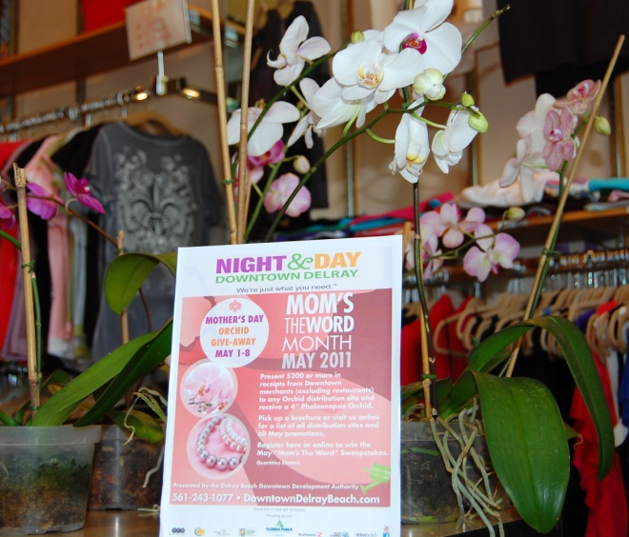
2010-2011 Marketing Investments
Total Business Participation
149 Merchants Participated
443 Total Specials or Promotions to include in store events
Overall Merchant Rating of the Program
85% Rank the overall Awareness Program Good to Excellent
90% of the merchants surveyed said that the program assisted in developing new customers
Comments:
“Love the Night and Day – it makes the town seem alive”
“Cannot measure the results but do believe it has increased awareness of my store”
“Love the design, the commercial – especially at primetime”
Total Marketing Investments:
DDA ‘s total: $101,343
In-Kind Received: $246,980
Sponsor Support: $67,349
Business Coop: $188,470
Total Value: $1,214,882
Economic Impact: $204,347,608
*American Arts Calculator

Slide 10
2011-2012
Marketing Campaign

Slide 11
2011-2012 Marketing & Promotion Program
Marketing Goal: To strengthen the brand and increase
awareness of the downtown businesses that will result in
positive economic growth
Strategies:
Consistently utilize the Night and Day brand within all advertising and promotional materials
Enhance the Monthly Merchant Advertising Promotion
Identify the core customer
Expand the Reach of the consumer audience
Print / Online / Social Media / Multi Media
Broaden the reach of customers

Slide 12
2011-2012 Marketing & Promotion Program
Strengthen the Brand
Continue to Market Locally and Regionally
Print / Online / Social Media / Multi Media
Build upon the Monthly Promotions
Broaden the reach of customers

Slide 13
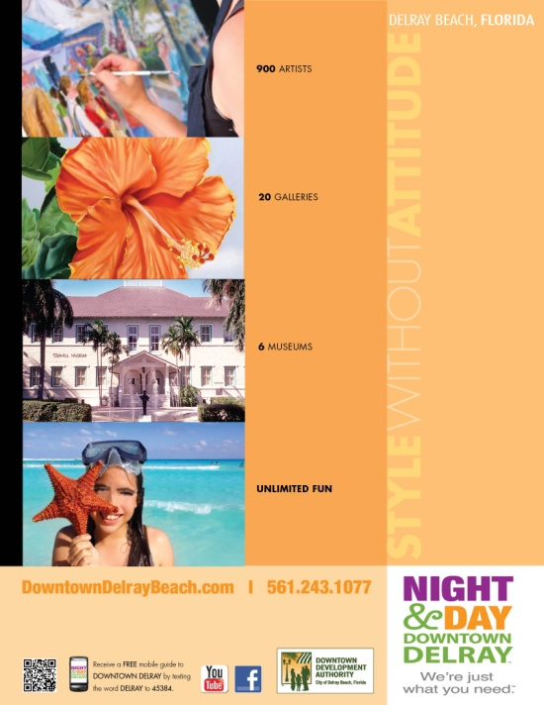
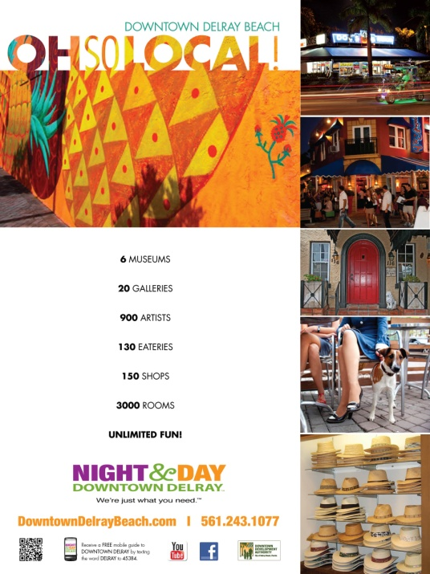
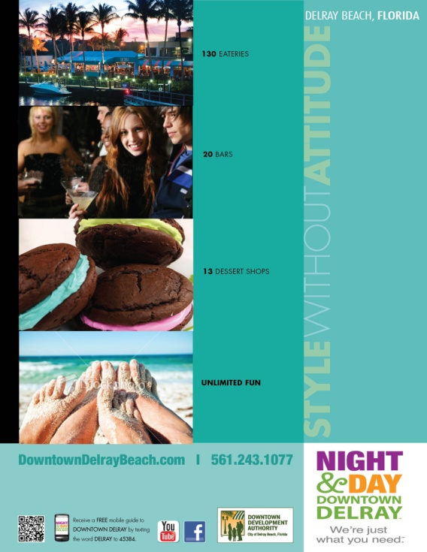
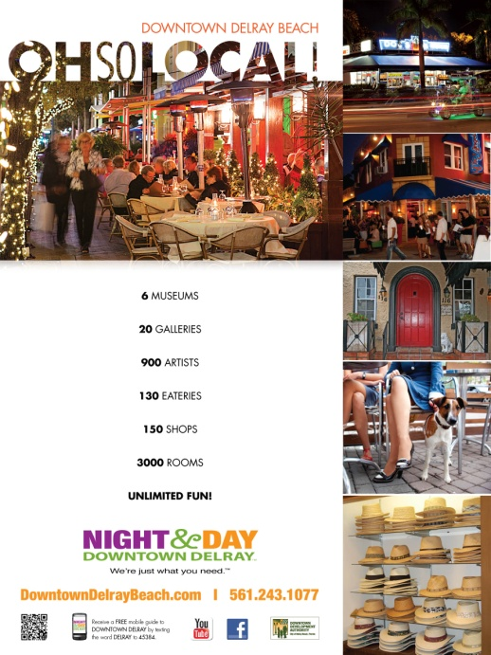
2011-2012 Marketing & Promotion Campaign
Proposed Design
Regional/National
Advertising
Proposed
Local
Advertising
‘Style Without Attitude” as quoted in NY Times, Jan. 16 article by Jonathan Vatner

Slide 14
Marketing & Promotion
Continue to Build Momentum
Continue to Produce the Monthly Brochure
Increase Merchant Participation
Increase awareness and drive sales
Grow impressions to exceed 100Million through all advertising vehicles
Brochure Concept

Slide 15
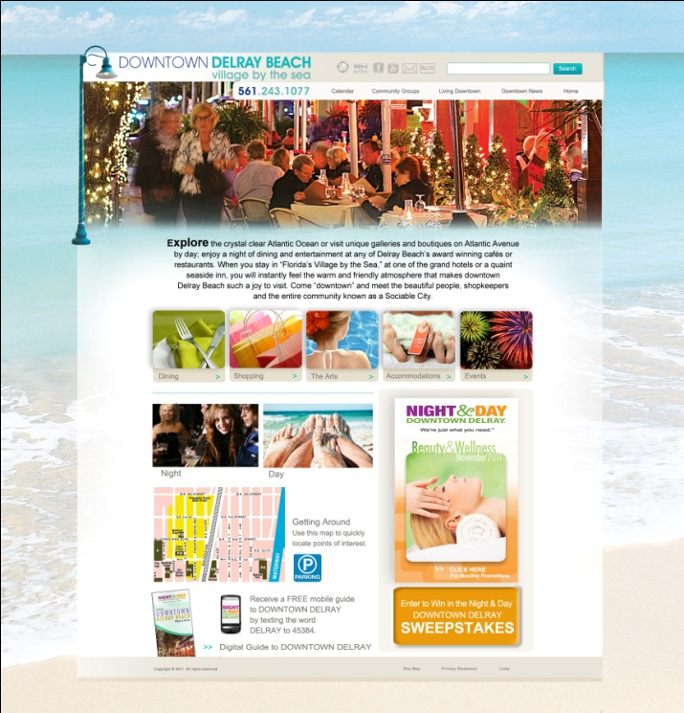
Marketing Campaign
Consistent Look throughout the marking pieces
Continually drive customers to the Downtown Website
Drive customers to social media sites and business websites

Slide 16
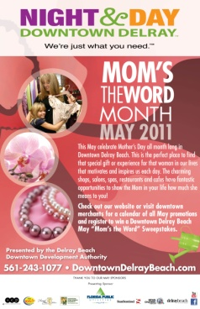
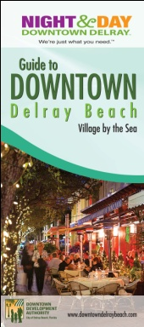
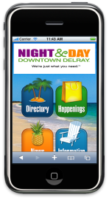
Advertising Vehicles
Print Media –Local and National Target
Brochures and Posters
Magazine and Newspaper
FL Travel and Life
Crossings – Canada
Delray Beach and Boca Magazine
Visit Florida Guide
FL Travel Monthly
Art and Culture
Palm Beach Post – TGIF
Downtown Guide Book
TV Commercial Spots – Local
Channel 5 and Comcast
.15 second spot
Merchant involvement
Crossings

Slide 17
Advertising Vehicles
Social Media/Online - Local and National target
Email Blasts weekly
Face Book
Target Advertising
Visit Florida
Website posting
Palm Beach Convention and Visitor Bureau
Website posting
Travel Writer Blogs
Mobile Website
Smartphone users
QR Codes
Creative marketing messages

Slide 18
2011-2012 Marketing & Promotion Impressions
Increase in Print Media (local and national)
30 Million
Increase Television (local)
35 Million
Increase in Internet/Social Media
50 Million
Grow impressions to exceed 100Million through all advertising vehicles

Slide 19
Monthly Brochure Details
Monthly Merchant Campaign Continues:
Brochure Themed Promotions and Posters
Themes:
October: Celebrating our Heritage – Highlighting the Centennial
November: Beauty & Wellness Month
December: Holiday Shopping in Delray Beach
January: Art & Fashion Month
February: The “Heart” of Delray Month
March: Culinary Month
April: Earth Month
May: Mother’s Day Promotion
June/July: Summertime Downtown
August/Sept.: Love the Local

Slide 20
Opportunities
Co- Op Advertising with the
DDA
Monthly Promotions and Partnerships
Magazine Ads
Television & Cable
Mobile Website
Guidebook
Maximize exposure and spend

Slide 21
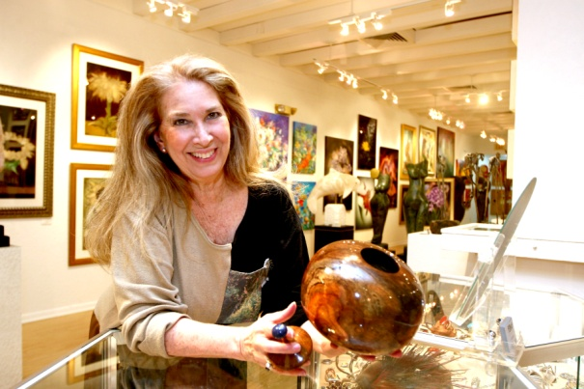
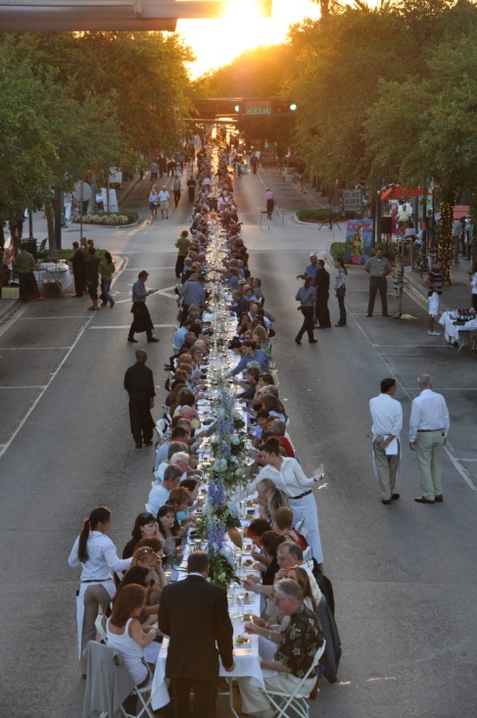
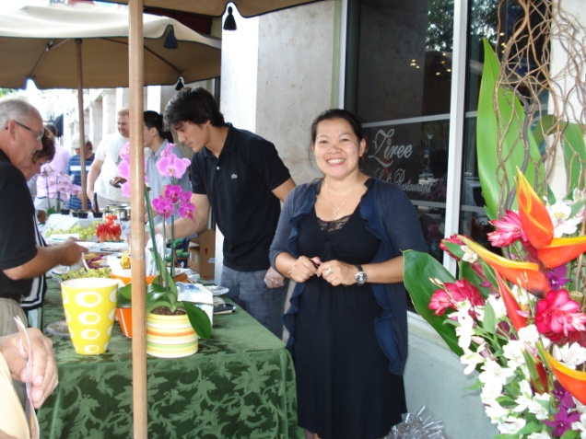
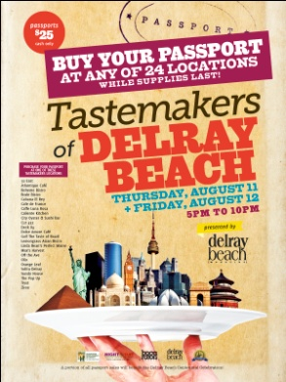
Additional Marketing Success
Tastemakers of Delray Beach
Savor the Avenue – Nation’s Longest Dining table (served 1000 people)
Reusable Tote Bag Giveaway
Earth Day on the Avenue
Successful Retail Promotions – Valentine’s Day and Mother’s Day

Slide 22
Contact us:
Marjorie Ferrer, Executive Director
mferrer@downtowndelraybeach.com
Laura Simon, Associate Director
lsimon@downtowndelraybeach.com
561-243-1077
downtowndelraybeach.com

