Slide 1
Advancing the New Urban Paradigm
Florida Redevelopment Association
Annual Conference
October 20, 2011
Kevin Tyjeski, AICP, LEED AP
Interim Deputy Economic Development Director
City of Orlando, Florida

Slide 2
What is Urban Design?
The arrangement of buildings to define space and create opportunities for social interaction.
If buildings are too far apart, they are unrelated objects sitting is space.
If buildings are close to the street and to each other, they define space, creating memorable places.
-- Based on Allan Jacobs and Donald Appleyard, 1987, Toward an Urban Design Manifesto.

Slide 3
Why is Urban Design Important?
It can improve our quality of life; it can make us feel better.
It can create places that we care about.
-- Based on Paul Goldberger, 2009, Why Architecture Matters.

Slide 4
Reference Projects
Baldwin Park Planned Development
SoDo Town Center
Dr. Phillips Center for the Performing Arts

Slide 5
Baldwin Park Planned Development
Developer - Orlando NTC Partners
Site - 1,096 acres, New Urbanist mixed-use neighborhood
Development Program
Attached Residential: 3,202 dwelling units
Detached Residential: 1,128 dwelling units
Total Residential: 4,400 dwelling units
Office: 614,000 sq. ft.
Civic: 244,000 sq. ft.
Village Center Retail: 190,000 sq. ft.
Village Center Office: 226,000 sq. ft.
Status
PD approved July 1998
All development approvals in place

Slide 6
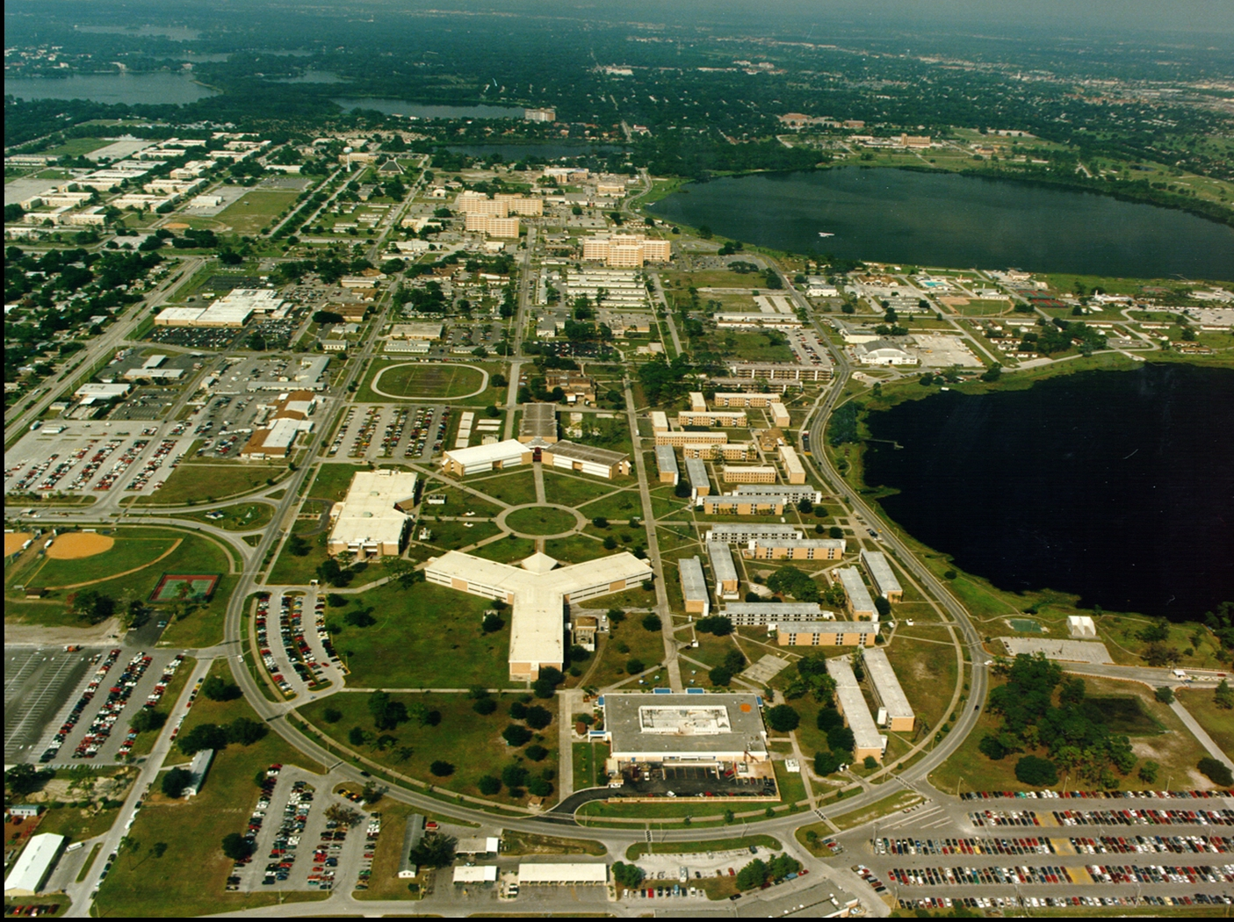

Slide 7
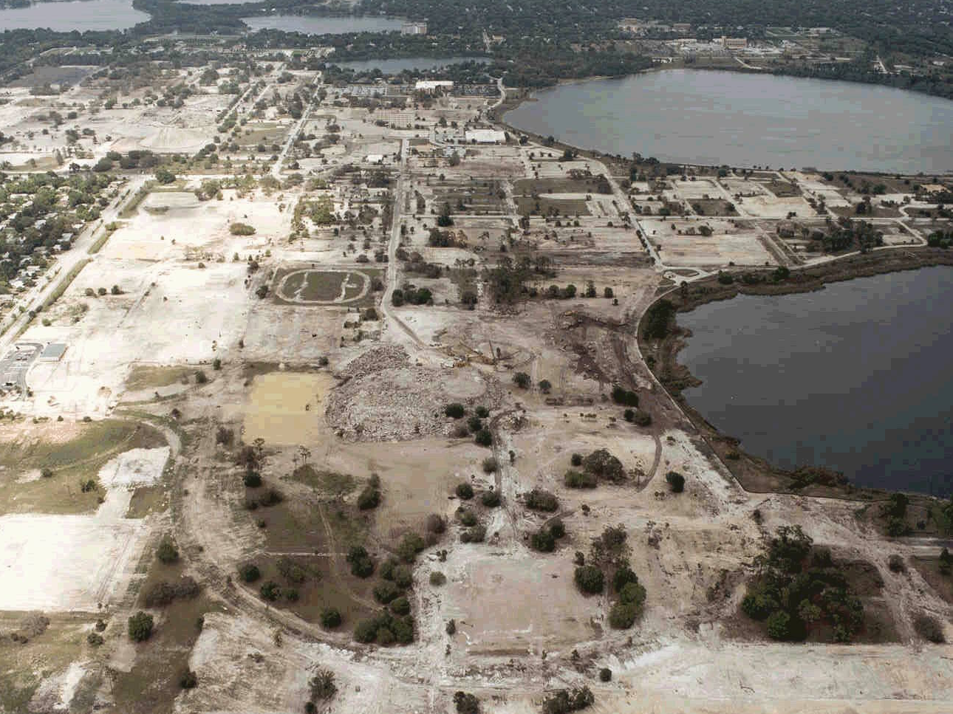

Slide 8
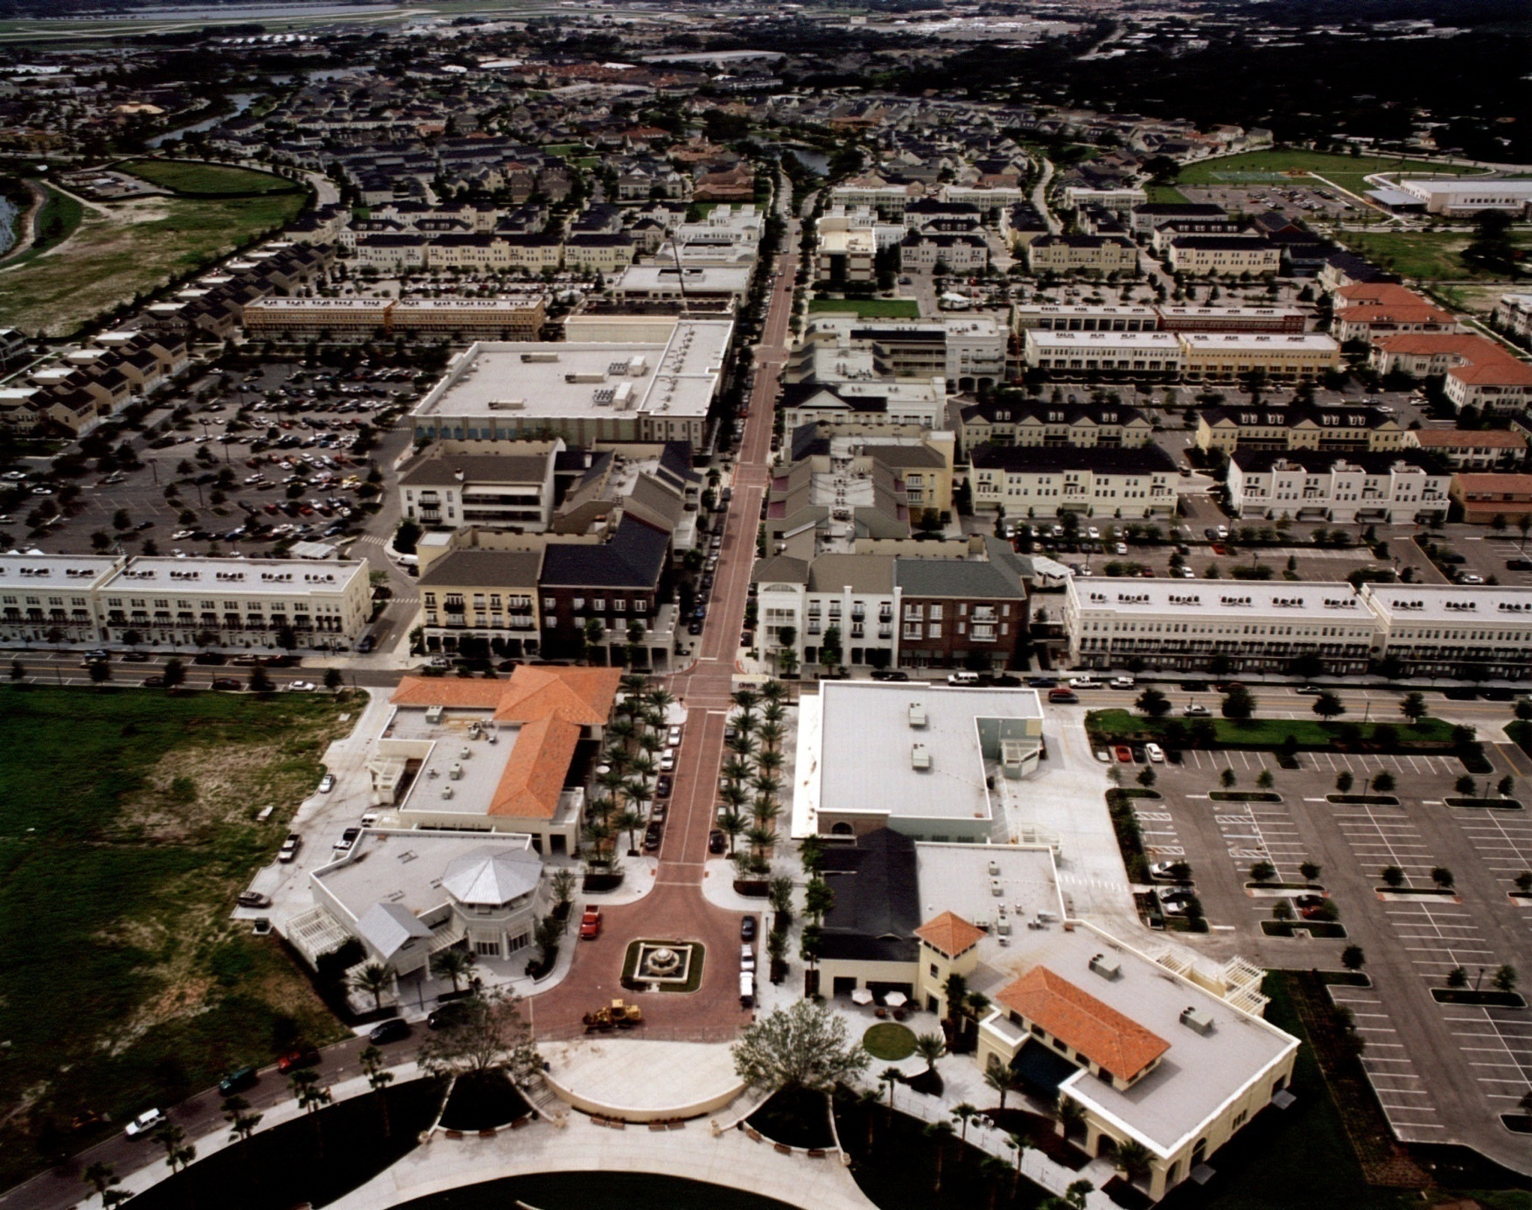

Slide 9
SoDo (South of Downtown Orlando)
Developers
Kimco Realty Corp.
Wood Partners
North American Properties
Site - 22 acres, urban infill main street
Development Program
Office: 75,000 sq. ft.
Residential: 300 dwelling units
Retail/Restaurants: 370,000 sq. ft.
Status
PD approved July 2006
Grand Opening October 2008

Slide 12
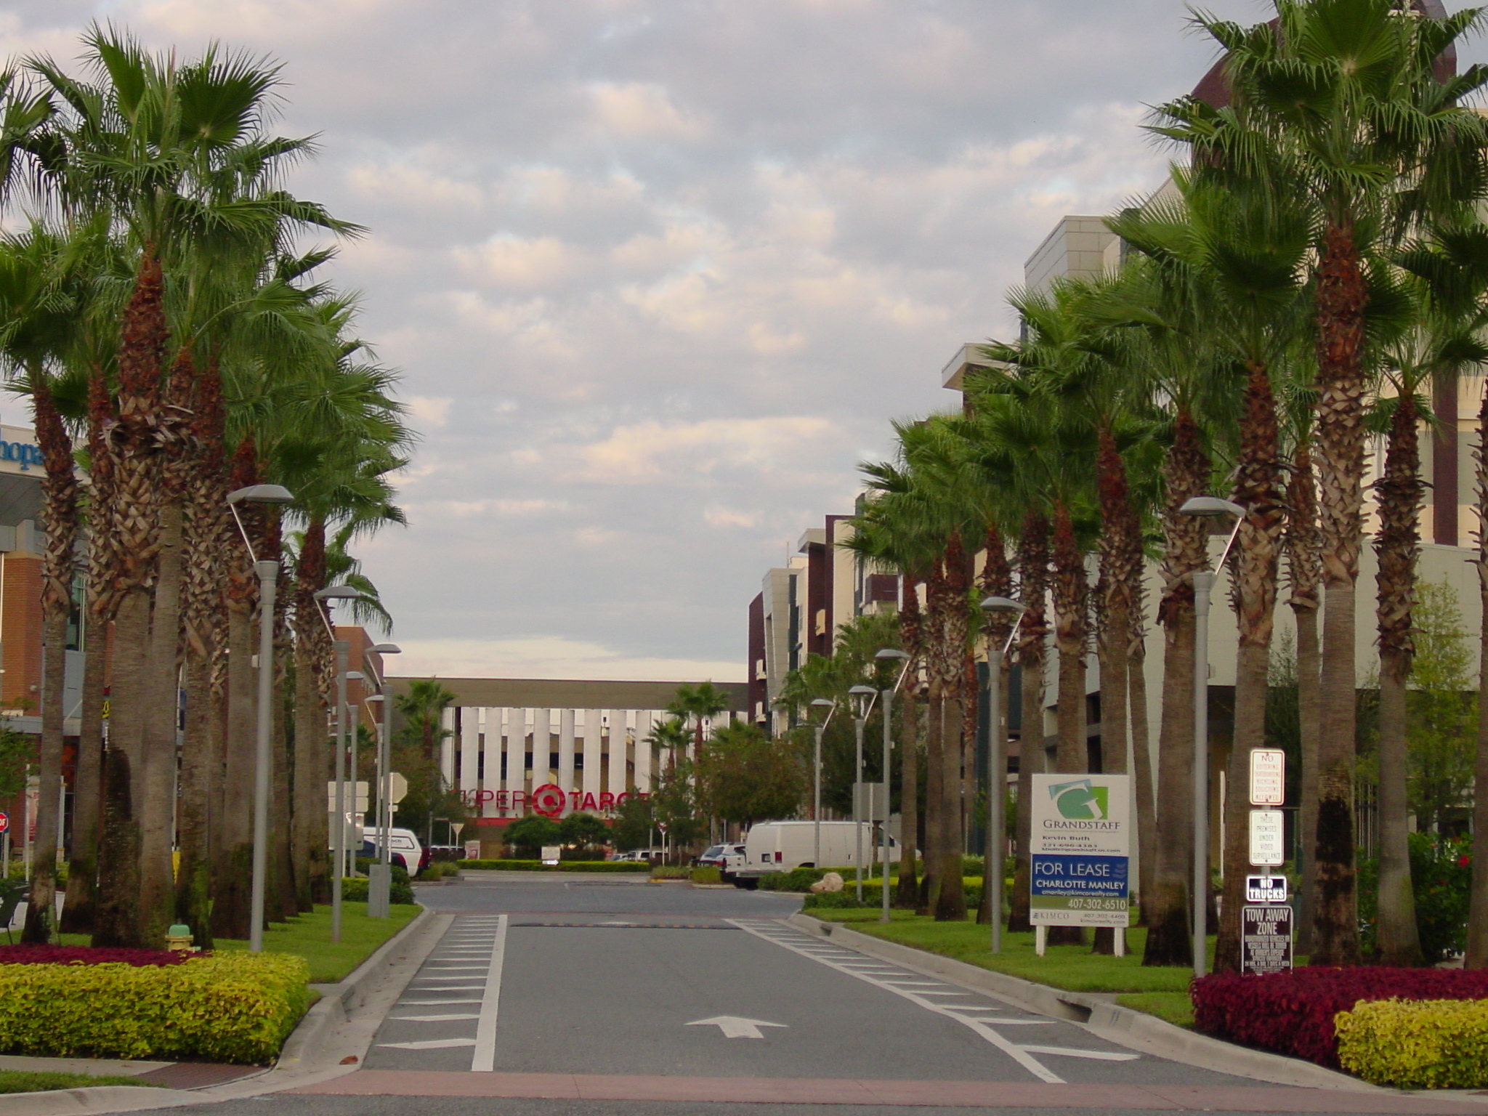

Slide 13
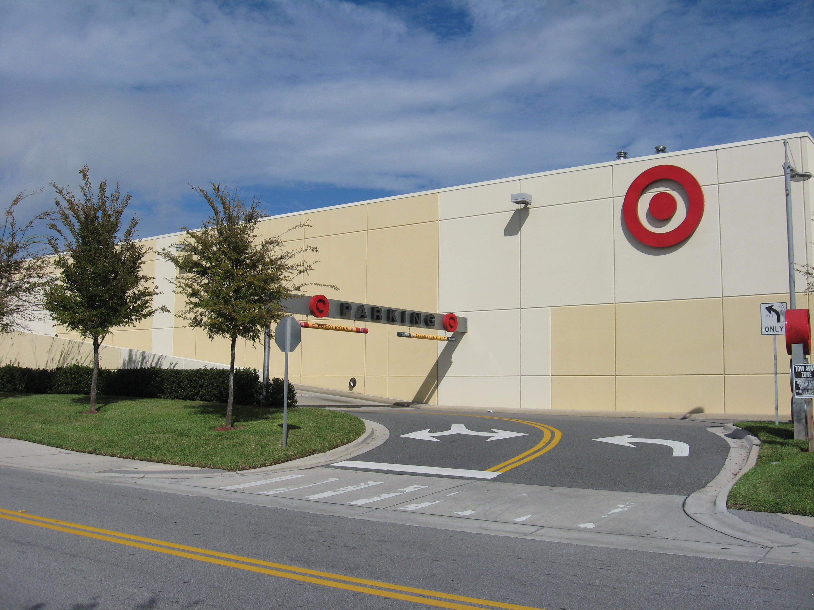

Slide 14
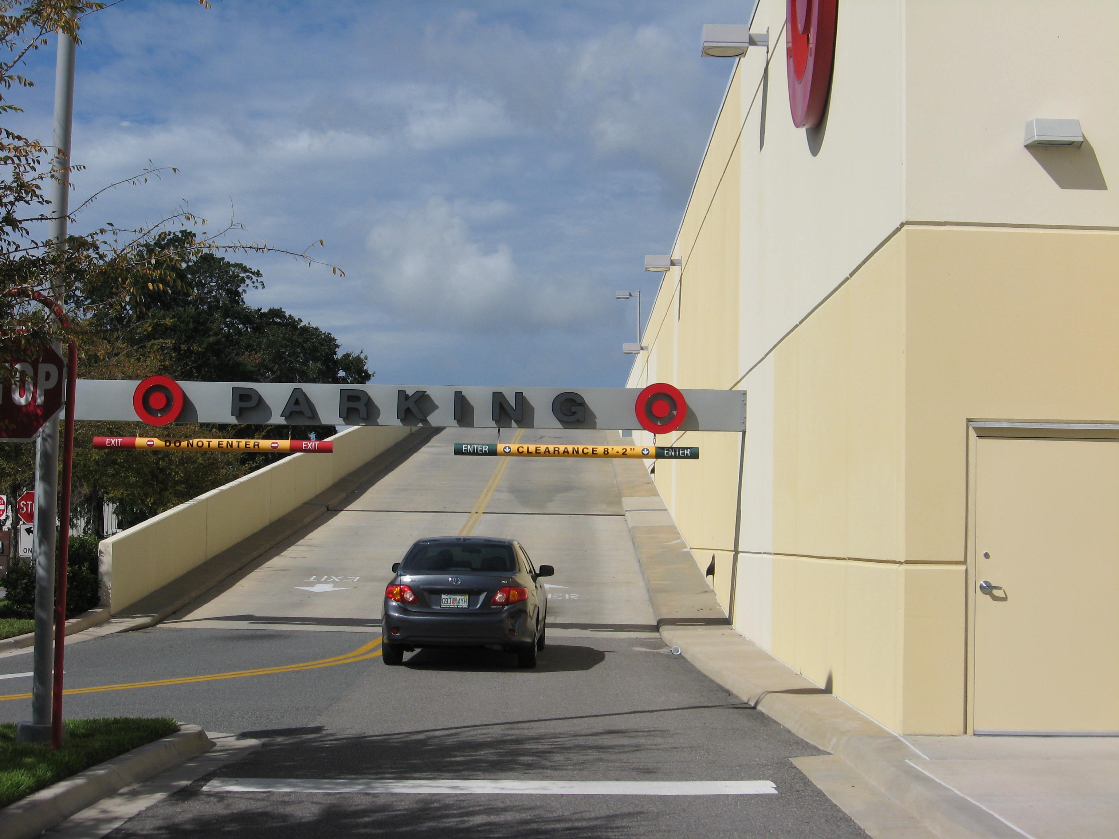

Slide 15
Dr. Phillips Center for the Performing Arts
Development Program
2,700 seat Disney Theater (Amplified)
300 seat Community Theater
1,700 seat Multiform Theater (Acoustic)
Status
Ground Breaking - June 2011
Grand Opening - November 2013

Slide 17
How do we advance the New Urban Paradigm?
Have a Vision
A Vision is not merely a concept of an idea, it’s a personal feeling.
The vision sets the stage for everything.
Your vision should tell a story about your project, so the designer and the client can imagine what it will become.
That vision will dictate the design, architectural style, density, use and character of the development.
The vision is the first step for establishing how this project will be different from others.
-- Chris Alexander, 1987, New Theory of Urban Design

Slide 18
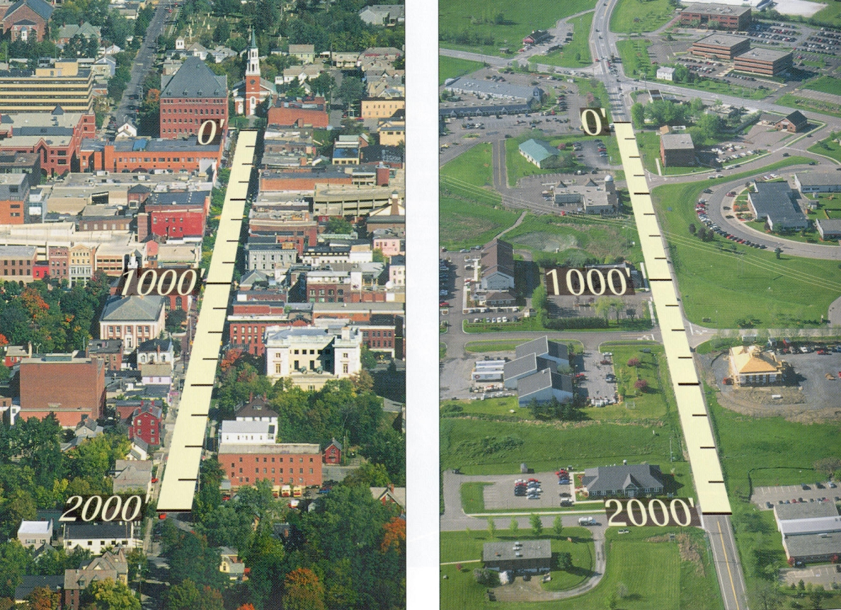

Slide 20
How do we advance the New Urban Paradigm?
Have a Vision
Establish a set of guiding principles
Position statements that guide decisions regarding the design of the development

Slide 21
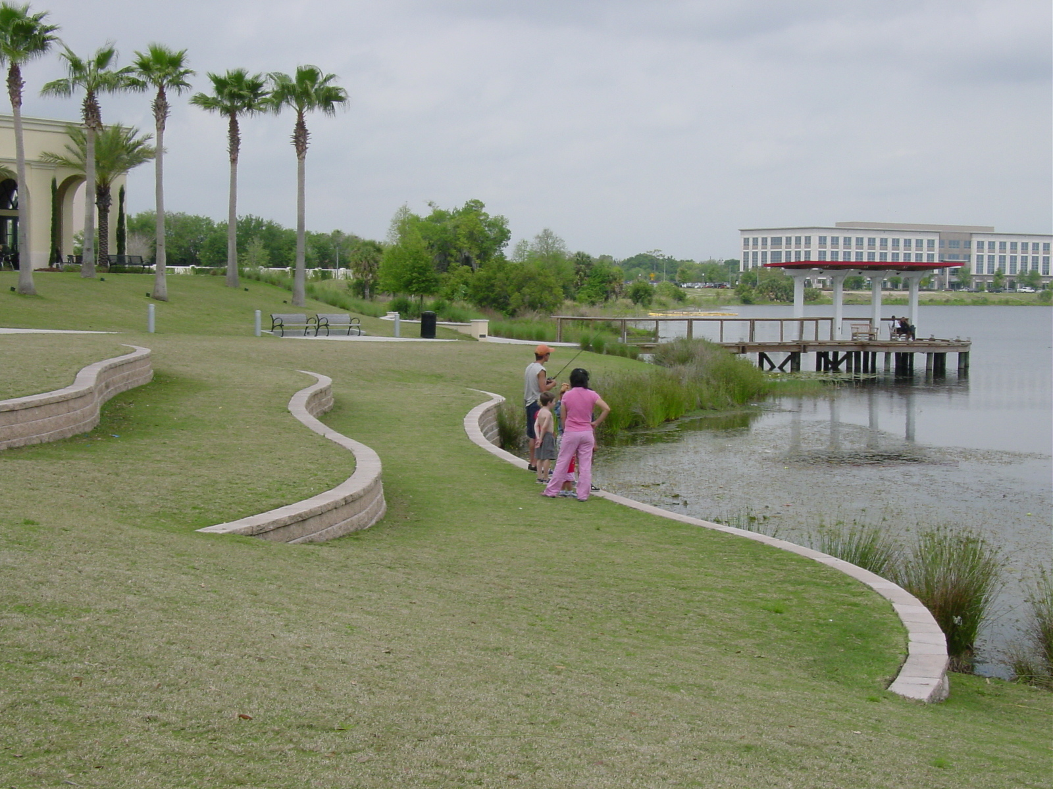
Guiding Principles Environment
Lakes and natural features will be treated as amenities to be preserved, celebrated and protected.
Continuous and connected open space systems will support diverse ecosystems and wildlife.

Slide 22
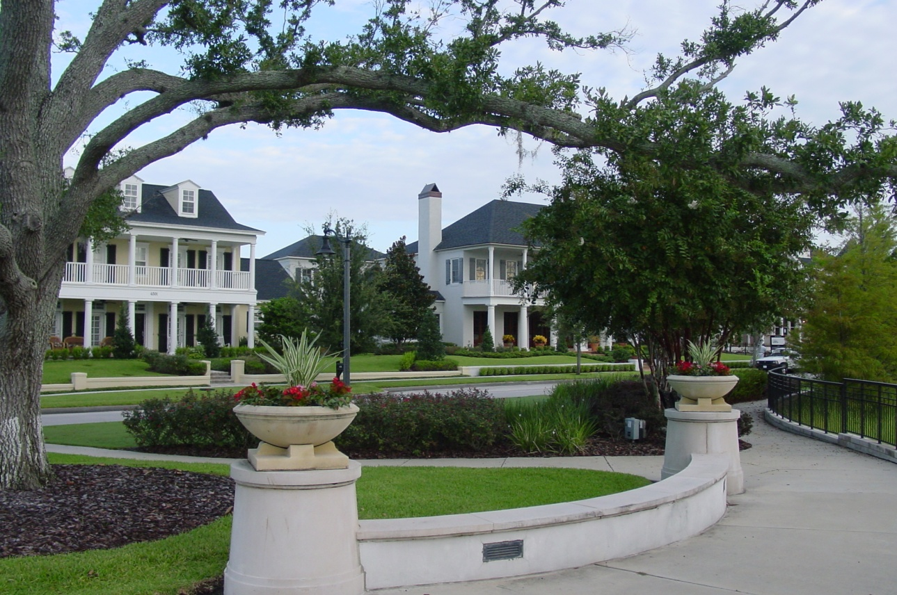
Guiding Principles Development Patterns
A broad variety of housing types will be provided, including attached and detached housing, multifamily dwellings, and single-family homes.
Most homes will be located within a 5 minute walk of a neighborhood green, a square or a civic use.

Slide 23
Guiding Principles Development Patterns
A mix of land uses and residential densities will support a variety of lifestyle choices and needs.
Gated communities will be prohibited.

Slide 24
Guiding Principles Development Patterns
A Village Center within a 10 minute walk of most neighborhoods will promote the goal of a walkable community.
The Village Center will be the community’s commercial hub and principle public gathering place.

Slide 25
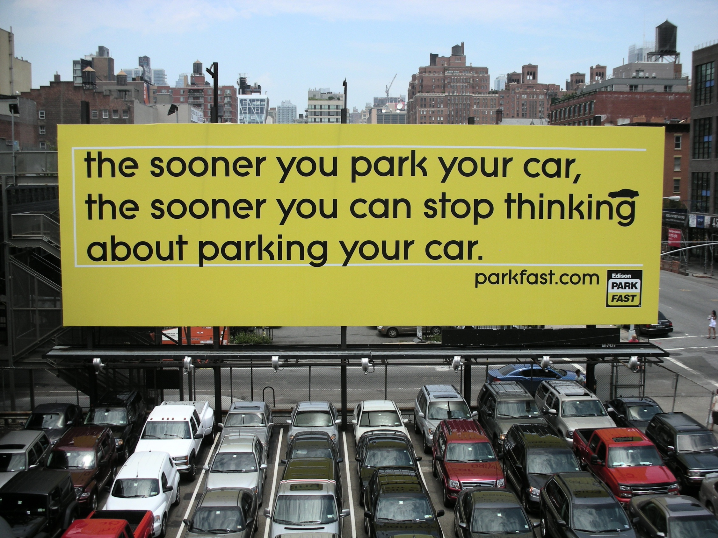
Guiding Principles Transportation
Narrow streets, on-street parking, discontinuous streets, no four-lane streets, and other traffic calming measures will deter fast moving traffic.
Multiple points of entry from surrounding neighborhoods will reduce trip lengths and maximize cycling and walking.

Slide 26
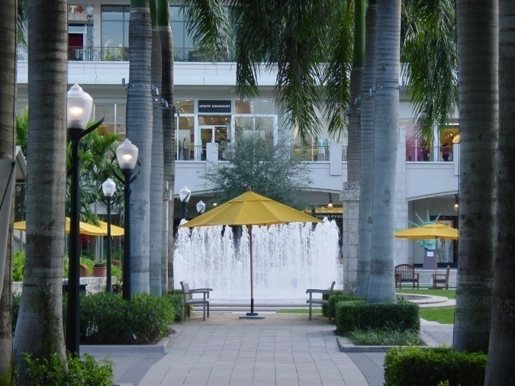
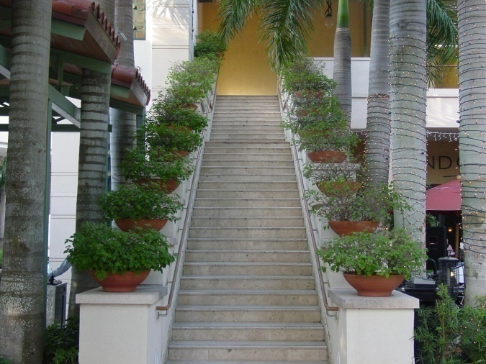
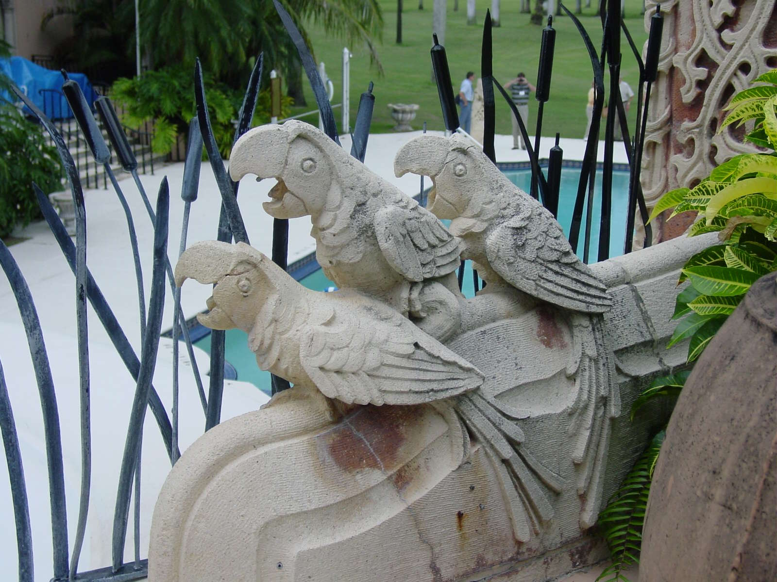
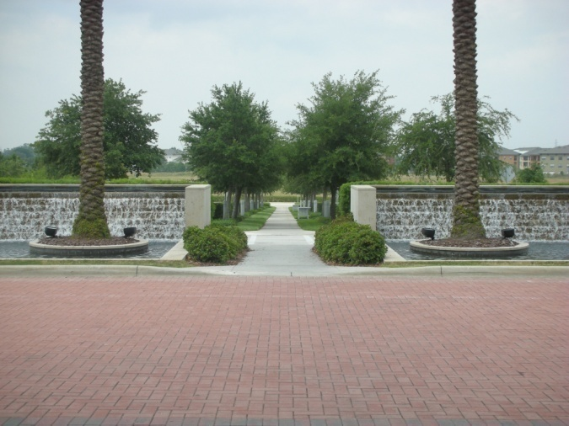
DPAC Design Considerations
Kevin Tyjeski, AICP
November 13, 2007

Slide 27
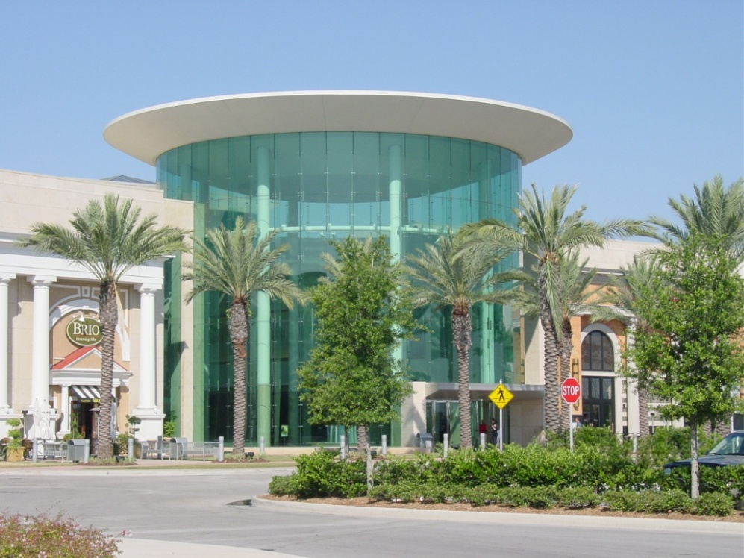
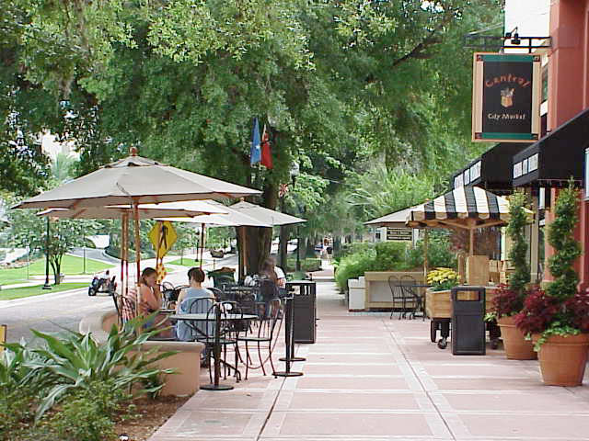
Florida is…outdoors – tropical, sunny and clear.
Use large expanses of clear glass to symbolize inclusion – let everyone see in.
Provide generous sidewalks so visitors feel comfortable and welcome - not claustrophobic.

Slide 28
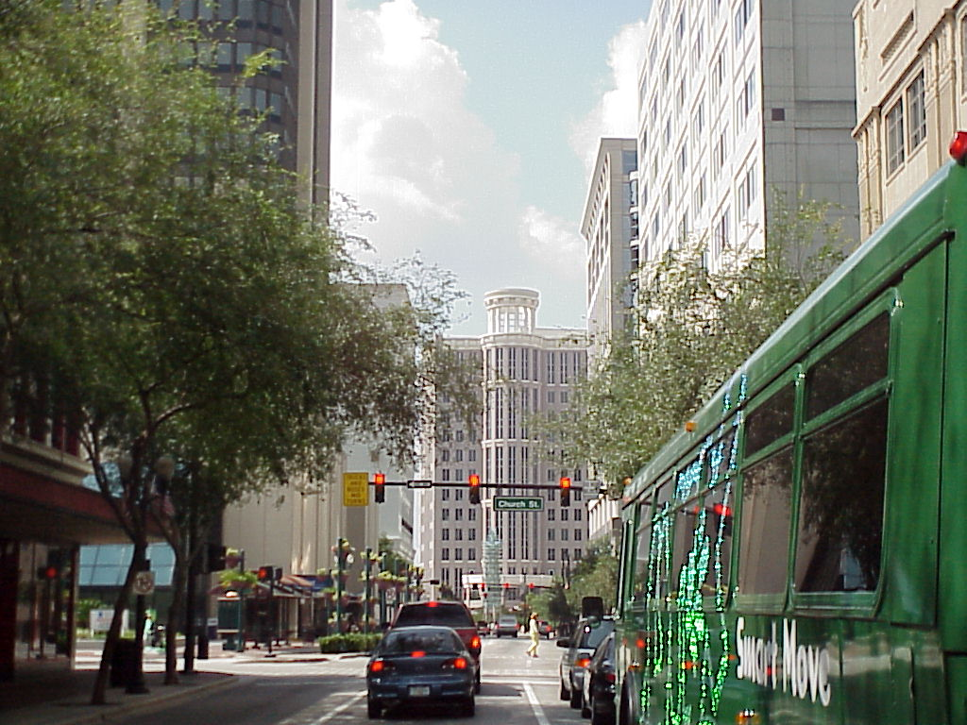
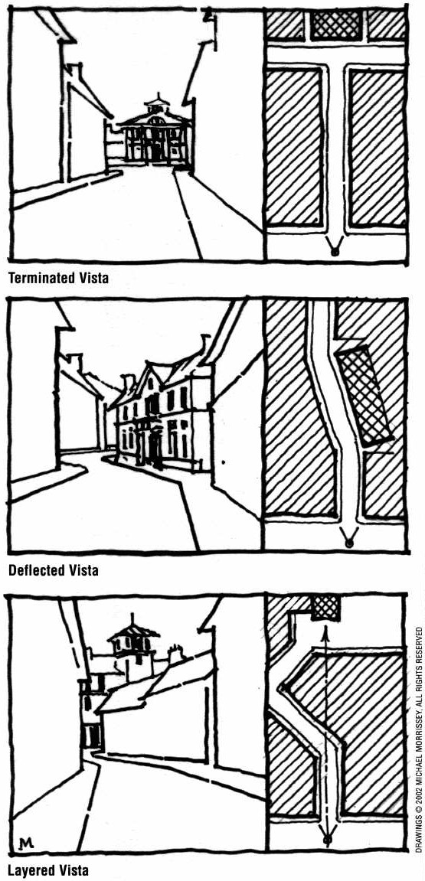
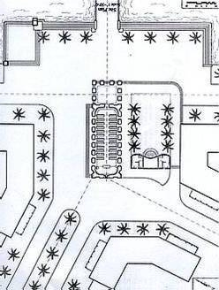
Consider views from every direction.
Does the building terminate a vista?
How is the building perceived from a distance?

Slide 29
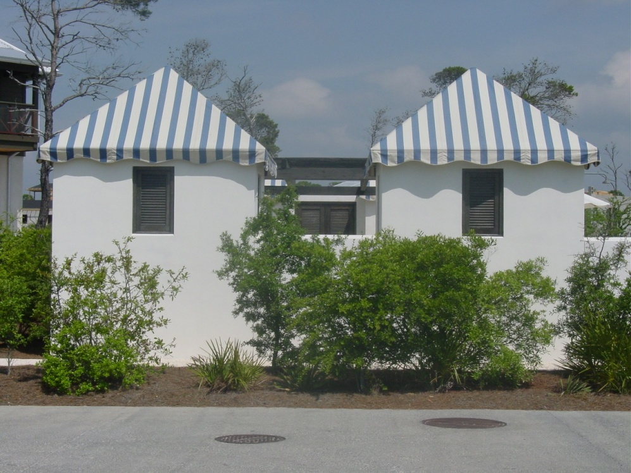
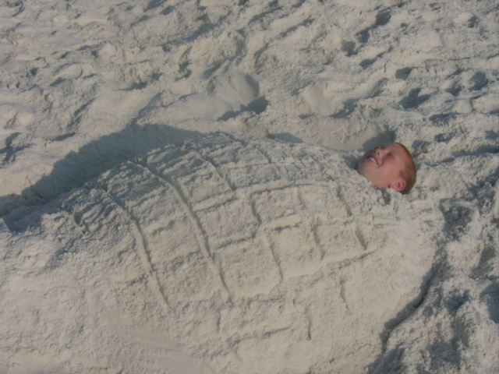
Important buildings should be white, or a natural sand color - White to signify the building’s importance and to appear cool and tropical; natural to symbolize timelessness.
Contrast the white or natural exterior with splashes of color. Interior walls seen through exterior glass walls can be particularly dramatic at night.

Slide 30
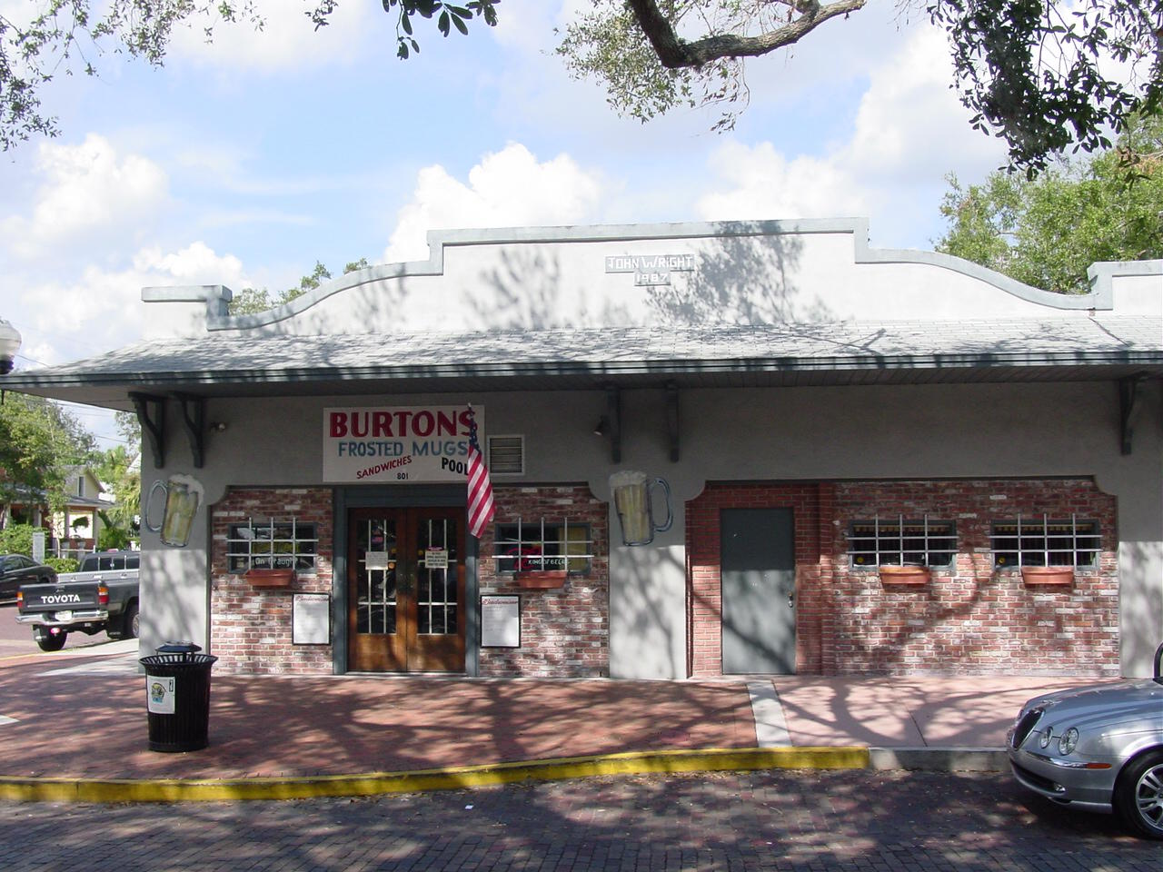
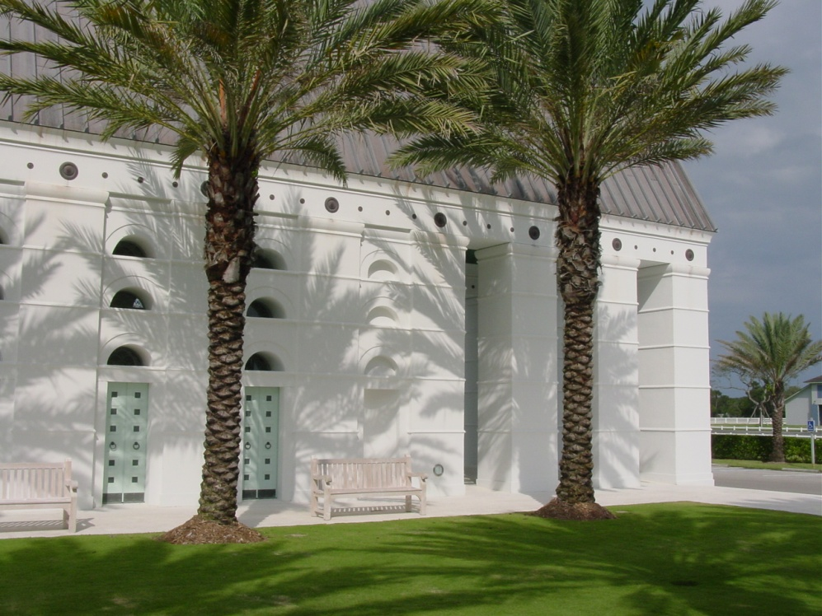
Create shade and shadow.
Shadows cast by deep overhangs provide relief from the intense Florida sun.
Trees can filter and diffuse light, to cut down on glare and strong contrasts that are hard on the eyes.
Silhouettes cast on building walls provide a subtle change in color and create visual interest – both during the day and at night.

Slide 31
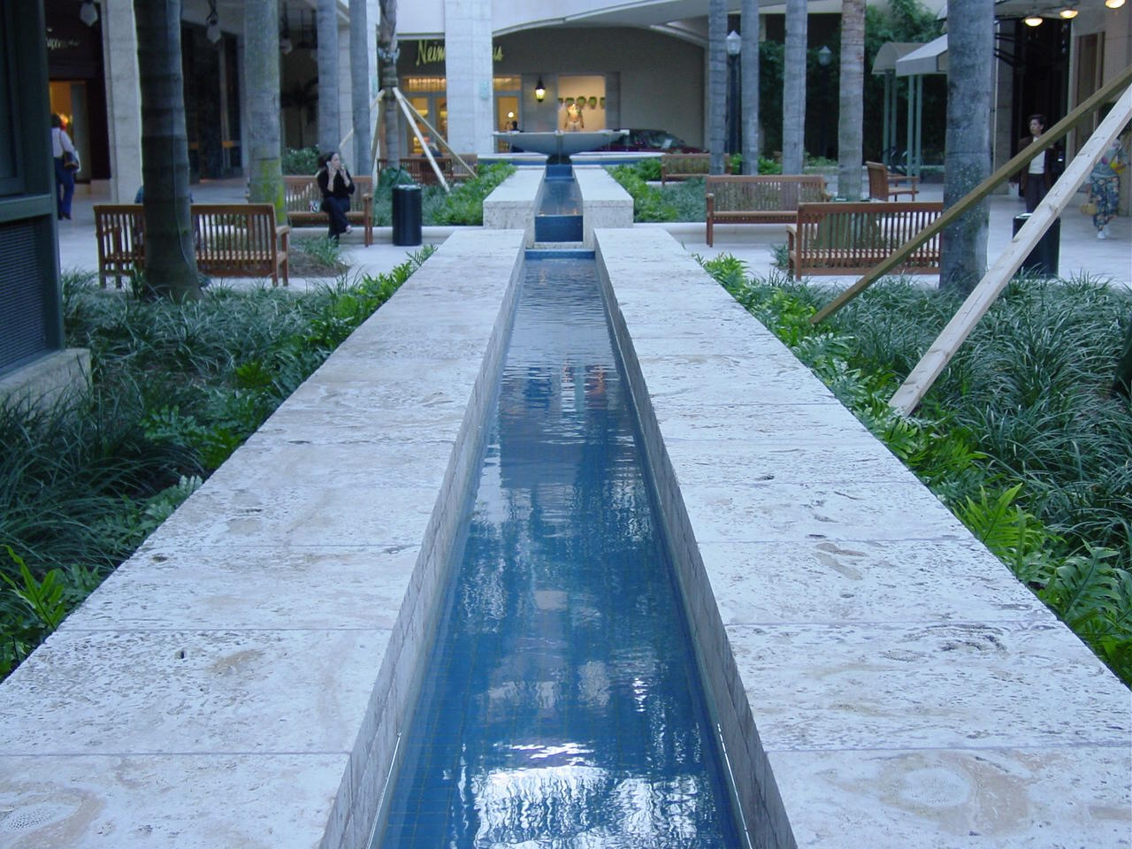
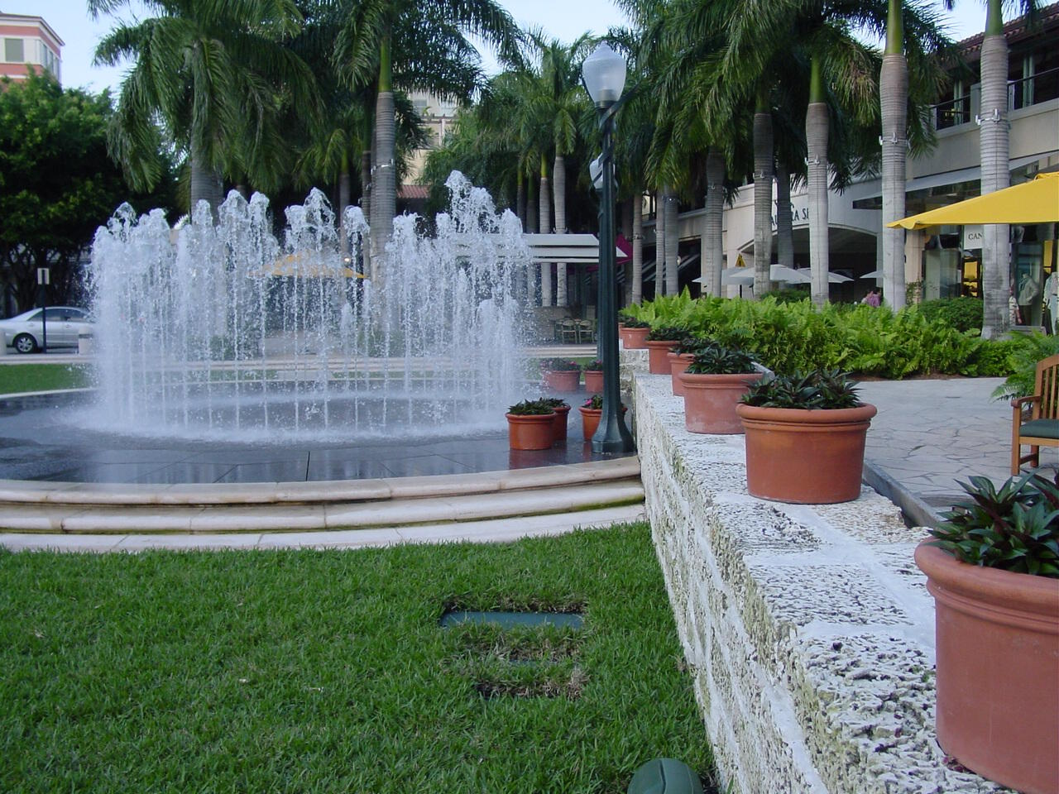
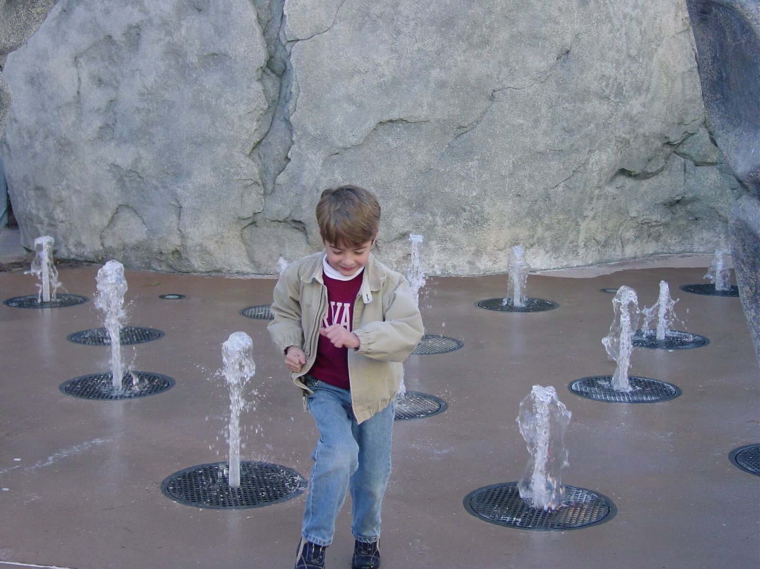
Incorporate water to symbolize Florida’s connection to the ocean and to the hours of relaxation Floridians spend around their swimming pools.

Slide 32
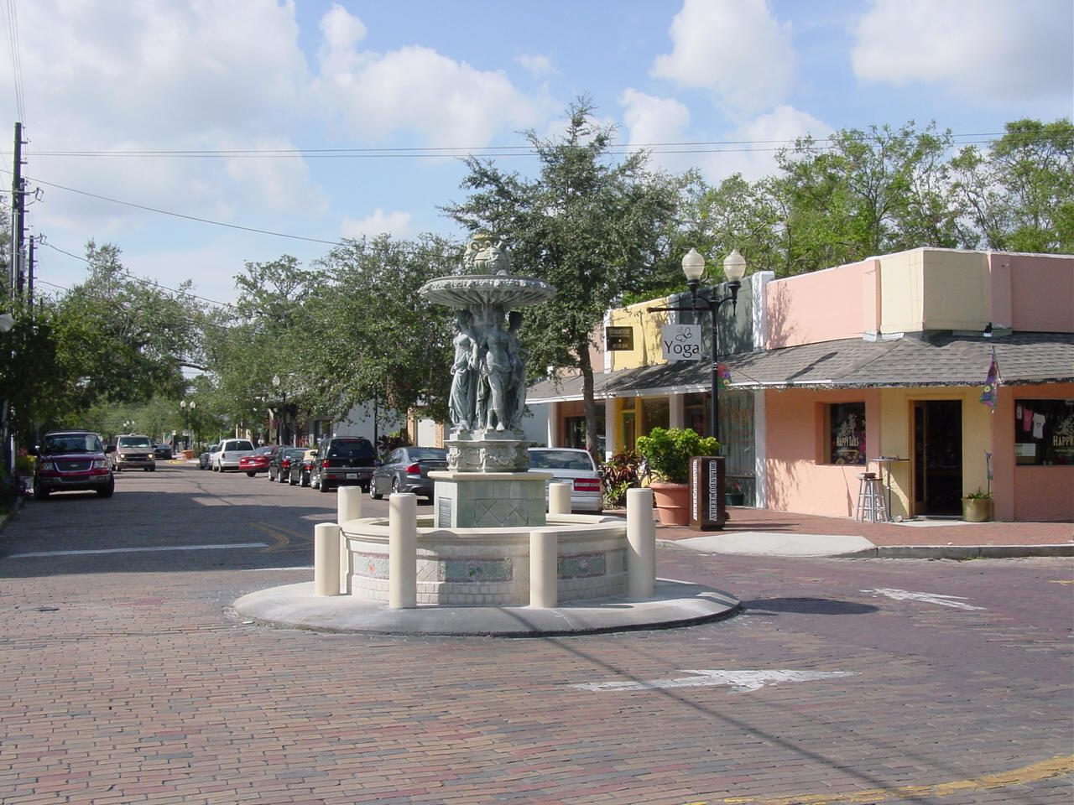
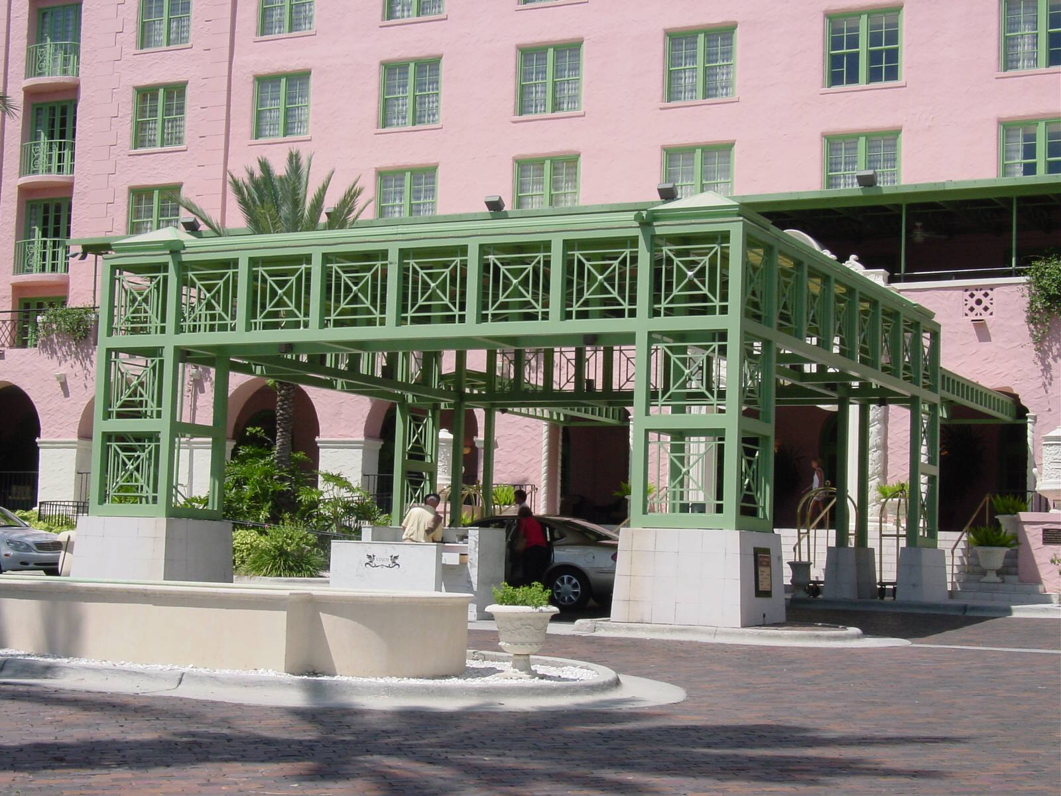
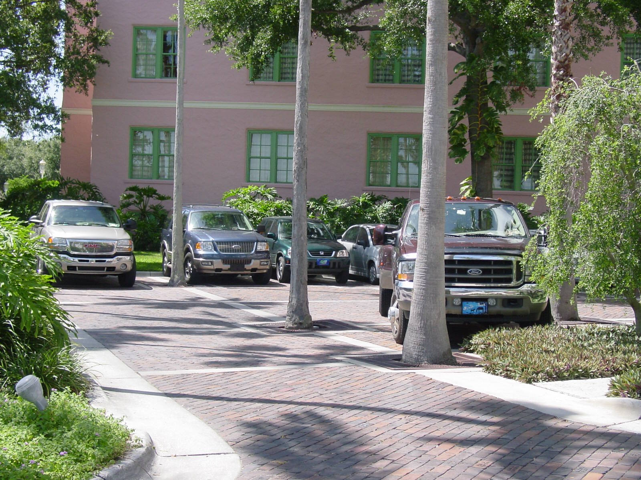
Brick streets, parking areas and drives provide color and human scale.

Slide 33
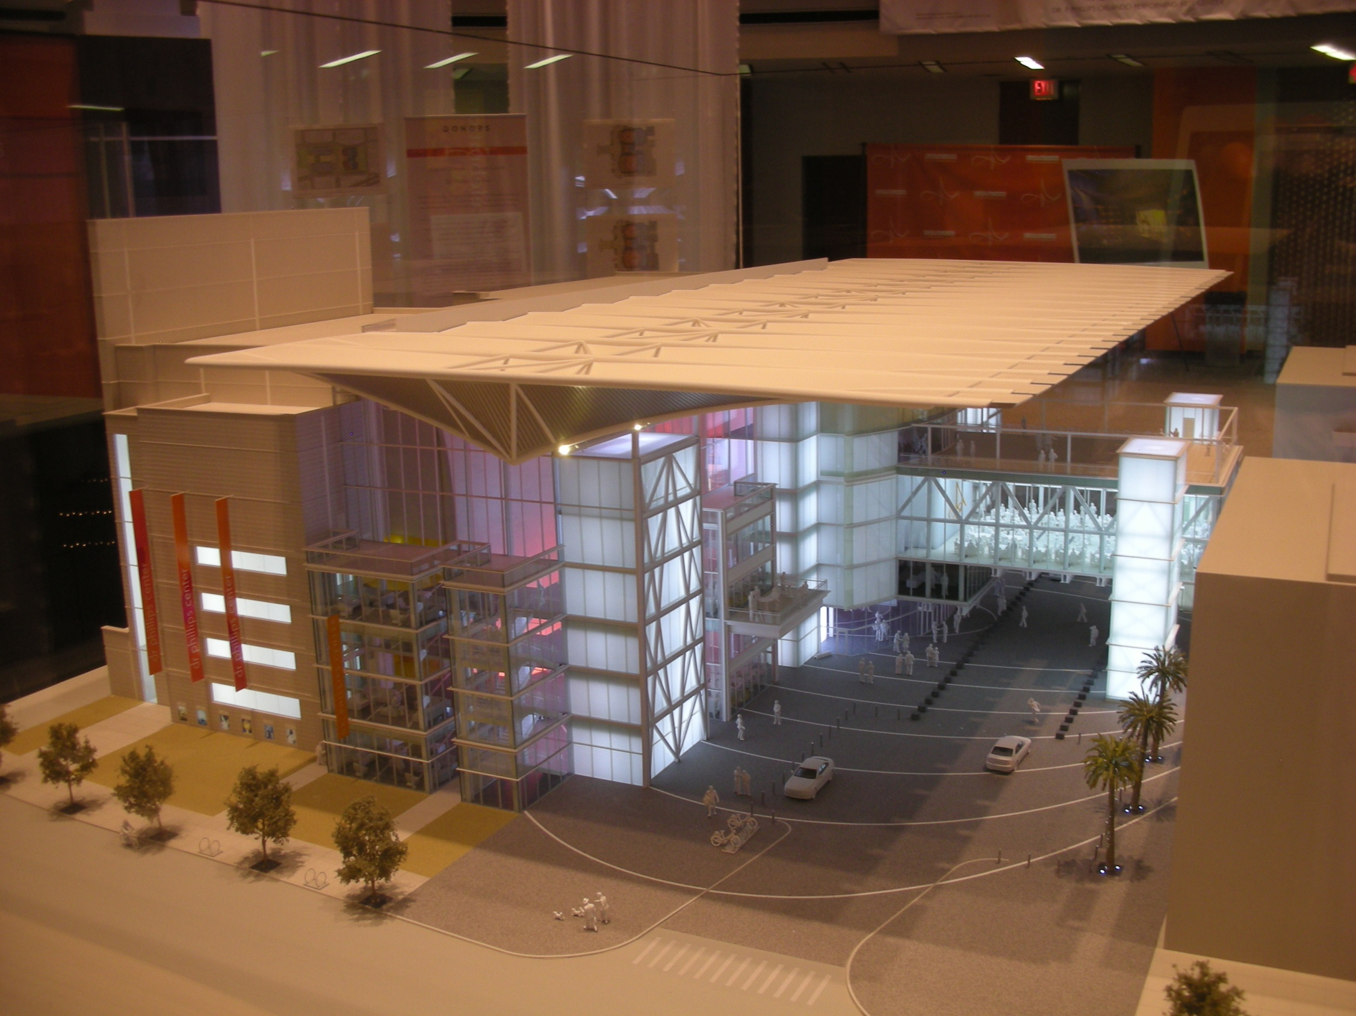

Slide 34
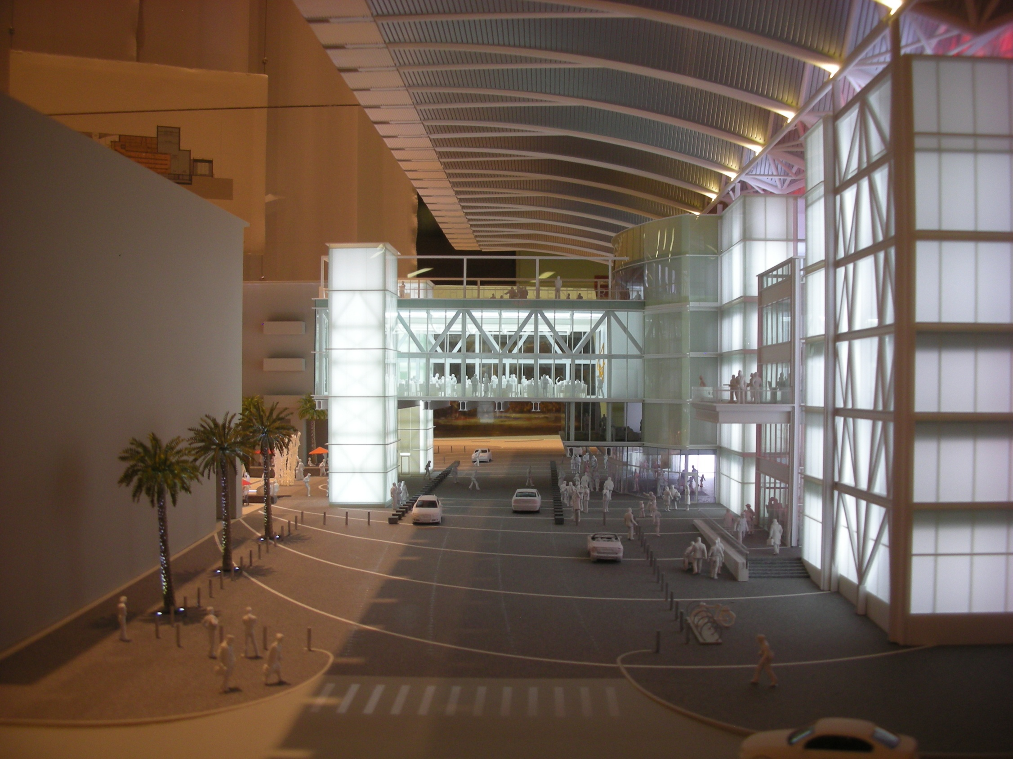

Slide 35
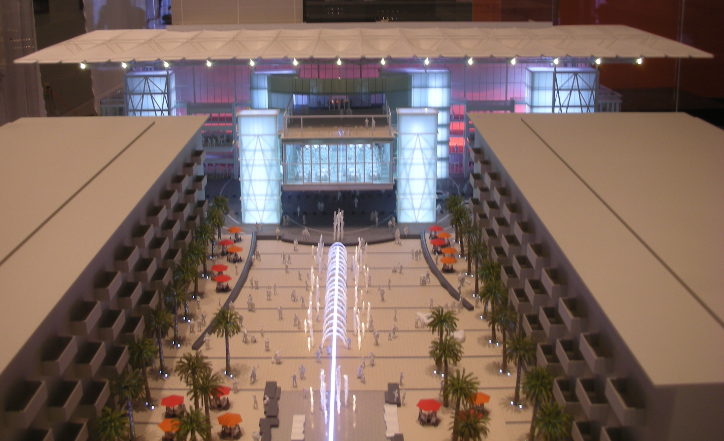

Slide 36
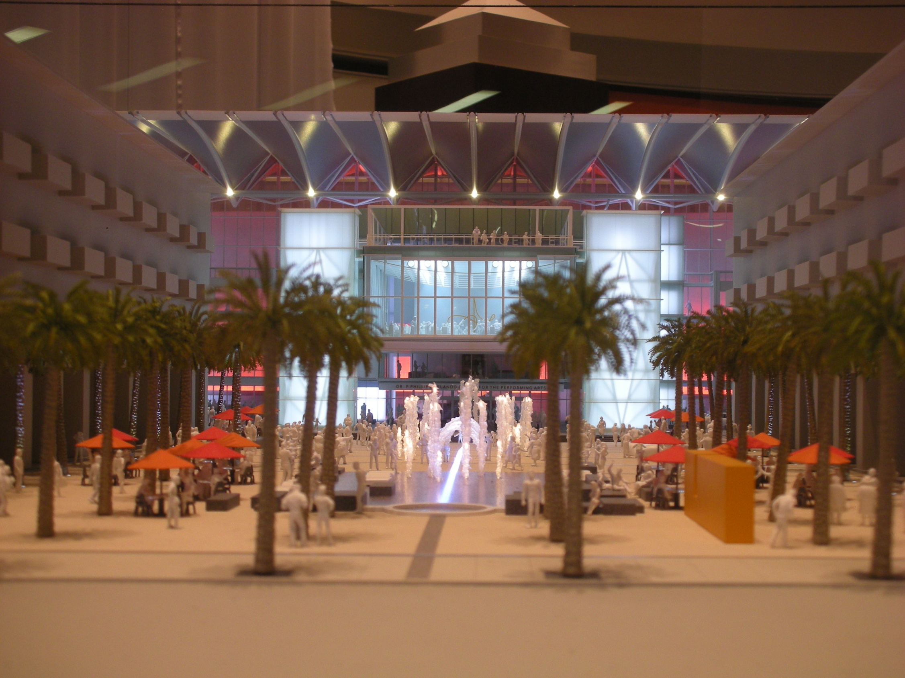

Slide 37
How do we advance the New Urban Paradigm?
Have a Vision
Establish a set of guiding principles
Be careful

Slide 38
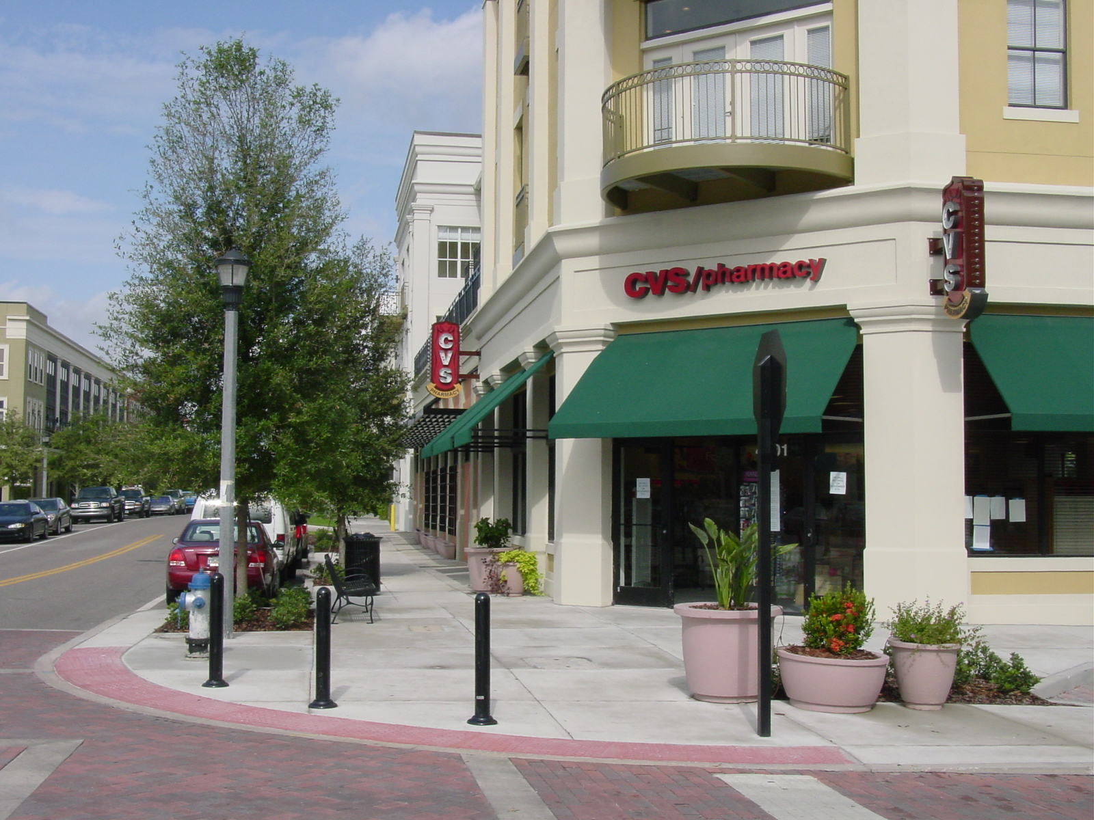
Details Matter

Slide 39
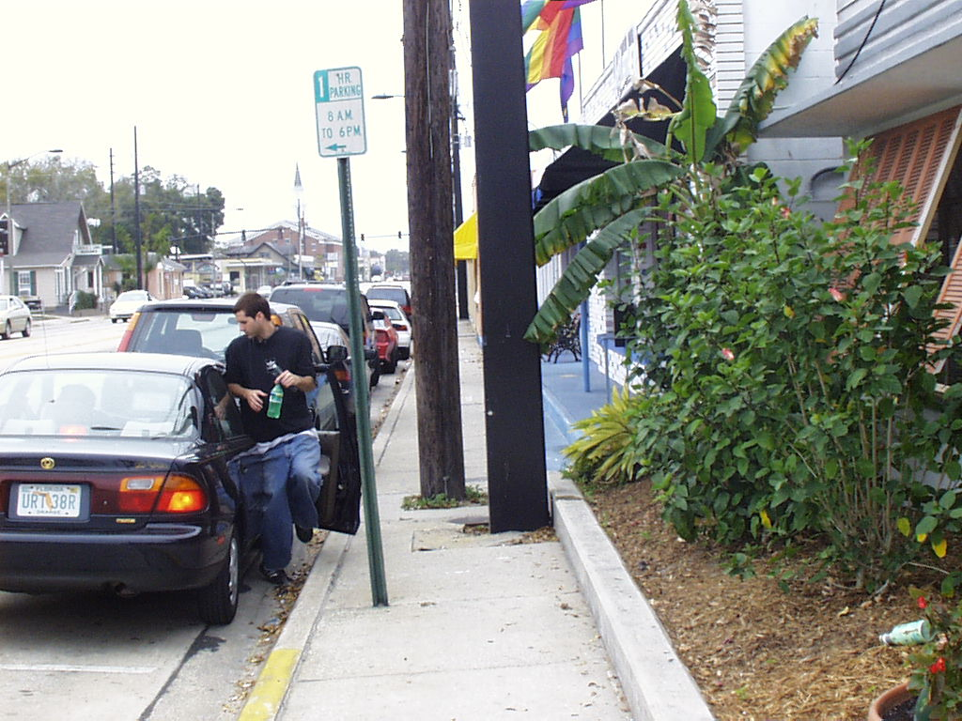

Slide 40
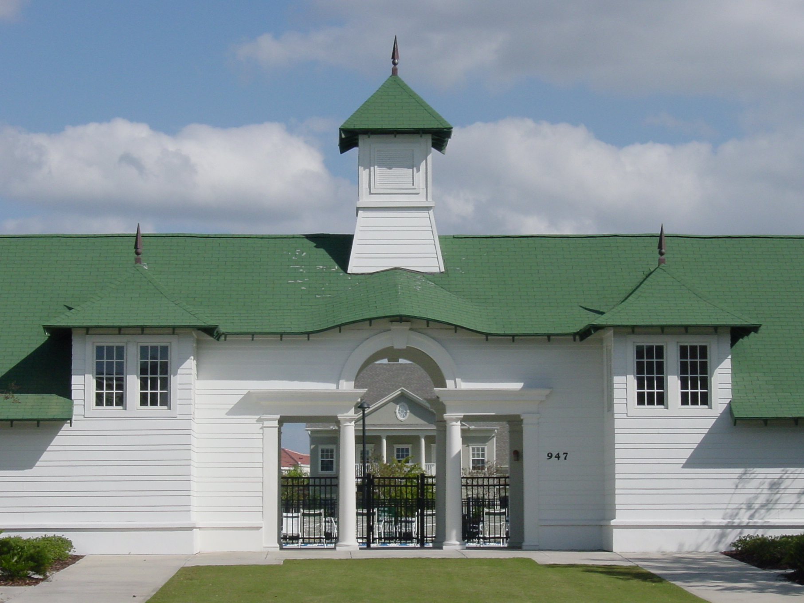

Slide 41
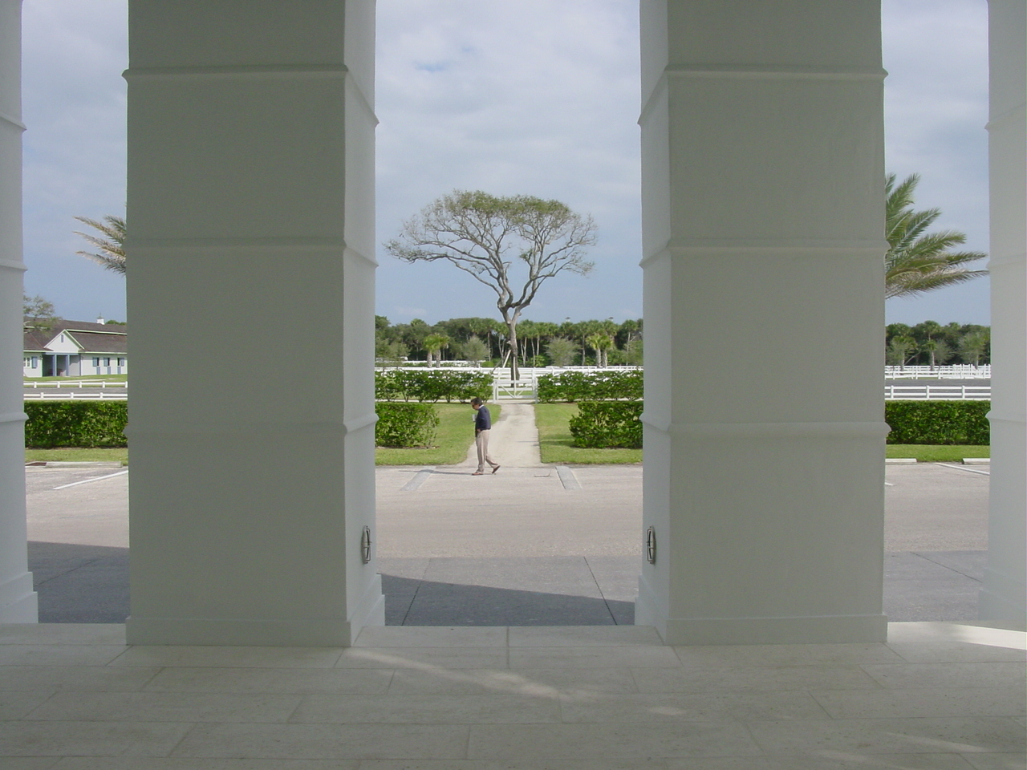

Slide 42
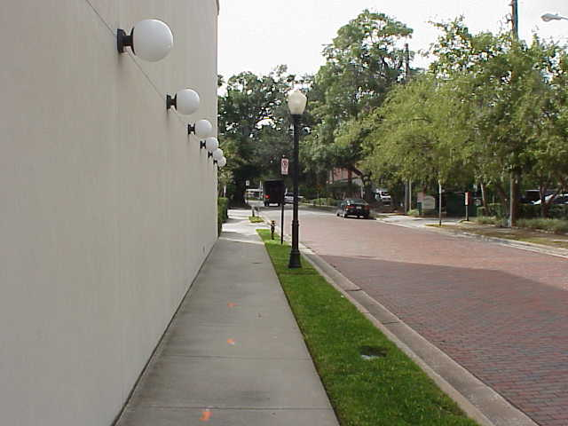
Face the Street

Slide 43
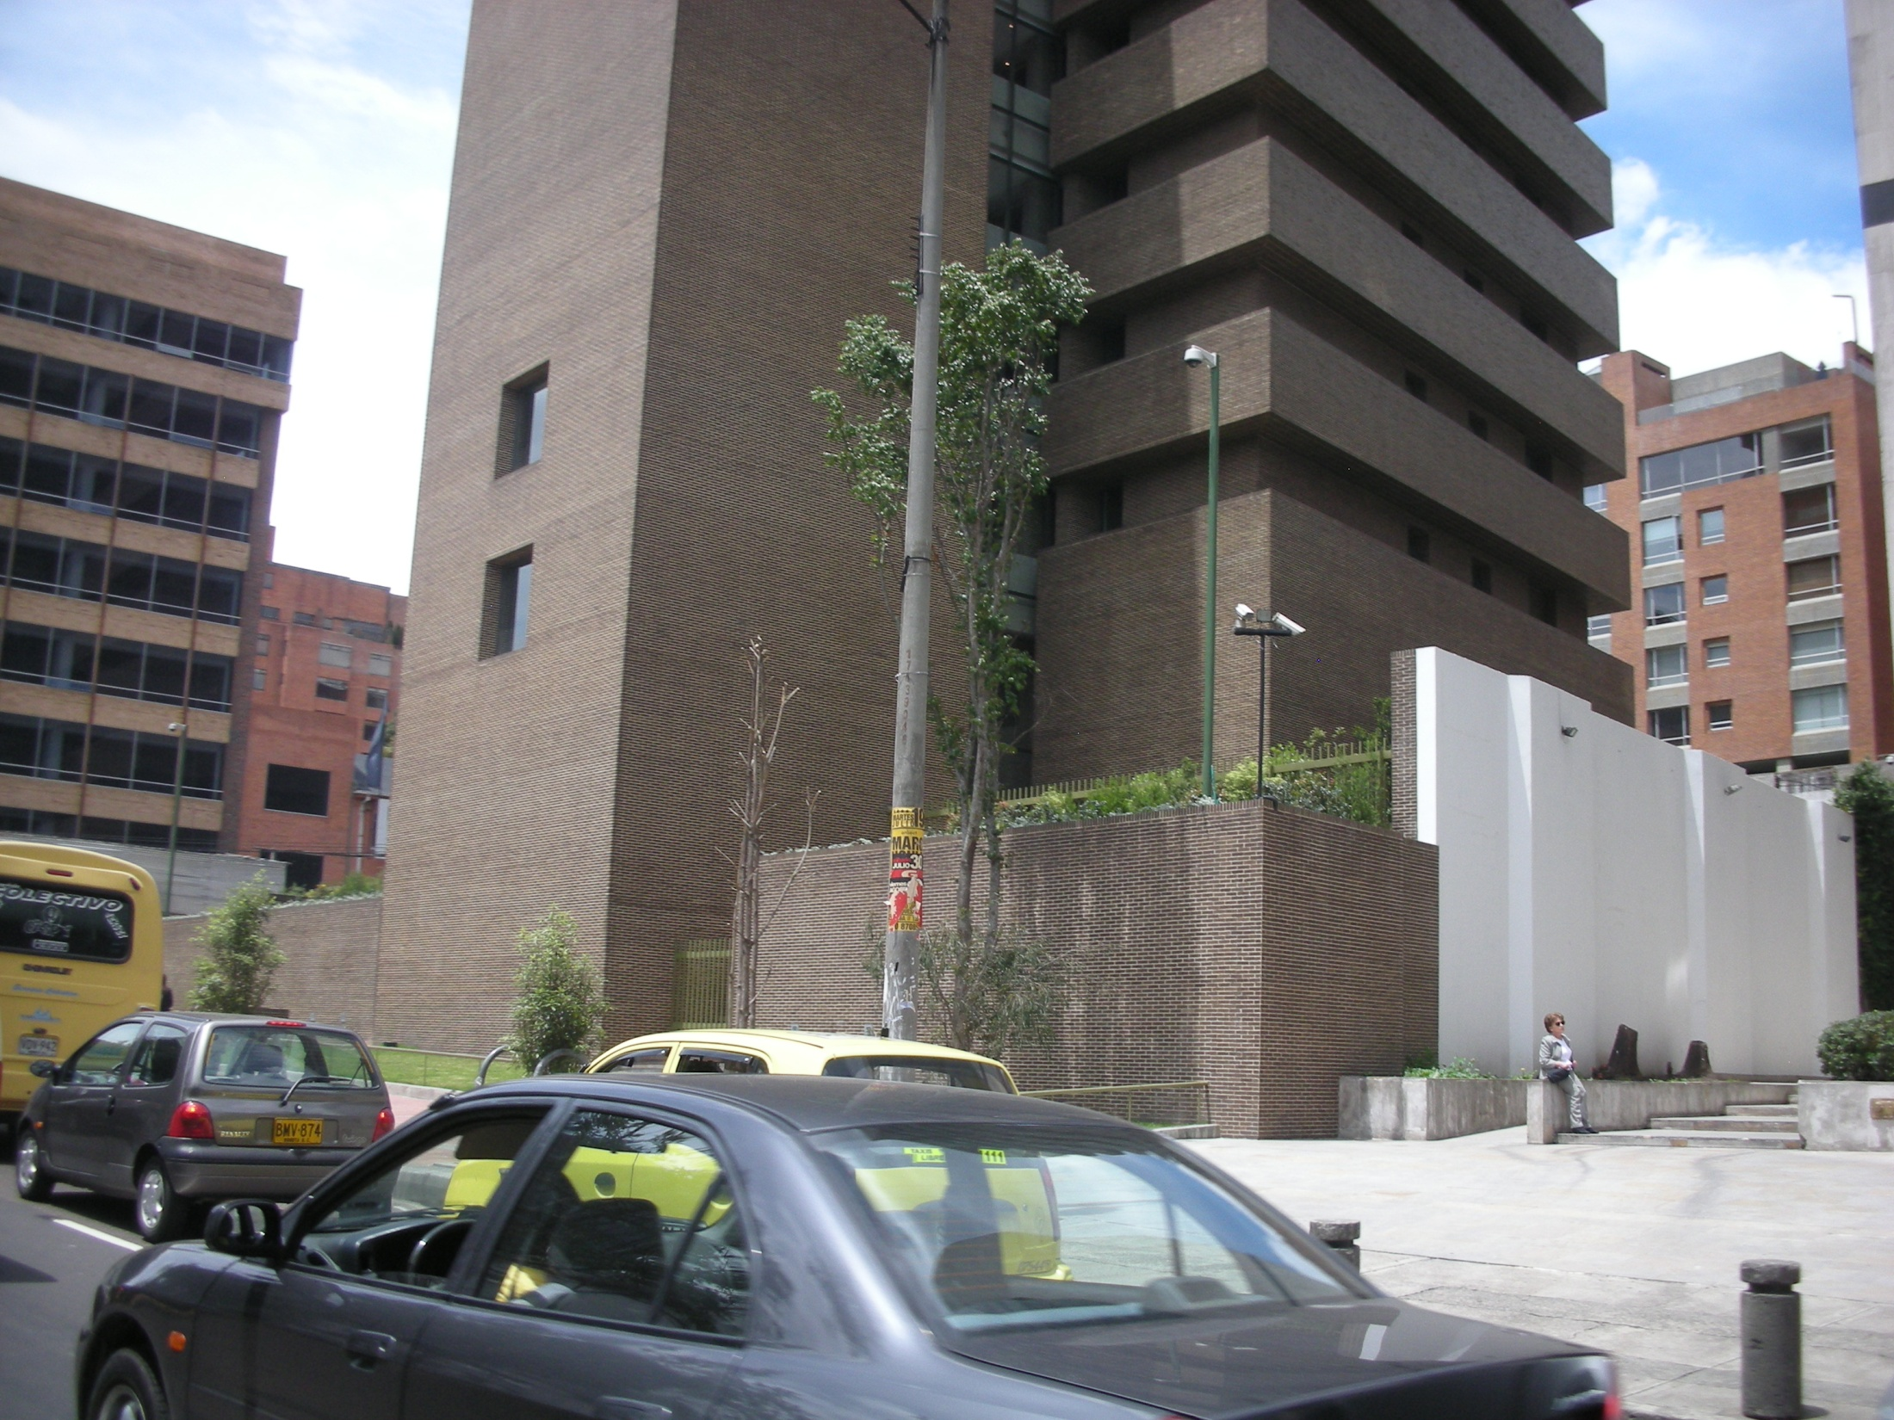

Slide 44
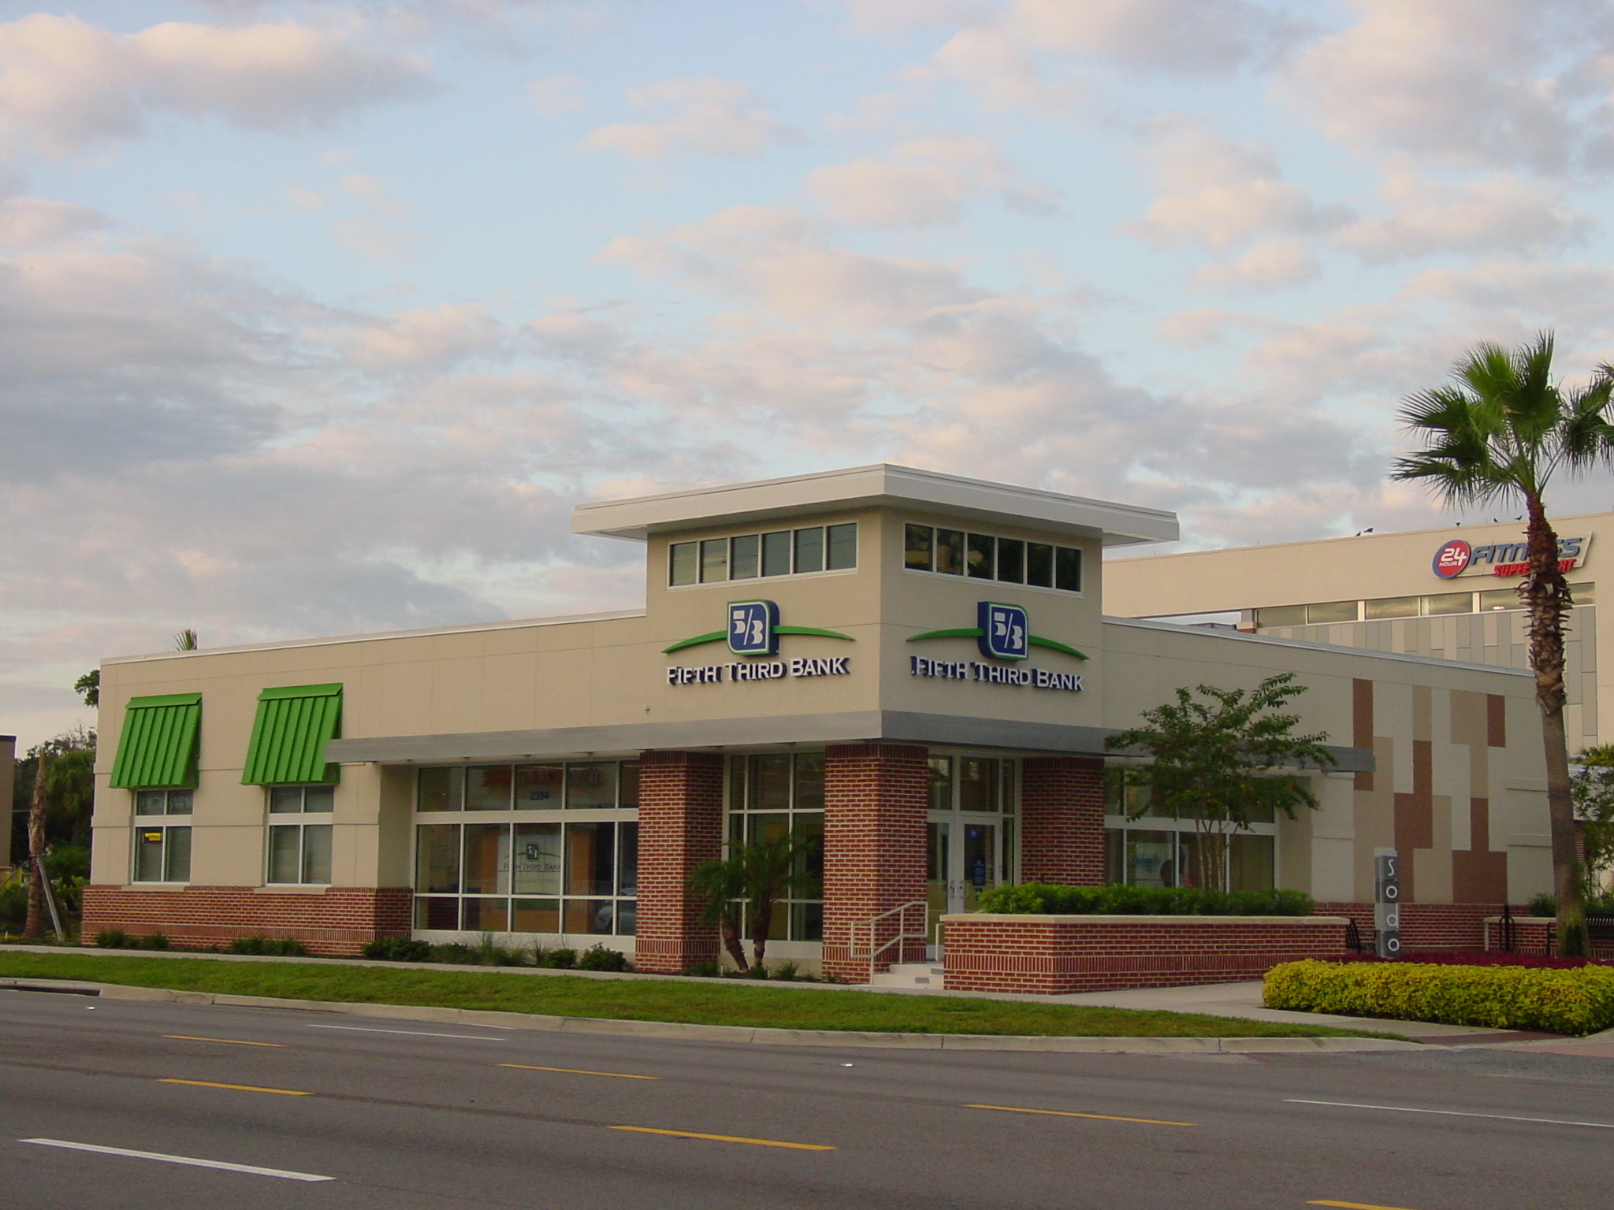

Slide 45
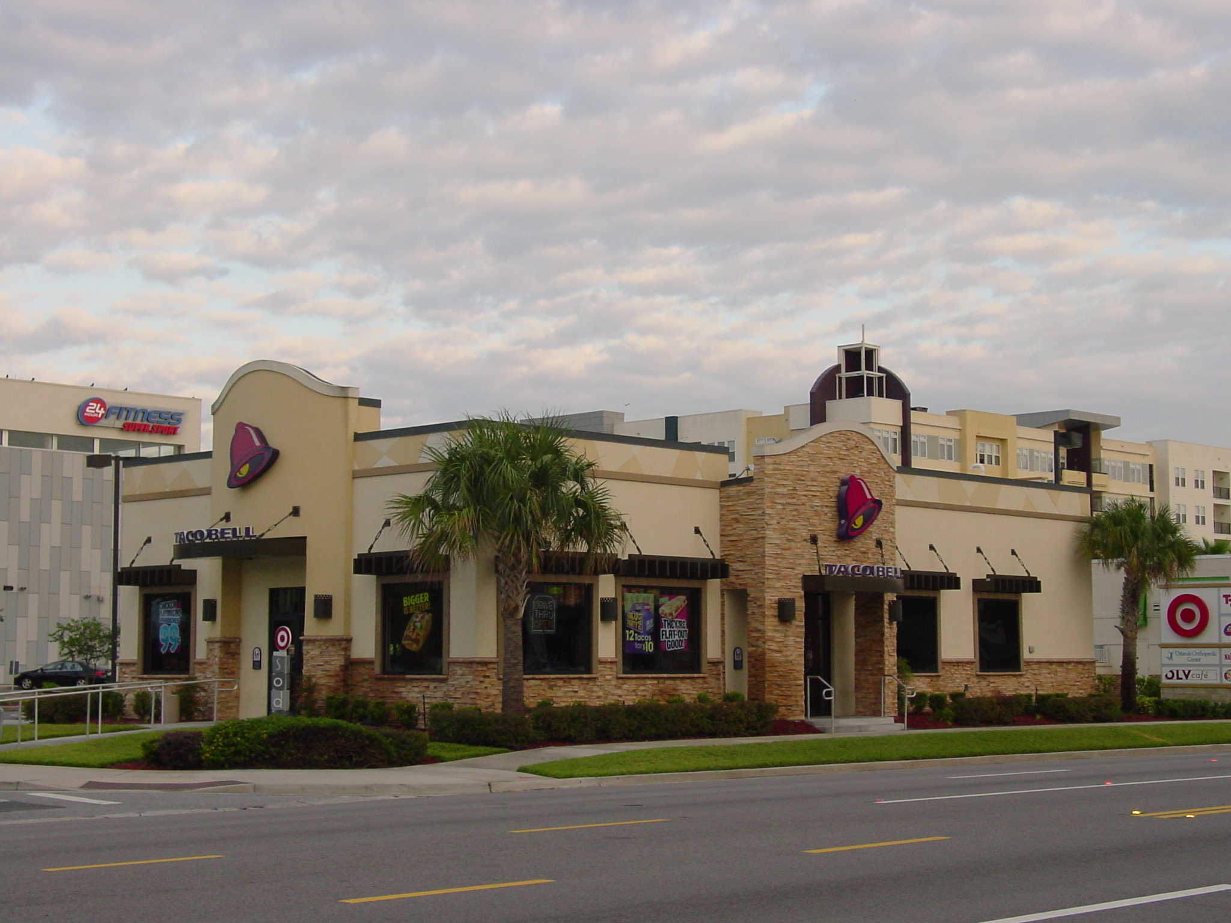

Slide 46
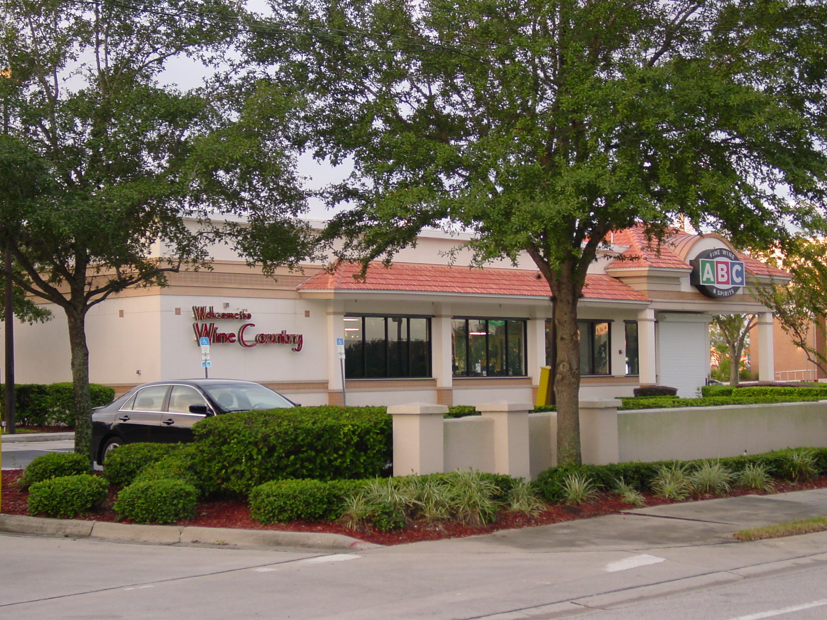

Slide 47
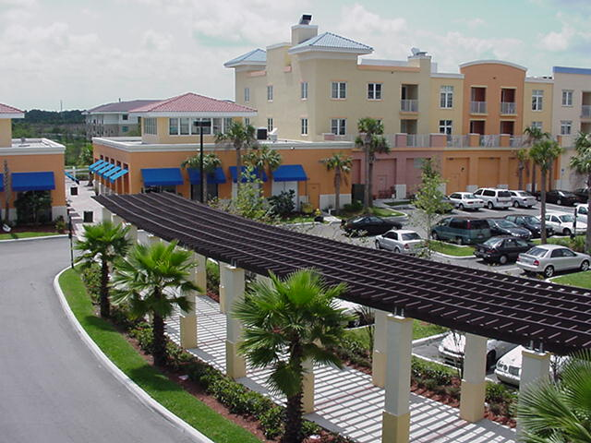
H U M A N

Slide 48
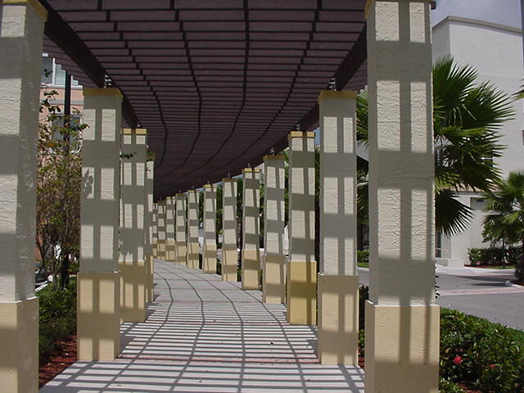

Slide 49
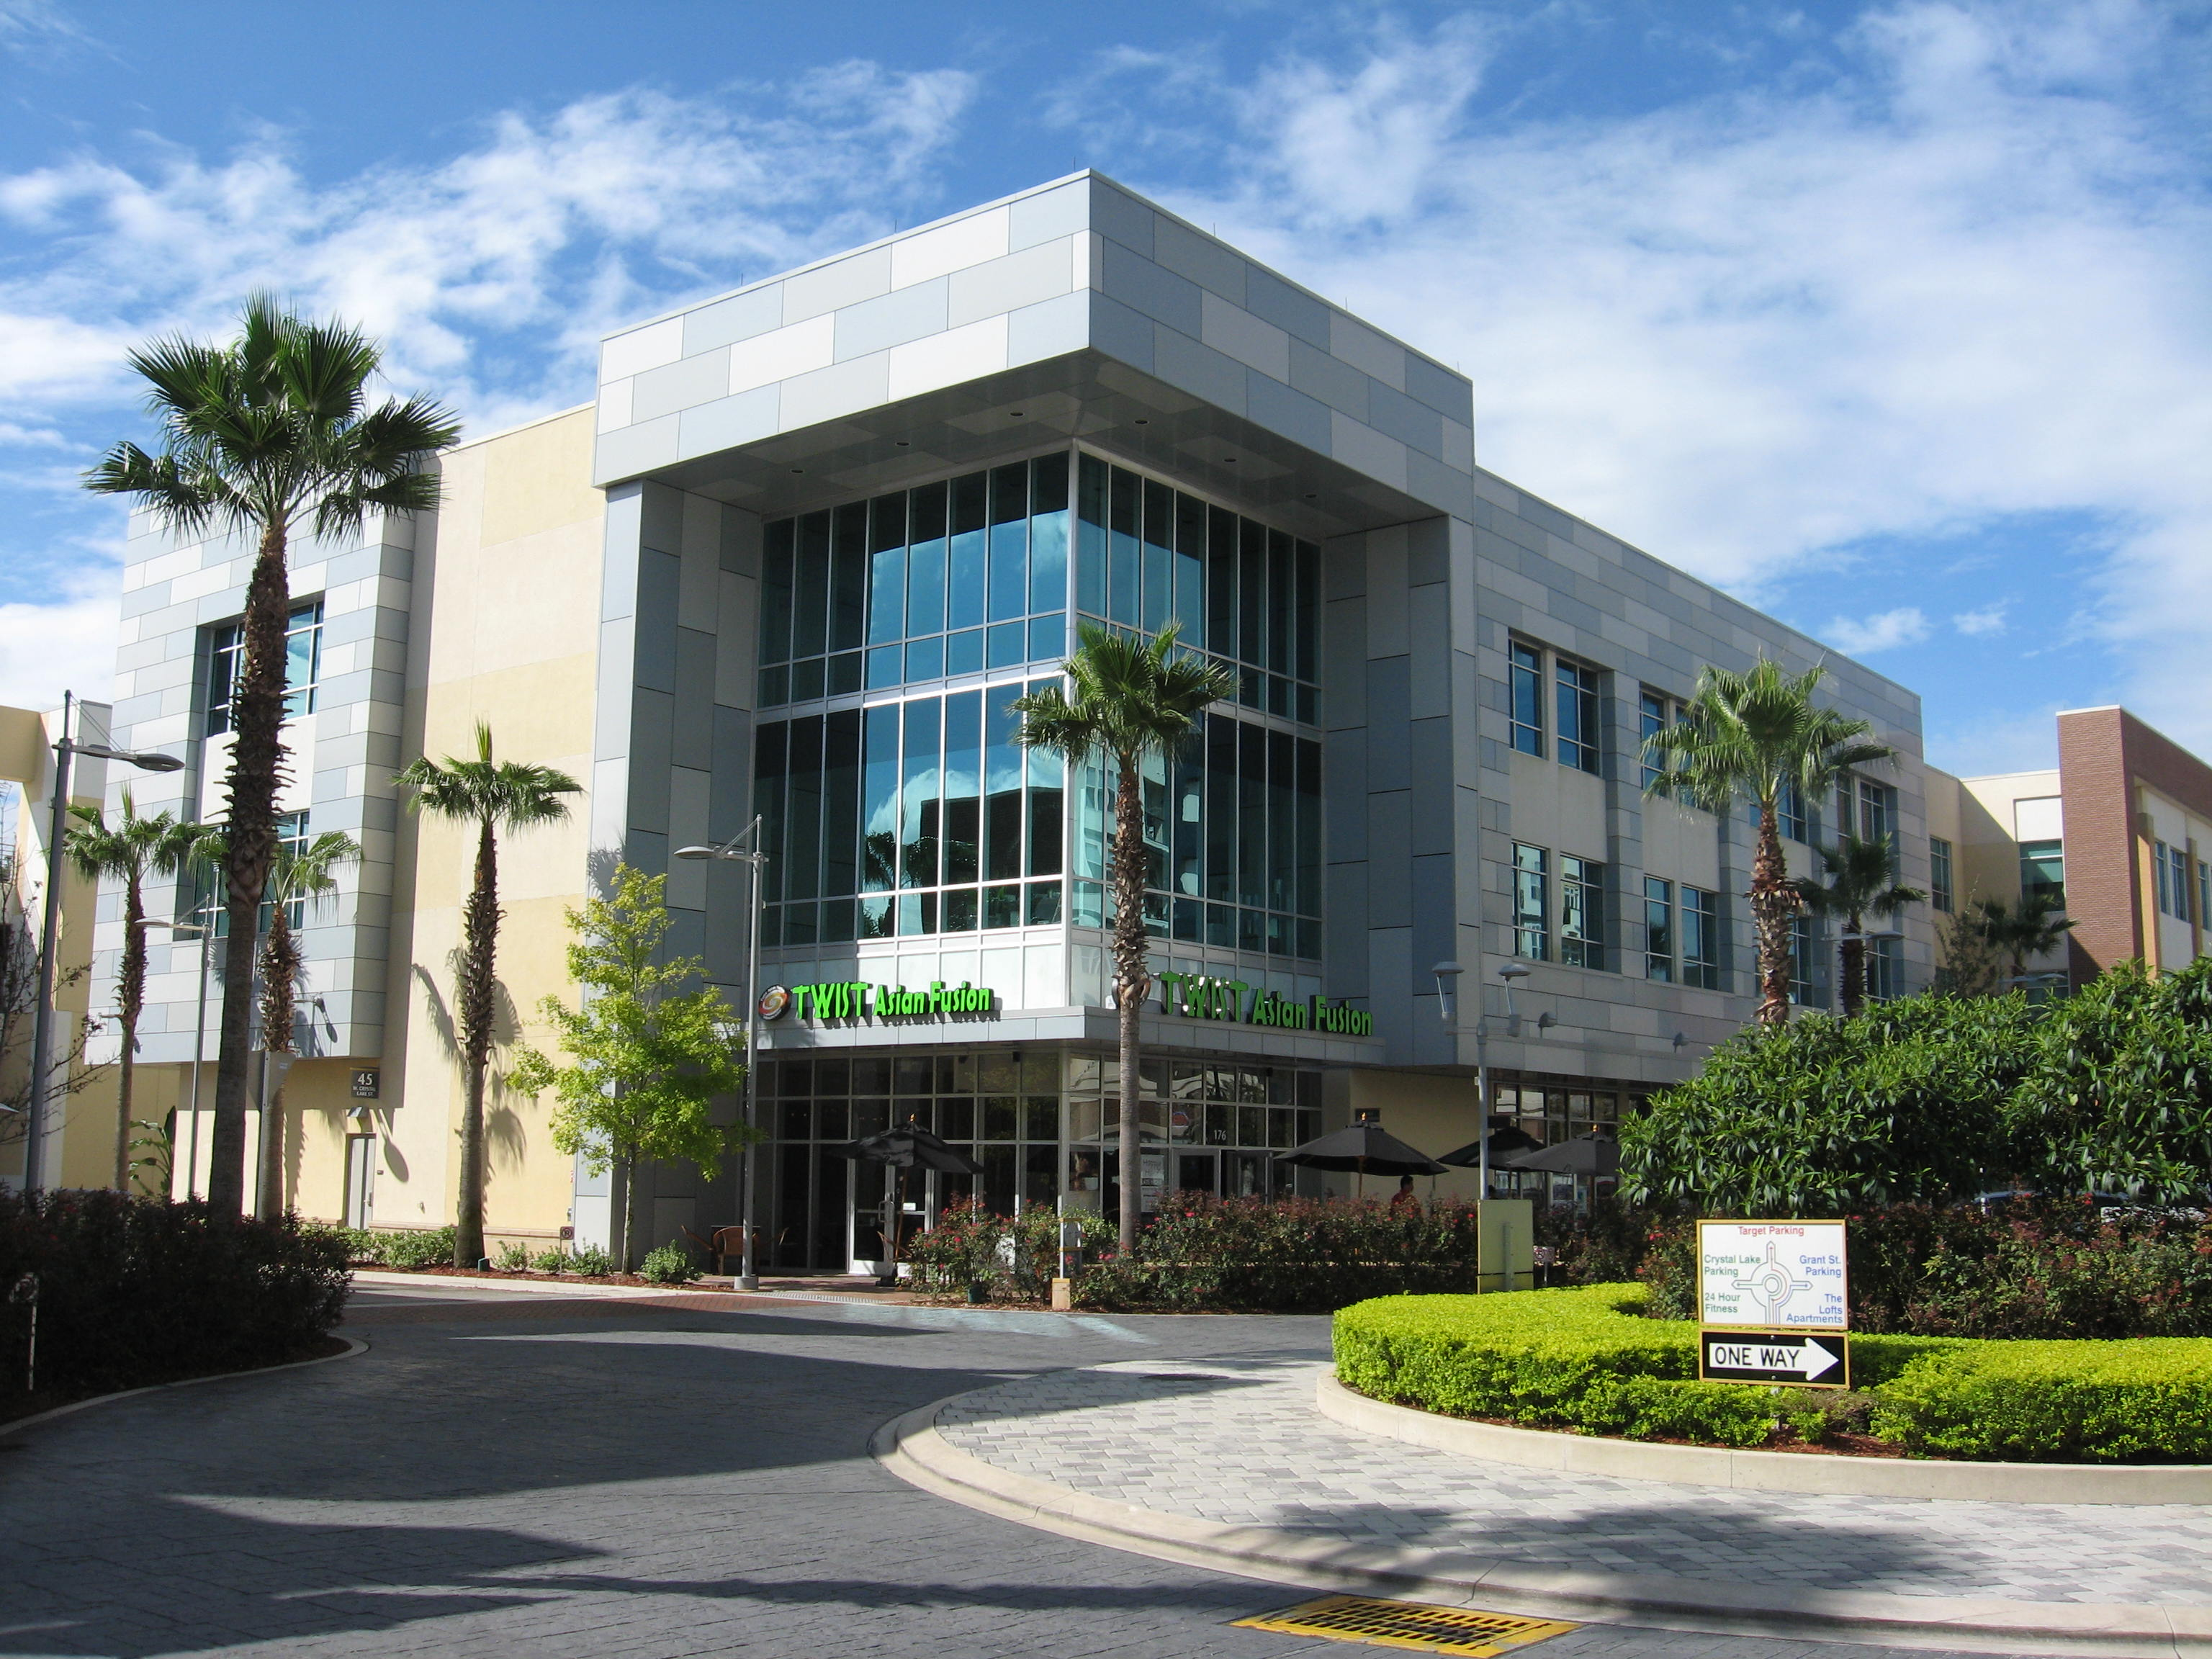
Every front has a back

Slide 50
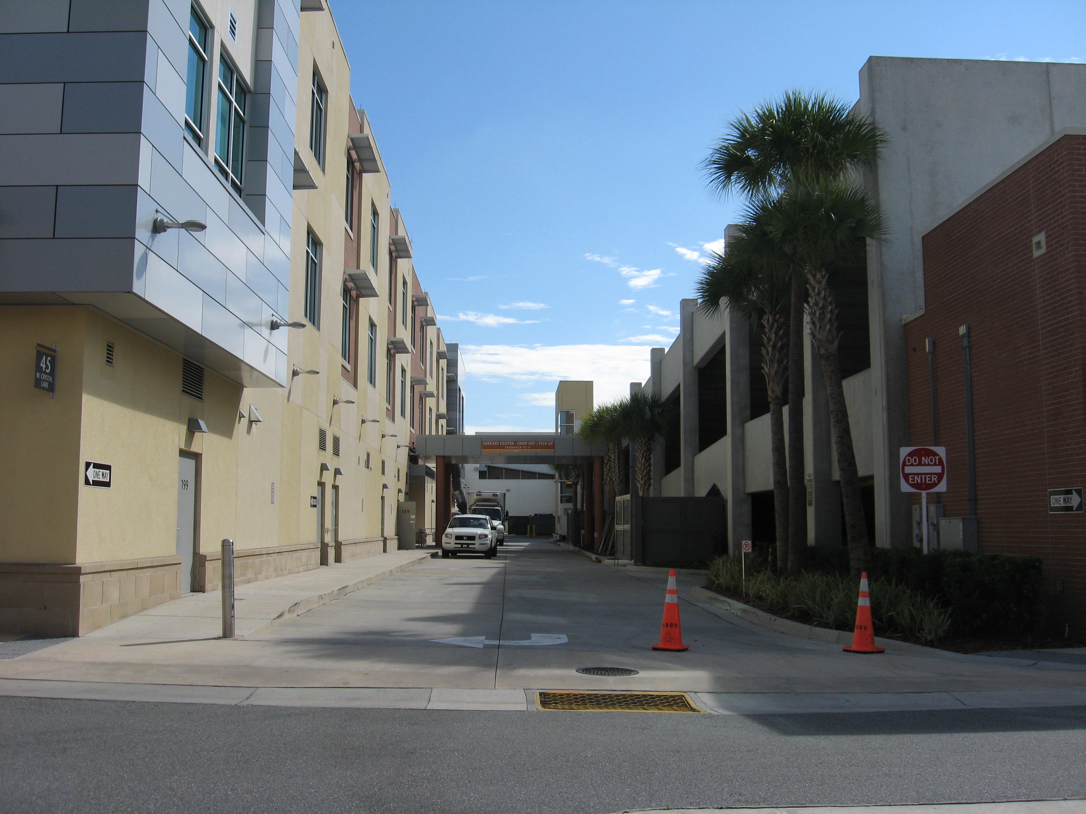

Slide 51
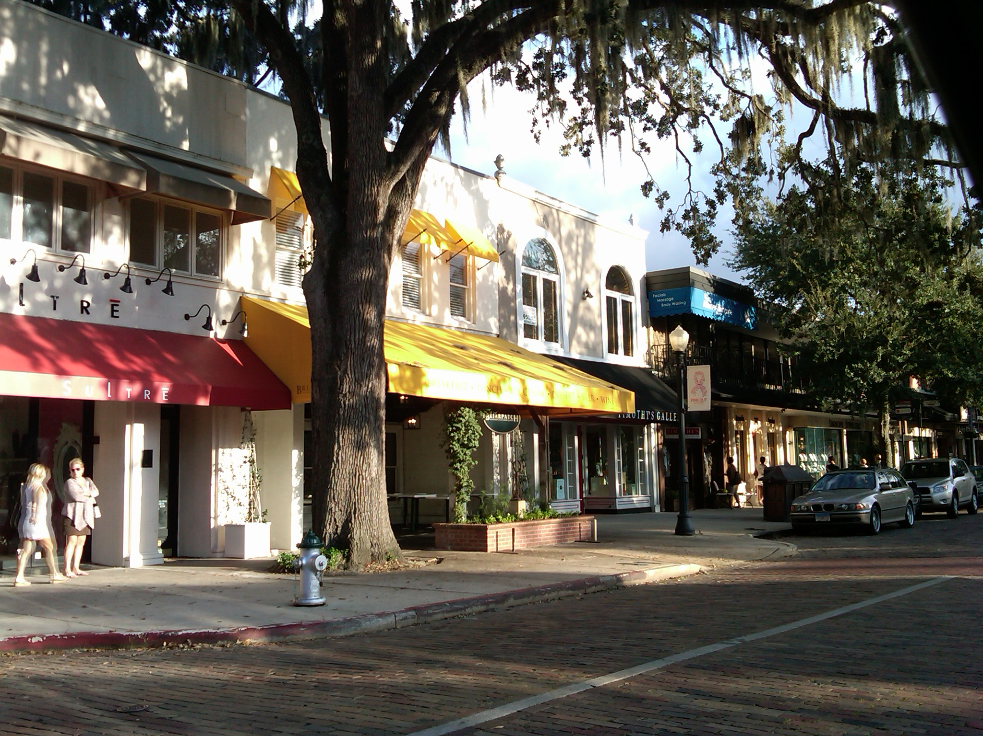

Slide 52
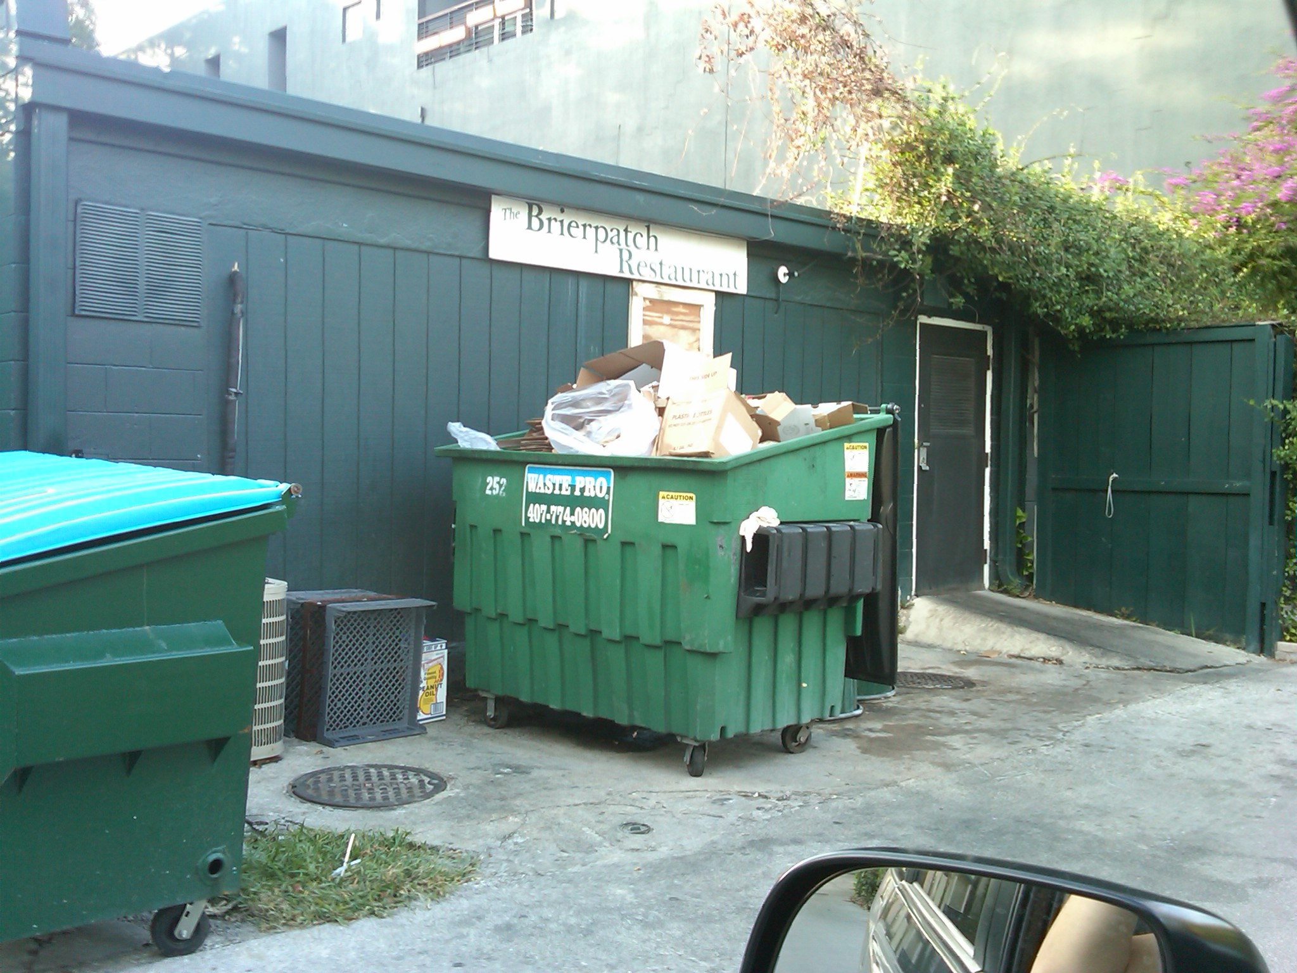

Slide 53
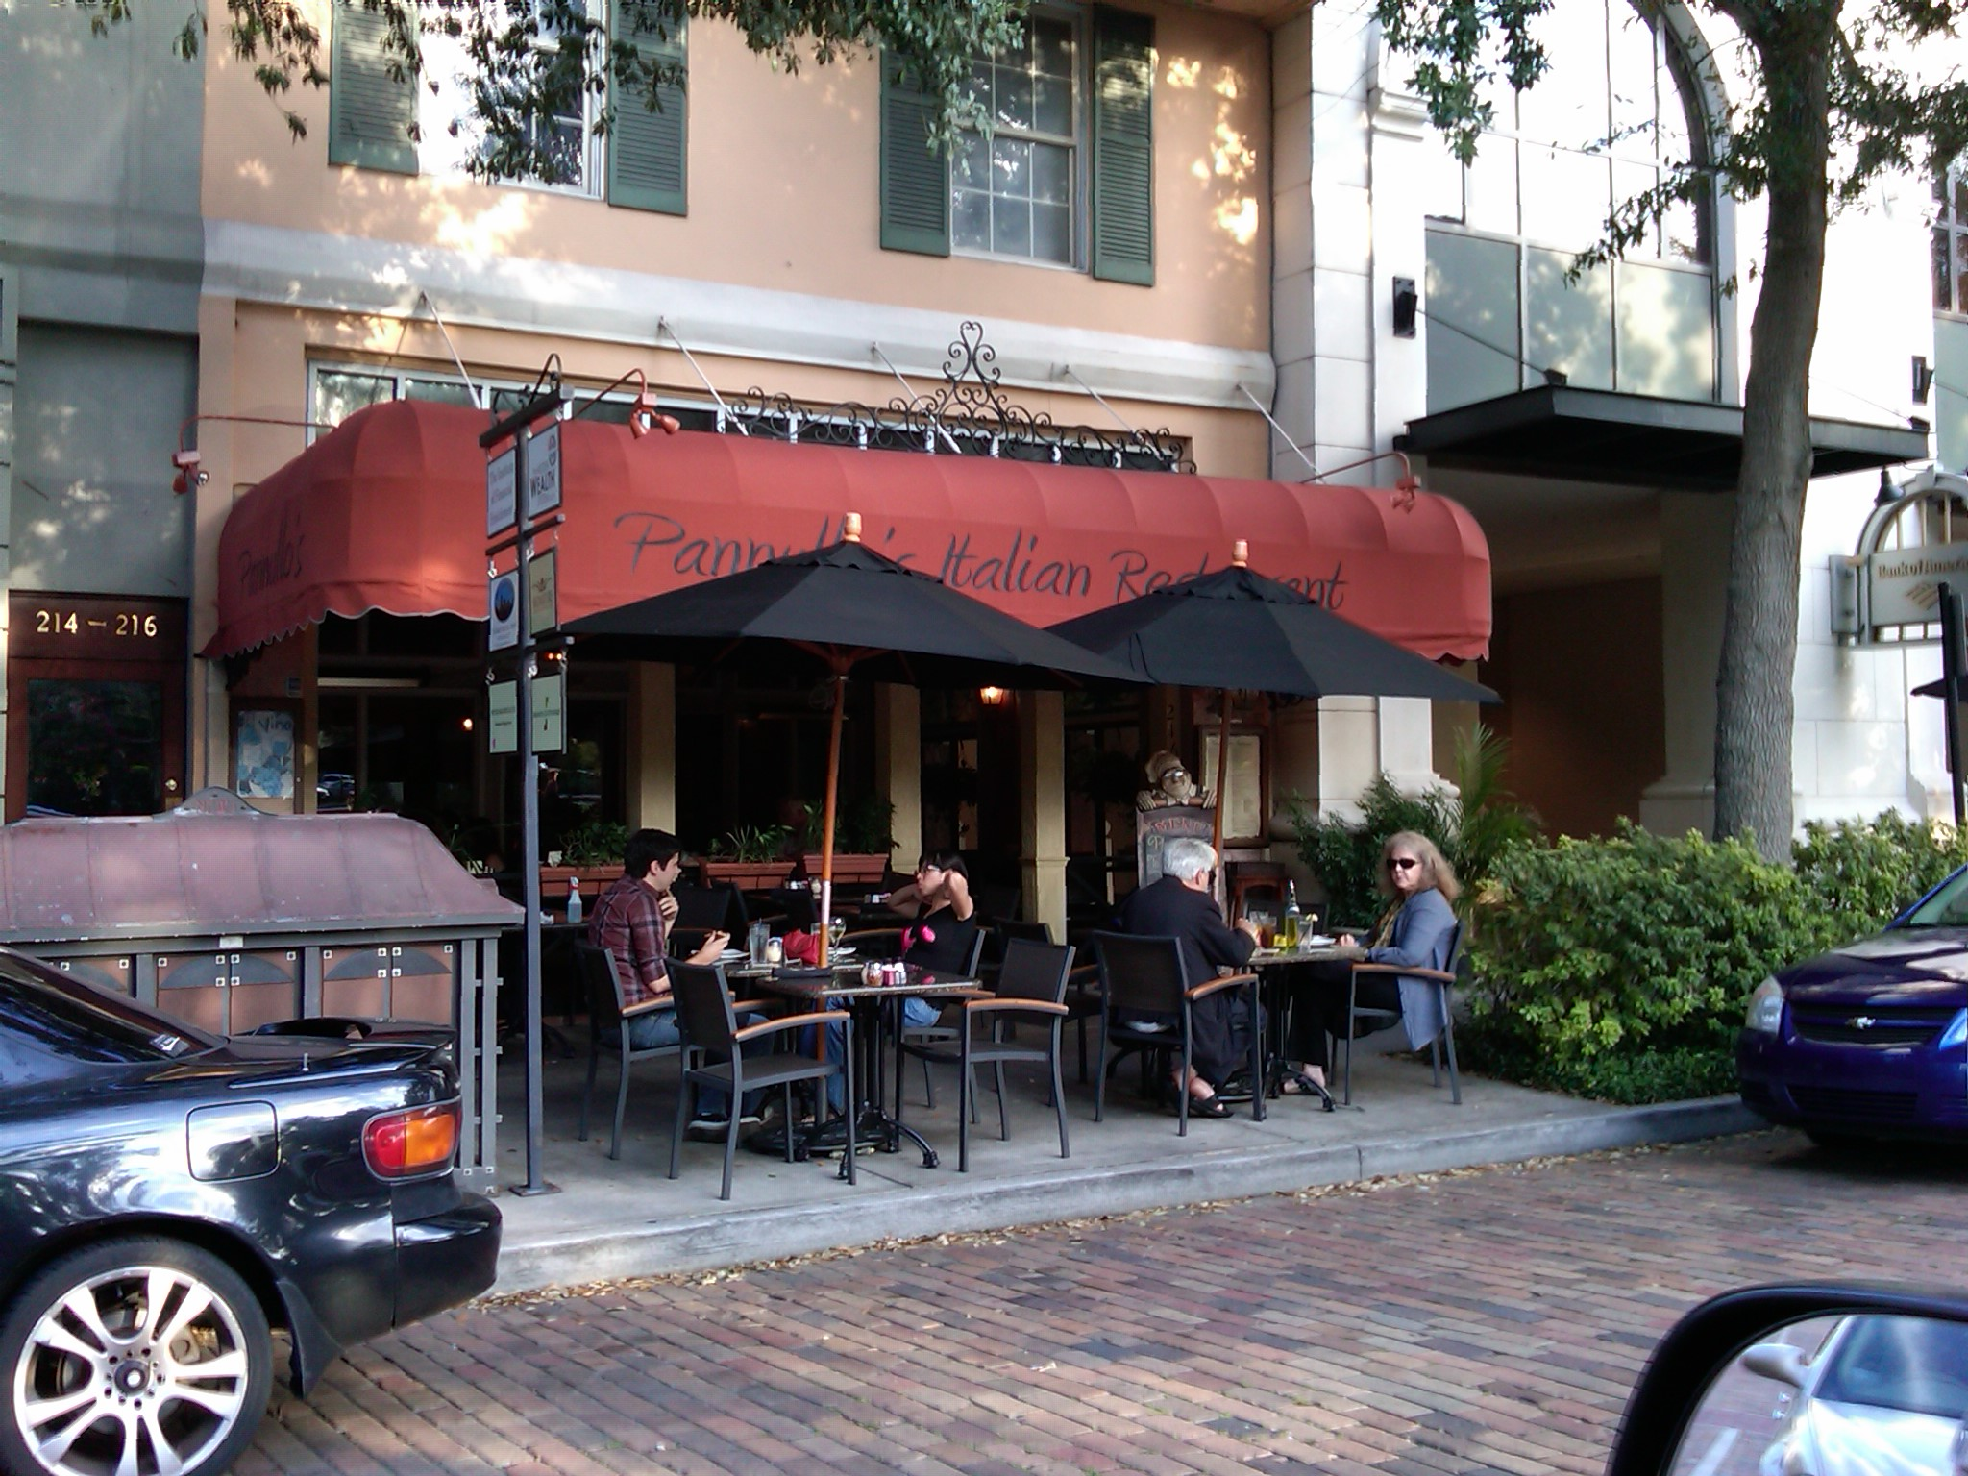

Slide 54
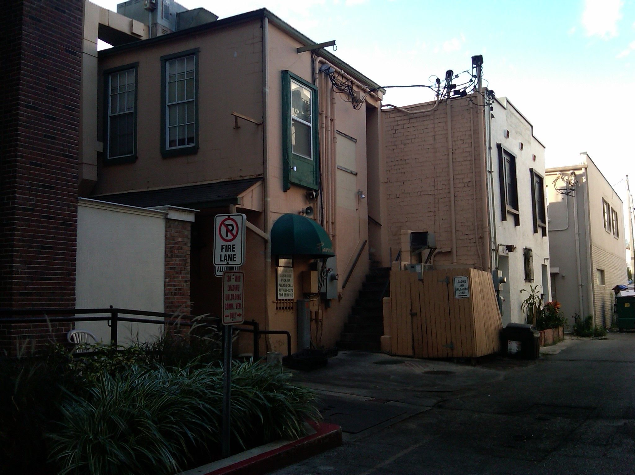

Slide 55
How do we advance the New Urban Paradigm?
Have a Vision
Establish a set of guiding principles
Be careful
Don’t be too careful

Slide 57
Creativity Happens

Slide 60
How do we advance the New Urban Paradigm?
Have a Vision
Establish a set of guiding principles
Be careful
Don’t be too careful
Remember, one size doesn’t fit all

Slide 61
Not all sidewalks are created equal

Slide 63
Restaurant
Retail
Office
Residential

Slide 64
New Broad Street Residential

Slide 65
New Broad Street Office

Slide 66
New Broad Street Retail

Slide 67
New Broad Street Retail

Slide 68
New Broad Street Restaurant

Slide 69
New Broad Street Restaurant

Slide 70
How do we advance the New Urban Paradigm?
Have a Vision
Establish a set of guiding principles
Be careful
Don’t be too careful
Remember, one size doesn’t fit all
16 hours to success

Slide 71
Live, Lunch and Play

Slide 72
How do we advance the New Urban Paradigm?
Have a Vision
Establish a set of guiding principles
Be careful
Don’t be too careful
Remember, one size doesn’t fit all
16 hours to success

