Slide 1
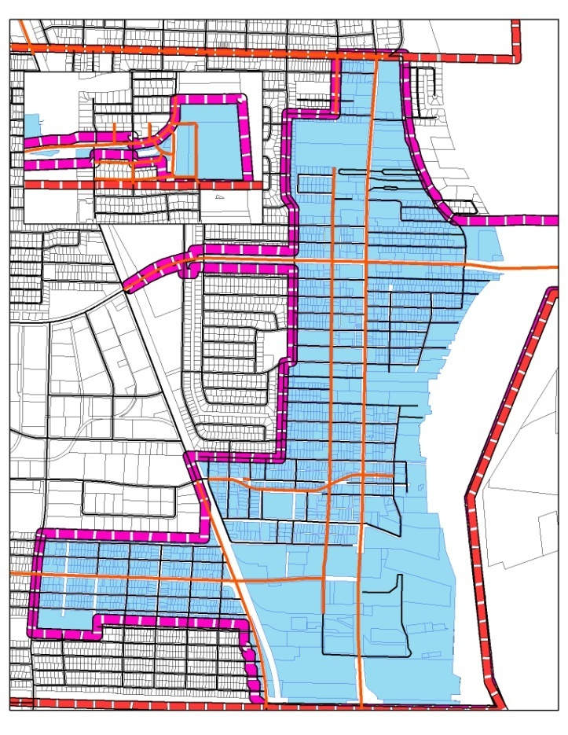
2014 State of the Riviera Beach CRA
Silver Beach Rd
Singer Island
Blue Heron Blvd
FLORIDA’S DYNAMIC
WATERFRONT COMMUNITY
Avenue F
Australian Ave
MLK Blvd

Slide 2
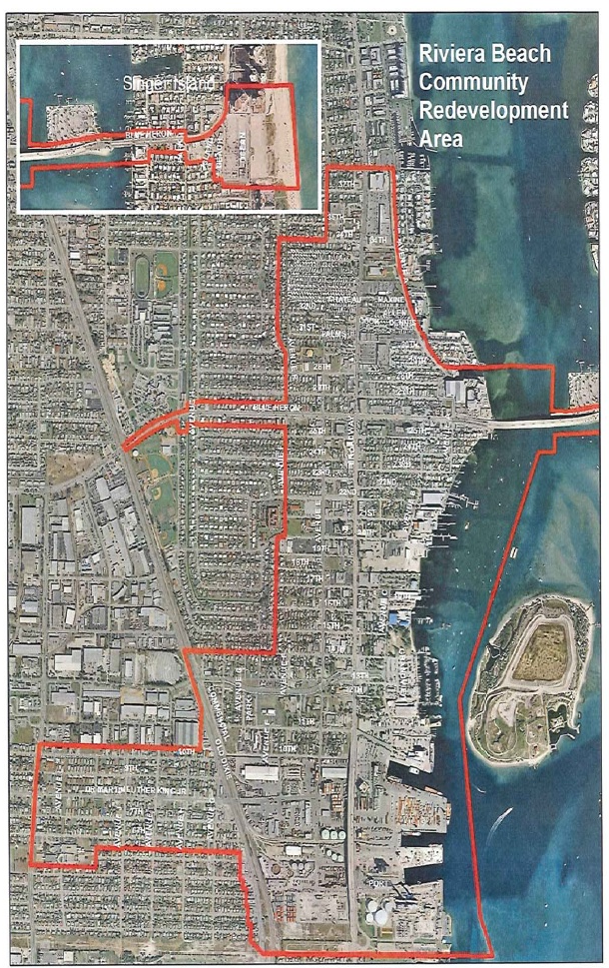
About the CRA
Established in 1984
Comprised of the oldest part of the City:
858 acres
15% of the population
Expenditures guided by the CRA Plan
Revised in 2011

Slide 4
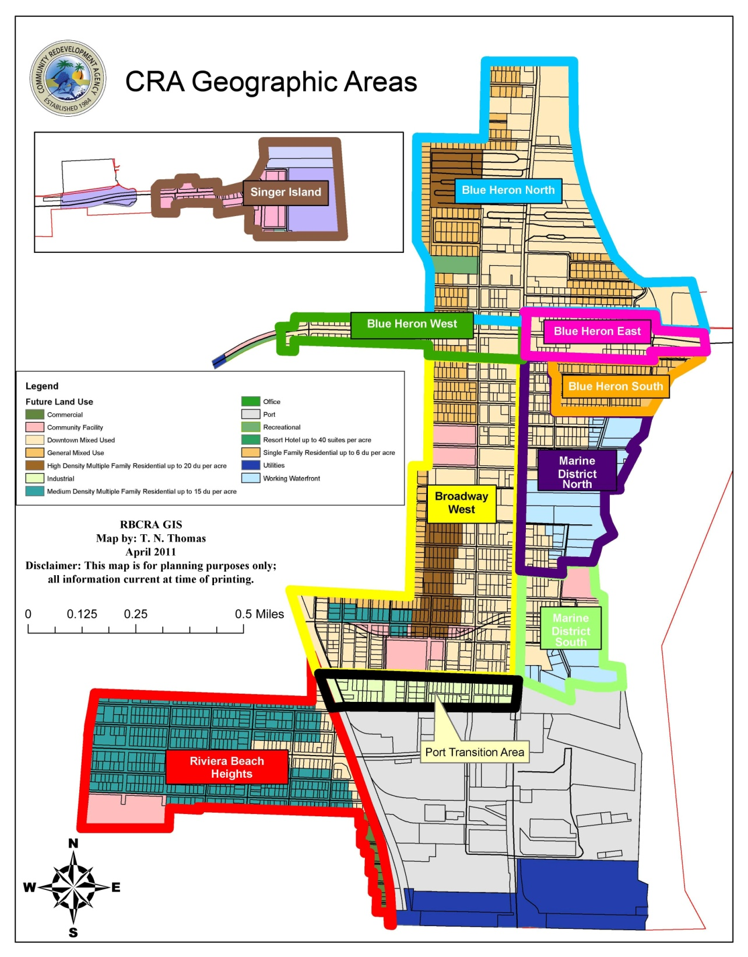
Impact Strategies
Investments are strategic and targeted:
10 Geo-Strategic Areas
5 Redevelopment Priority Areas:
Singer Island
Marina Districts (N&S)
Broadway West
Riviera Beach Heights
Blue Heron North

Slide 5
Sources of Revenues
Revenues derived from increase in tax base – NOT INCREASED TAXES
Future TIF Revenues:
Florida Power & Light
Municipal Marina
Broadway Development
Silver Beach Rd
Singer Island
Blue Heron Blvd
Avenue F
Australian Ave
MLK Blvd

Slide 6
Sources of Revenues & Trends
$5.45 million in revenues for FY 2013 (8% over PY)
Development creates value:
$1 million increase in tax value = $13,000 in TIF revenue
Major increase in FY 2016 associated with FPL plant modernization

Slide 7
Financing Redevelopment: Pay-Go or LEVERAGE
Florida Redevelopment Association

Slide 8
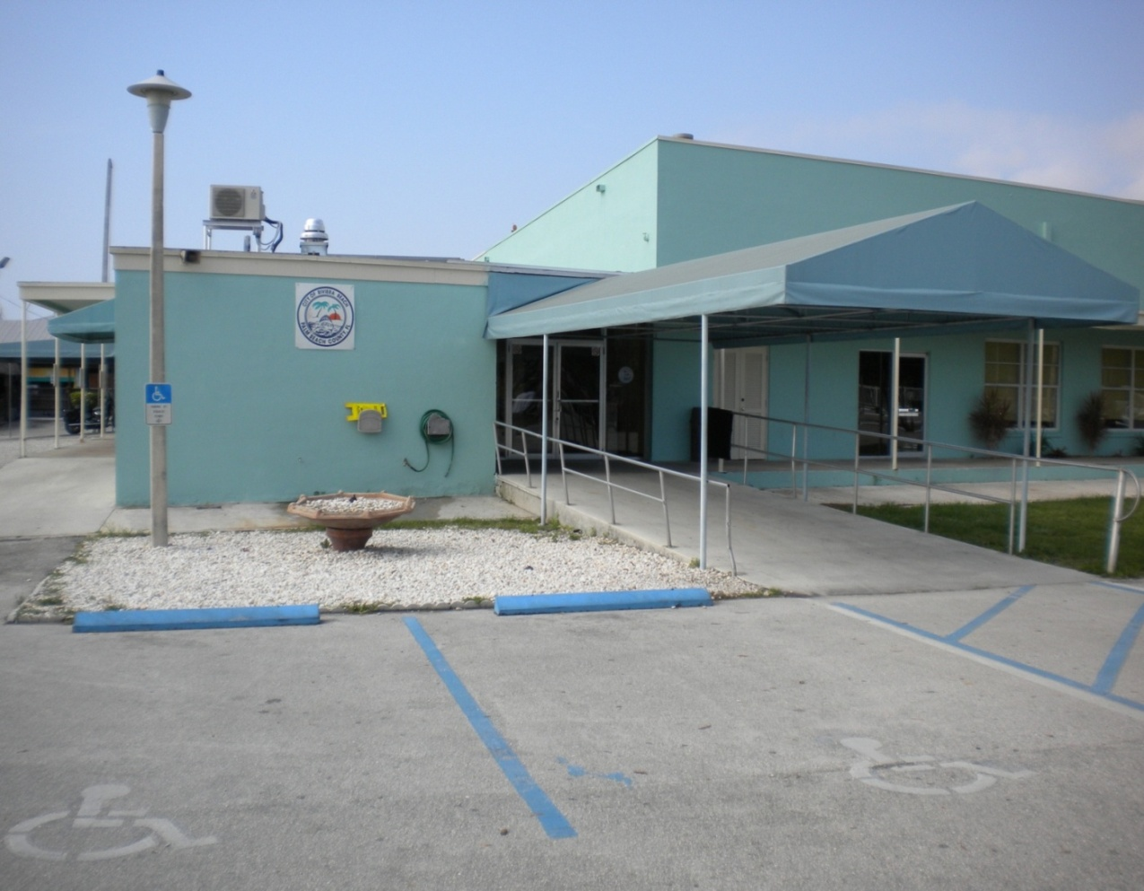
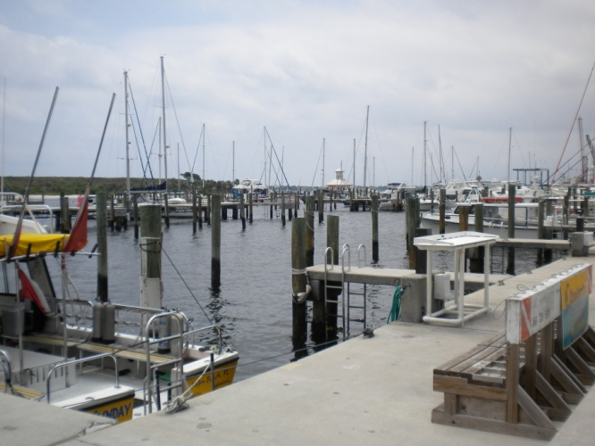
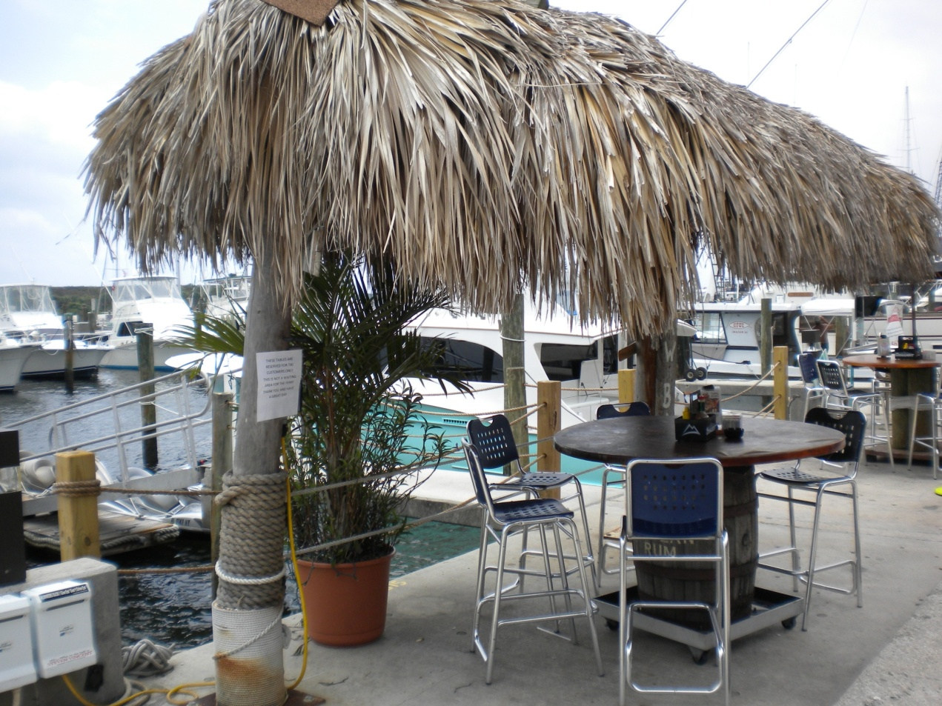
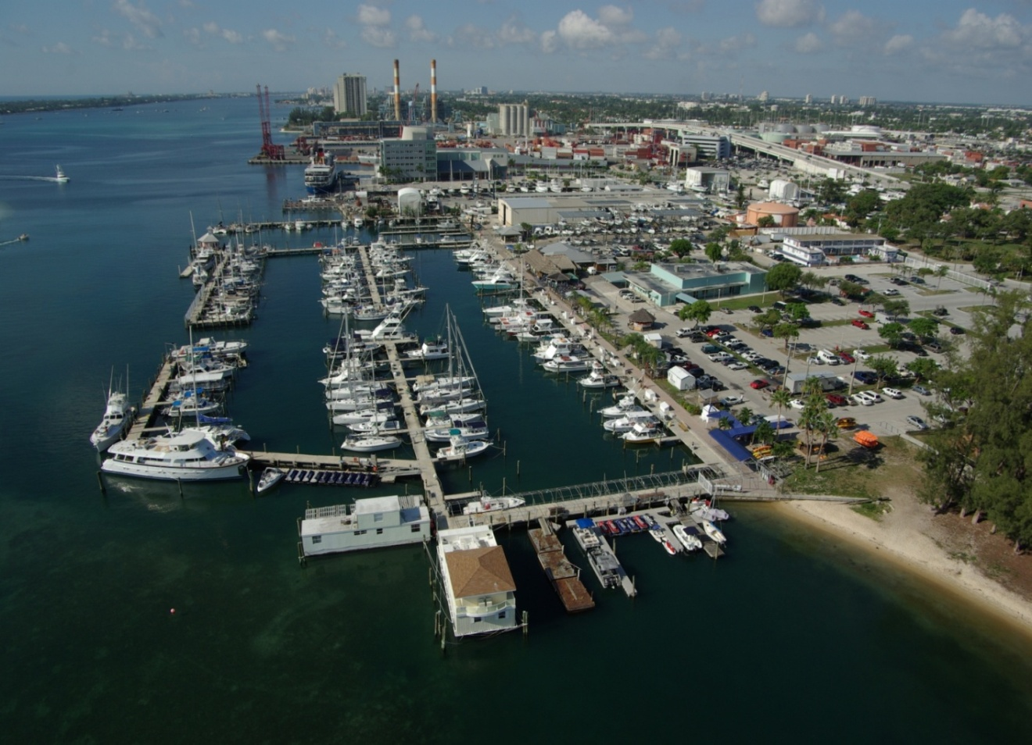
The Marina Now
Pay for Projects Annually
Or
Leverage & Do More

Slide 9
BB&T Loan Terms
CRA Board authorized the issuance of a “Redevelopment Revenue Note, Series 2011”
$25,570,000
Finance redevelopment projects in the CRA:
Marina District South
Riviera Beach Heights
Broadway West

Slide 10
Key Terms & Covenants
Category | Terms/Covenants
Loan Amount | $25,570,000
Term | 15 years
Collateral | First lien on CRA’s tax increment revenues
City Guaranty | None – not applicable
CRA Boundaries | BB&T permission required to change
Pre-Payment Penalty | Not applicable after Year 7
Additional Debt | Allowed if TIF revenues >1.5x total debt
Interest Payments | Due semi-annually
Principal Payments | Due annually
Notes:
Q: It appears that the CRA is taking a $25 million upfront loan as opposed to a draw down loan. Why was that decision made?
A: In order to reduce interest rate risk, the RFP for the loan was structured as a long-term fixed rate transaction for certainty of debt service payments and to convince our neighboring private property owners of our sincerity to improve the public and City assets.
Q: Who will be managing the money?
A: The Project Fund will be held in trust at BB&T. Disbursements from the Fund will be controlled by the Board through the Chair or Vice Chairperson
Q: It doesn’t appear to be any plan to use the money in the coming months, is the loan premature?
A: BB&T is to be commended to offer the CRA financing without the backing of the City (to budget and appropriate funding as a secondary pledge to the financing). Once its financing is secured, the CRA will be able to let out contracts with certainty of funding in place. Finally, the municipal market place is still in some disarray. It is not certain the CRA will be able to obtain financing, without City backing, at some point in the future.

Slide 11
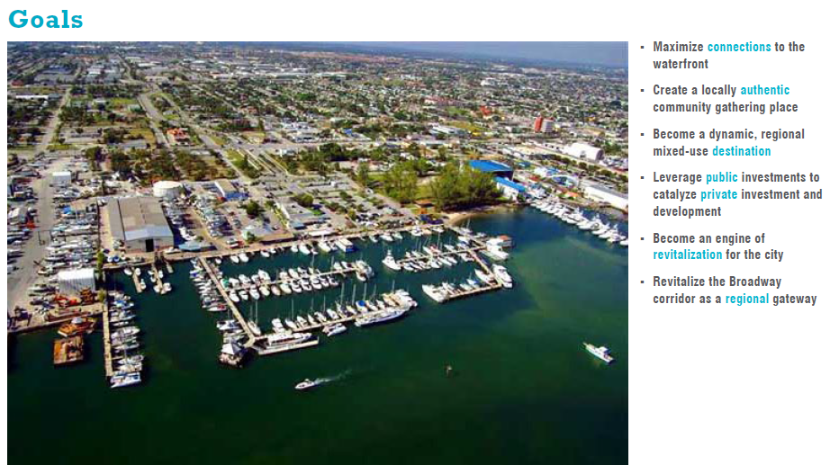
Maximize connections to the waterfront
Create a locally authentic community gathering place
Become a dynamic, regional mixed-use destination
Leverage public investments to catalyze private investment and development
Become an engine of revitalization for the Broadway Corridor and the City
Notes:
The City-owned Marina is the centerpiece for our redevelopment initiatives. The Riviera Beach Marina District is the last prime
waterfront redevelopment opportunity in South Florida. After years of false starts, economic declines and delays, the project
is positioned to take advantage of regional growth opportunities and local strengths that together will maximize untapped
economic potential beneficial to the City, County and Region.

Slide 12
Locally Authentic Maximize Connections to the Waterfront
Public Market & Market Court
Newcomb Hall
Bicentennial Park
New restaurants along Boardwalk & Promenade
The “New” Tiki
Marine Way

Slide 13
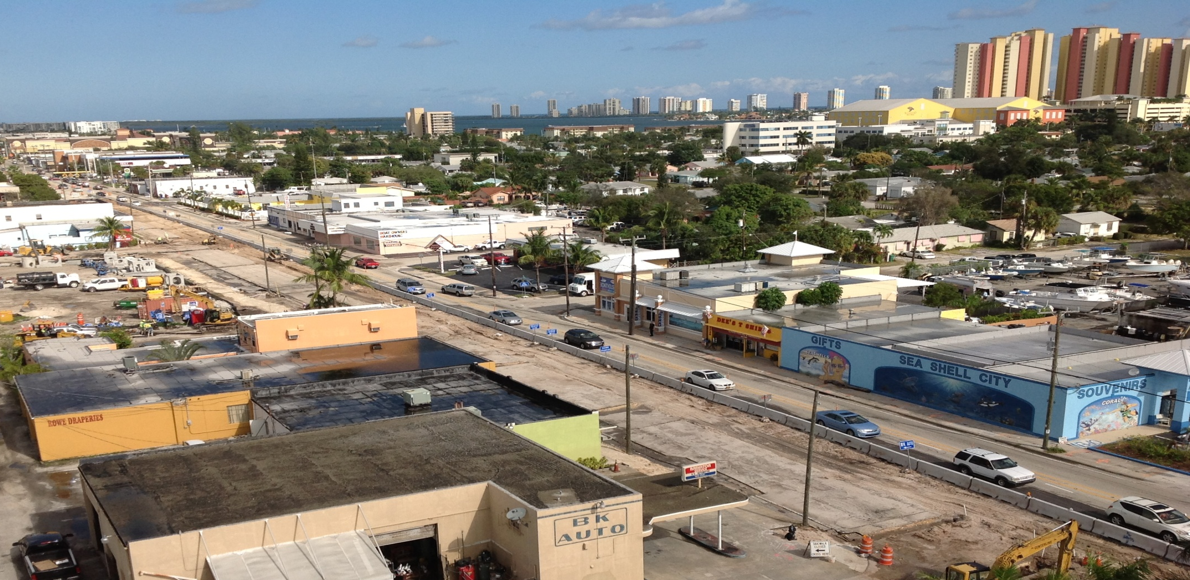
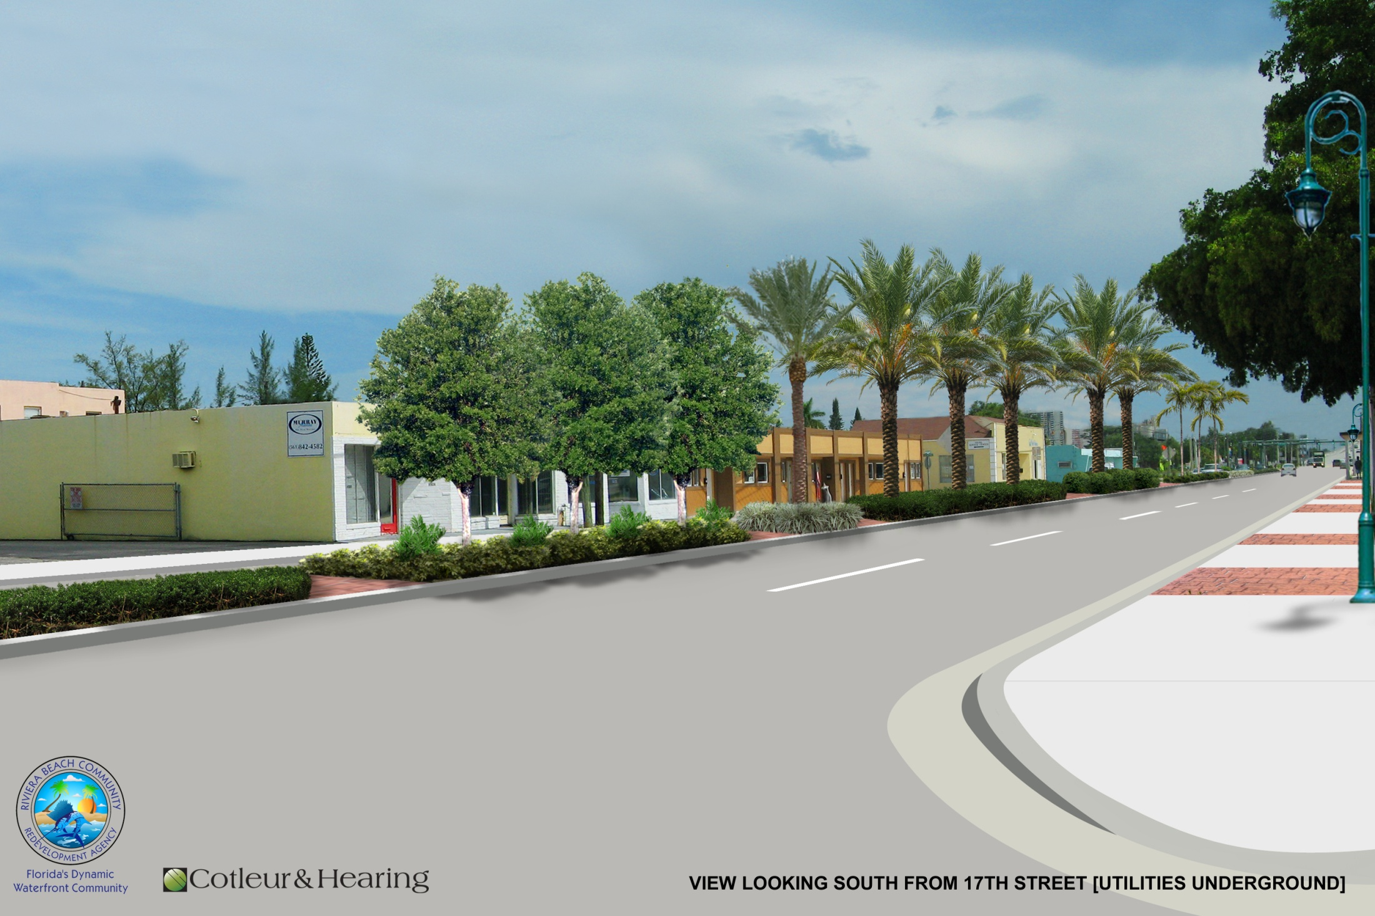
Regional Destination Revitalize the Broadway Corridor

Slide 14
Economic Impact
Economic Impact:
$29 million in public investments.
$245 million in private development.
Increase of over $3.2 million in annual tax increment revenues
Over 100 entrepreneurial opportunities in Phases 1&2 alone

Slide 15
Redevelopment Priority Areas
Riviera Beach Heights

Slide 16
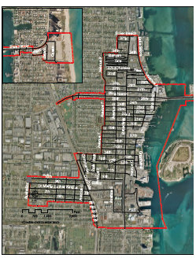
Riviera Beach Heights
Current Conditions
The City’s and CRA’s south western most boundary
Residential neighborhood in CTs 14.03 & 14.04:
50% of the families earn less than $24,000/yr
Unemployed 2.9x & 1.47x higher than national average
Persons below poverty at 32% & 40%, versus 12% countywide
Homeownership rate at 43% & 27%, versus 73% countywide
Source: US Census Data

Slide 17
Board Action
RBCRA BOARD OF DIRECTORS
RIVIERA BEACH CDC, INC
Board of Directors
CRA
Executive Director
CRA Commissioner Appointments
(5 Appointments)
CRA Personnel
To Staff
CBO Empowerment 13 Appointments
1/3 of the Board
Represent LICs (7 members)
Remainder of Board
6 Members Diverse Background
Appoint a 19-member board

Slide 18
Stitching Our Economic Vitality Together:
18
FDOT and Port of Palm Beach
City of Riviera Beach
MLK Improvements ( SR 710)
Jobs
Infrastructure
Green Environment
Infrastructure
Life Safety – Code Enforcement
Planning and Zoning
Riviera Beach Heights
Funding
Infrastructure
Economic Development
Economic Development
Community Development
Socio-Economic Empowerment
Palm Beach County
Riviera Beach CRA

Slide 19
Safe & Clean
Program Enhancements

Slide 20
Public Safety 2012 Initiatives
$500,000 in annual funds:
Invest in Surveillance Cameras
Initiate a Community Ambassadors Program
Hire a fulltime Public Safety Administrator
Support neighborhood “Block Watch” programs

Slide 21
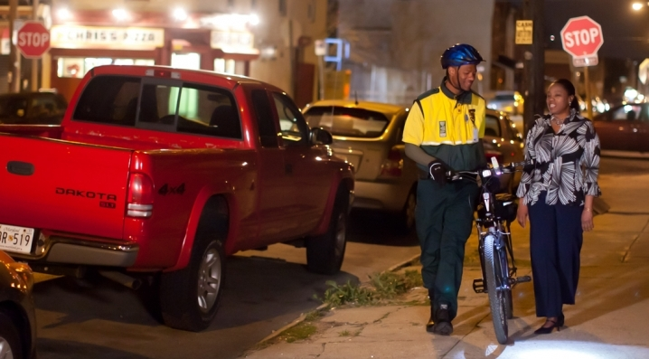
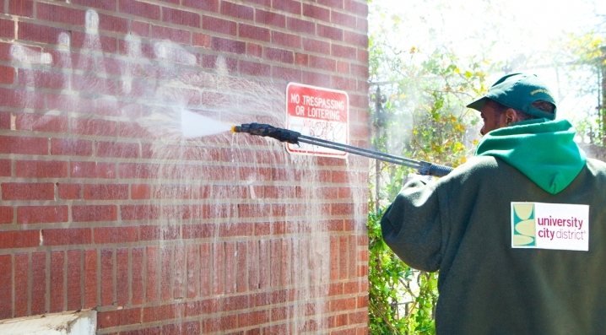
Safety Initiatives
Community Ambassador Program
Trained volunteers and paid “Clean & Safe” force
Easily Identifiable
Crime Prevention
Litter Patrol
Tourist Resource
Customer Service

