Slide 1
Panama city cra 2012
William R. Whitson
CRA Director

Slide 2
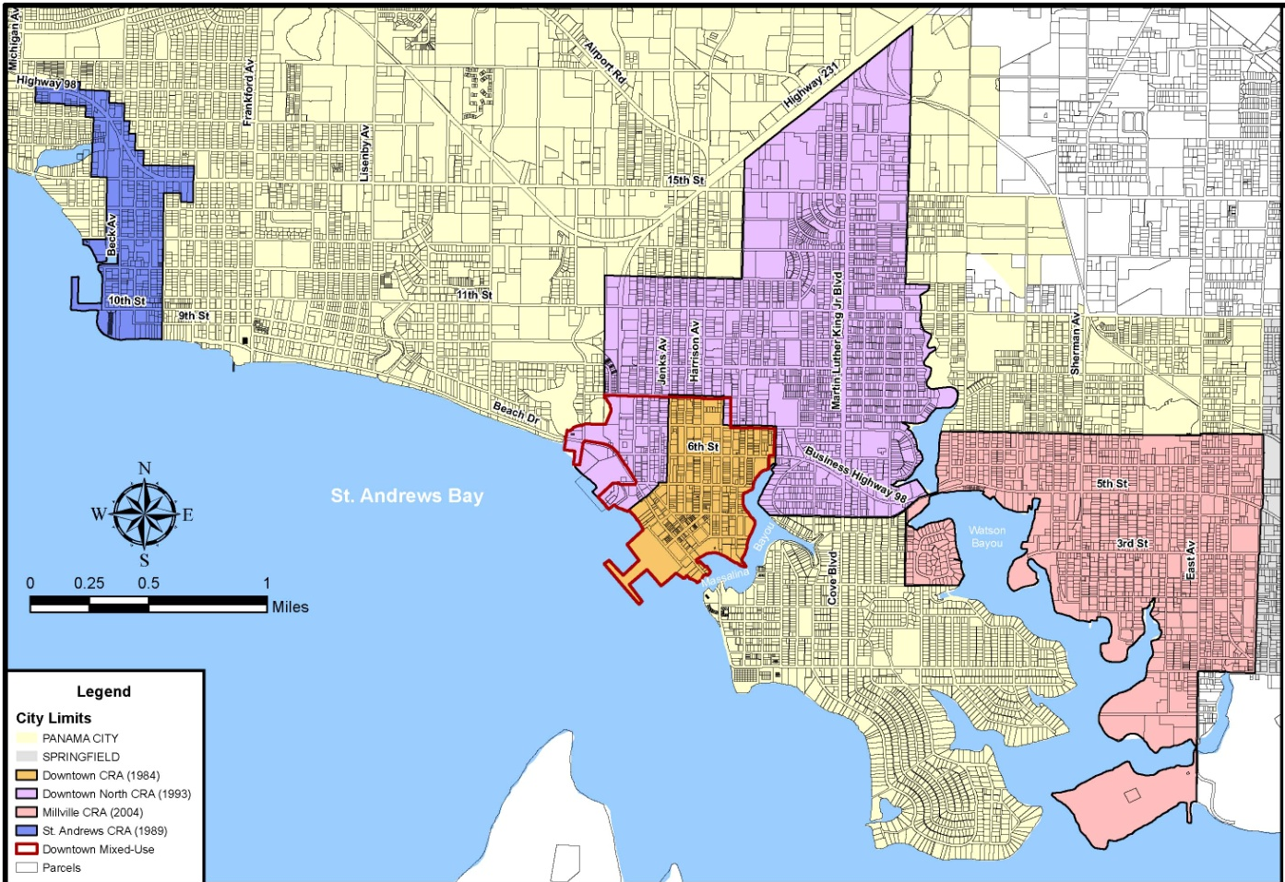
Introduction
Panama City has 4 CRA Districts
5.7 Million Budget & Staff of 7

Slide 3
General Challenges in CRA Areas
Loss of Retail activity-Community Anchors, Reasons to Come (Automobile)
Safety- Increased Crime/Negative Perception
Decline of Infrastructure (Roads, Sidewalks, water, sewer, new environmental regulations)
Age/Curb Appeal/Visual Blight

Slide 4
Annual Report
Chapter 2163 requirement due by March 31st each year….2010/2011 report highlight efforts.
(See copies on Website)

Slide 5
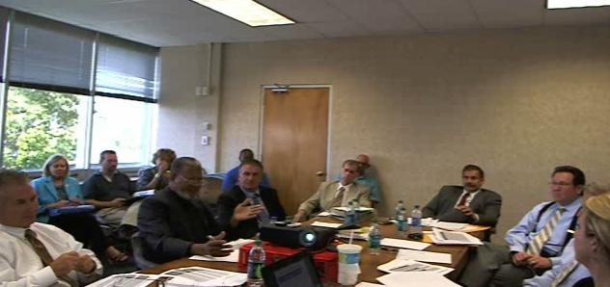
New Grants Program
Drafted and initiated new Grant Program for all CRA Districts
Commercial
Residential
Job Creation

Slide 6
2011/2012 Accomplishment Highlights NO SILVER BULLETS-WORKING HARD!!!
Ink Trax (20 jobs created)
PCE Grant (10 jobs created)
Marina Master Plan $4-5M Project Phase I & II
Tito’s Café Restoration (12 jobs created)
New Sign Guidelines Created
MLK Beautification
A.D. Harris Learning Village Acquired
Derelict Vessel Removal
CAP Program
Expanded Web/Facebook/Beach TV Active Efforts/Cross Marketing/Special Events

Slide 7
Two (2) Projects Downtown North
Ink Trax
A.D. Harris Learning Village

Slide 8
Questions? Key Contacts
Carol Westmoreland, FRA (850)222-9684
William Whitson, CRA Director Panama City (850)215-3869- Onya Bates, Staff Assistant
Toni Shamplain, Downtown North Program Manager (850)215-3872
Rob Rosner, St. Andrews Program Manager (850)872-7208
Tim Whaler, Millville Program Manager (850)215-3873

